Slide 1
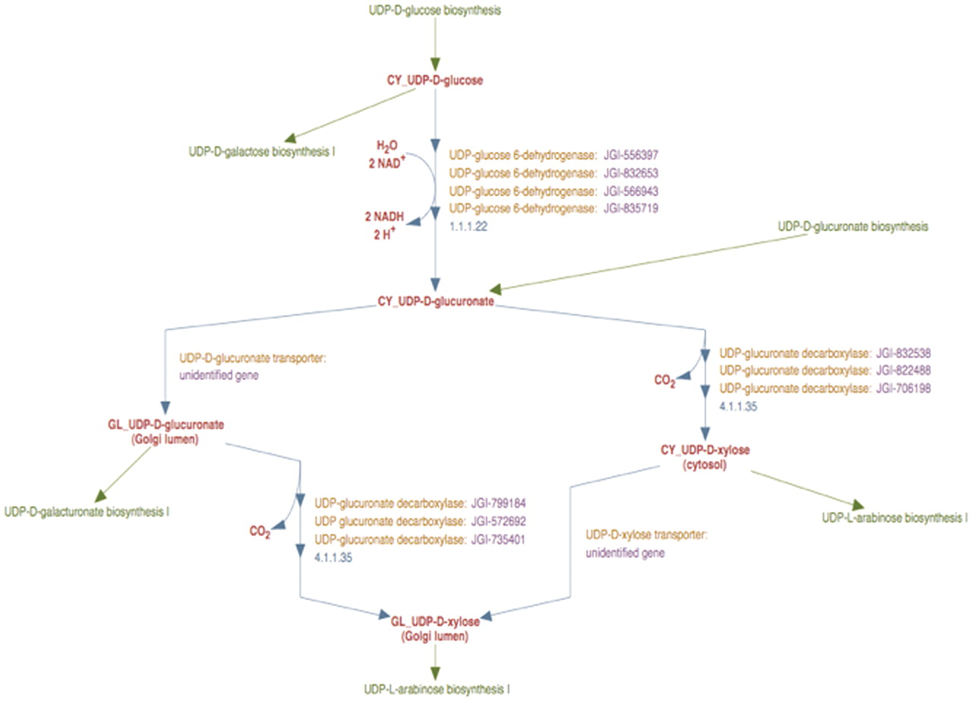
Figure 3. The enhanced representation of UDP-d-xylose biosynthesis pathway in prototype P. trichocarpa PGDB. In this ...
Notes:
Figure 3. The enhanced representation of UDP-d-xylose biosynthesis pathway in prototype P. trichocarpa PGDB. In this representation the sub-cellular localization of each metabolite in the pathway is specified by a two-letter prefix (Table 3). Note that Figure 2 shows 12 genes annotated as UDP-glucose dehydrogenases and 9 genes annotated as UDP-glucuronate decarboxylase. Manual curation yields only four UDP-glucose dehydrogenase enzymes and six UDP-glucuronate decarboxylase enzymes in Populus. Also note that genes encoding Golgi-localized membrane-bound UDP-glucuronic acid decarboxylase (UXS) can now be distinguished from the same enzyme activity residing in the cytosol.
Unless provided in the caption above, the following copyright applies to the content of this slide: © The Author(s) 2012. Published by Oxford University Press.This is an Open Access article distributed under the terms of the Creative Commons Attribution Non-Commercial License (http://creativecommons.org/licenses/by-nc/3.0), which permits unrestricted non-commercial use, distribution, and reproduction in any medium, provided the original work is properly cited.

