Slide 1
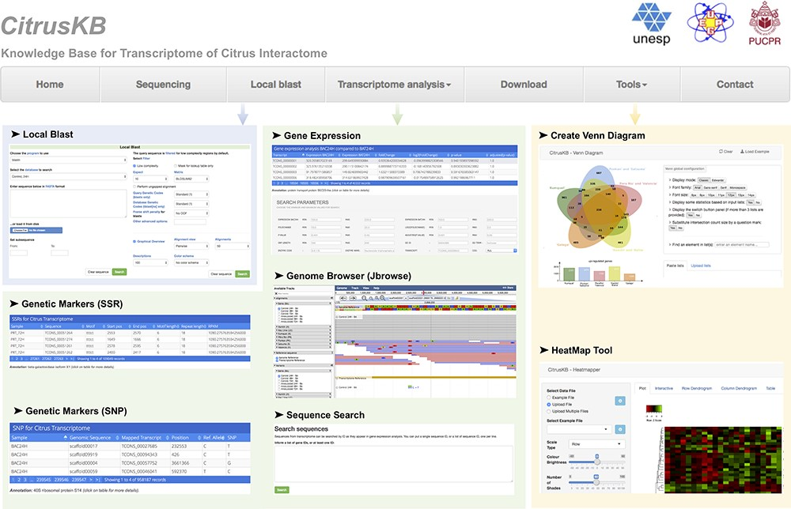
Figure 3. Citrus basic knowledge database (CitrusKB) website resources. Main functionalities are represented by the ...
Notes:
Figure 3. Citrus basic knowledge database (CitrusKB) website resources. Main functionalities are represented by the following screenshots: Local Blast (Local Blast navigation menu); Gene Expression, Genome Browser, Sequence Search, Genetic Markers (SSR) and Genetic Variants (SNP) (Transcriptome analysis navigation menu); transcriptome analysis tools Jvenn and Heatmapper (Tools navigation menu).
Unless provided in the caption above, the following copyright applies to the content of this slide: © The Author(s) 2020. Published by Oxford University Press.This is an Open Access article distributed under the terms of the Creative Commons Attribution License (http://creativecommons.org/licenses/by/4.0/), which permits unrestricted reuse, distribution, and reproduction in any medium, provided the original work is properly cited.

