Slide 1
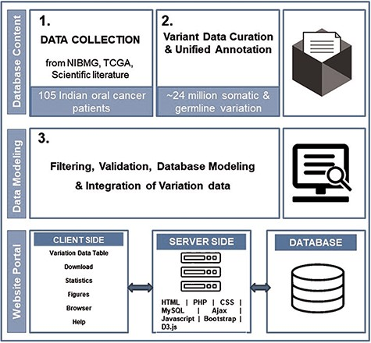
Figure 1. The overall schematic overview of steps to build dbGENVOC.
Notes:
Figure 1. The overall schematic overview of steps to build dbGENVOC.
Unless provided in the caption above, the following copyright applies to the content of this slide: © The Author(s) 2021. Published by Oxford University Press.This is an Open Access article distributed under the terms of the Creative Commons Attribution License (http://creativecommons.org/licenses/by/4.0/), which permits unrestricted reuse, distribution, and reproduction in any medium, provided the original work is properly cited.

Slide 2
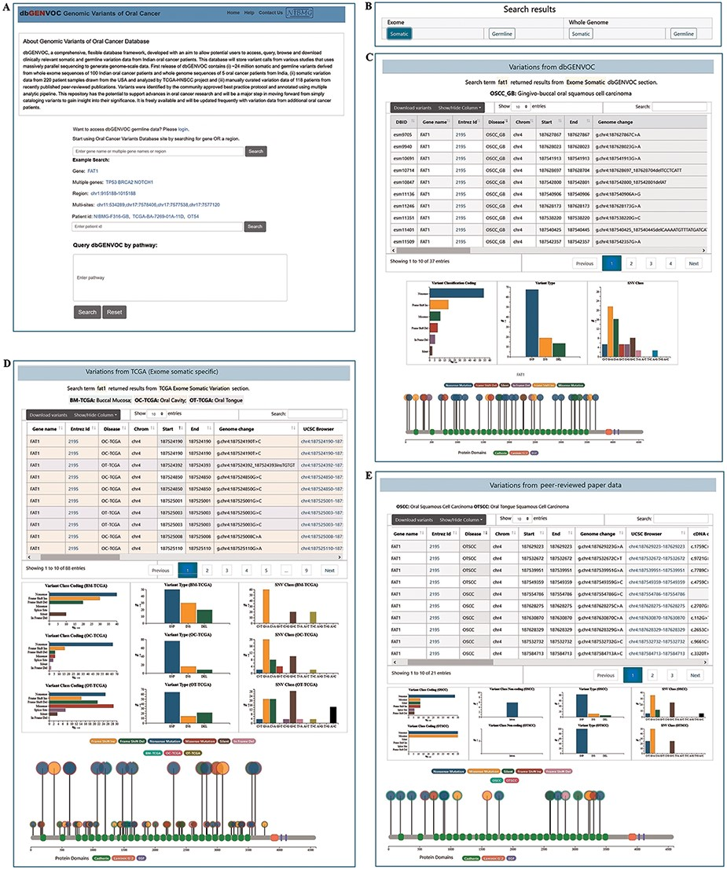
Figure 2. Screenshot of home page and result page. (A) Search for variants by single gene, multi-genes, region, ...
Notes:
Figure 2. Screenshot of home page and result page. (A) Search for variants by single gene, multi-genes, region, multi-sites, patient ID and pathway identifier. (B) Search result can be explicated by ‘exome somatic’, ‘exome germline’, ‘whole genome somatic’ and ‘whole genome germline’ variant data by clicking the respective buttons. (C) Search result variants information and corresponding graphical representation from Indian oral cancer patients. (D) Search result variants information and corresponding graphical representation from TCGA-HNSCC data. (E) Search result variants information and corresponding graphical representation from scientific literature oral cancer patients’ data.
Unless provided in the caption above, the following copyright applies to the content of this slide: © The Author(s) 2021. Published by Oxford University Press.This is an Open Access article distributed under the terms of the Creative Commons Attribution License (http://creativecommons.org/licenses/by/4.0/), which permits unrestricted reuse, distribution, and reproduction in any medium, provided the original work is properly cited.

