Slide 1
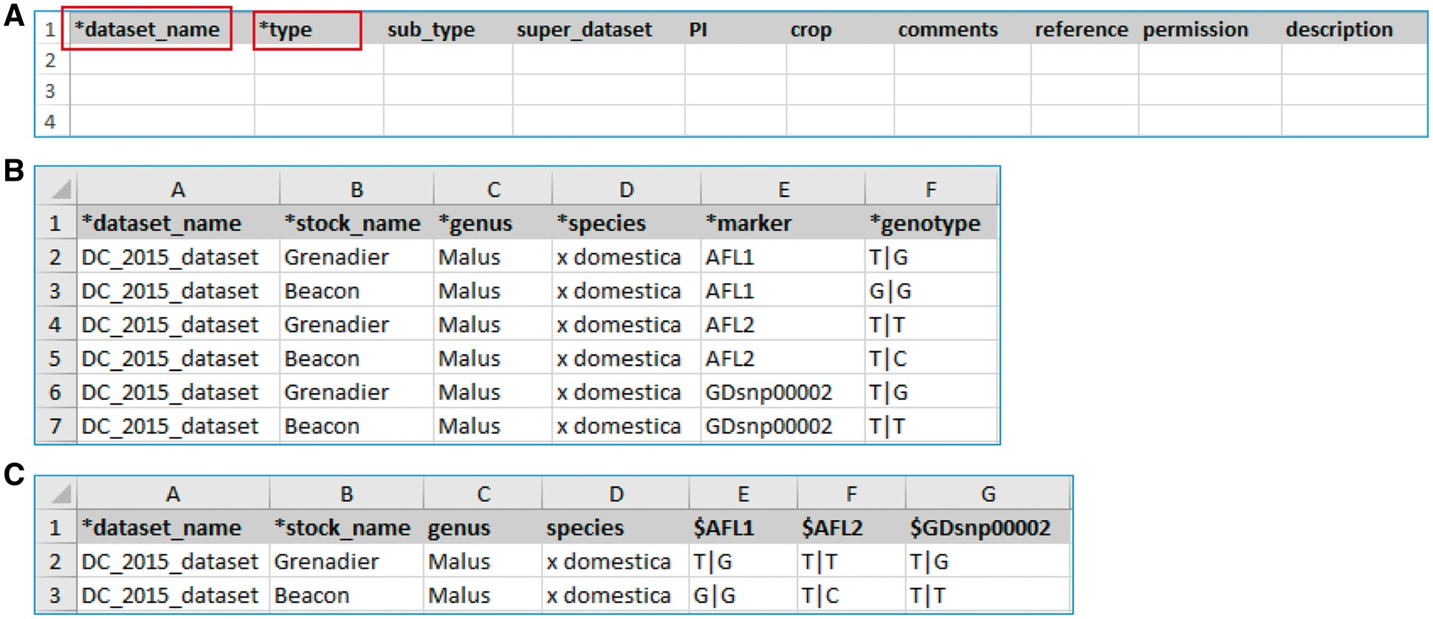
Figure 2. Example templates downloaded from the MCL module. (A) A template for contact data type. Columns with a prefix ...
Notes:
Figure 2. Example templates downloaded from the MCL module. (A) A template for contact data type. Columns with a prefix ‘*’are required fields. (B) A template for genotype datatype, ‘genotype_snp_long_form.’ (C) A template for genotype datatype, ‘genotype_snp_wide_form.’ Users can enter marker names as column headings with a prefix ‘$.’
Unless provided in the caption above, the following copyright applies to the content of this slide: © The Author(s) 2017. Published by Oxford University Press.This is an Open Access article distributed under the terms of the Creative Commons Attribution License (http://creativecommons.org/licenses/by/4.0/), which permits unrestricted reuse, distribution, and reproduction in any medium, provided the original work is properly cited.

