Slide 1
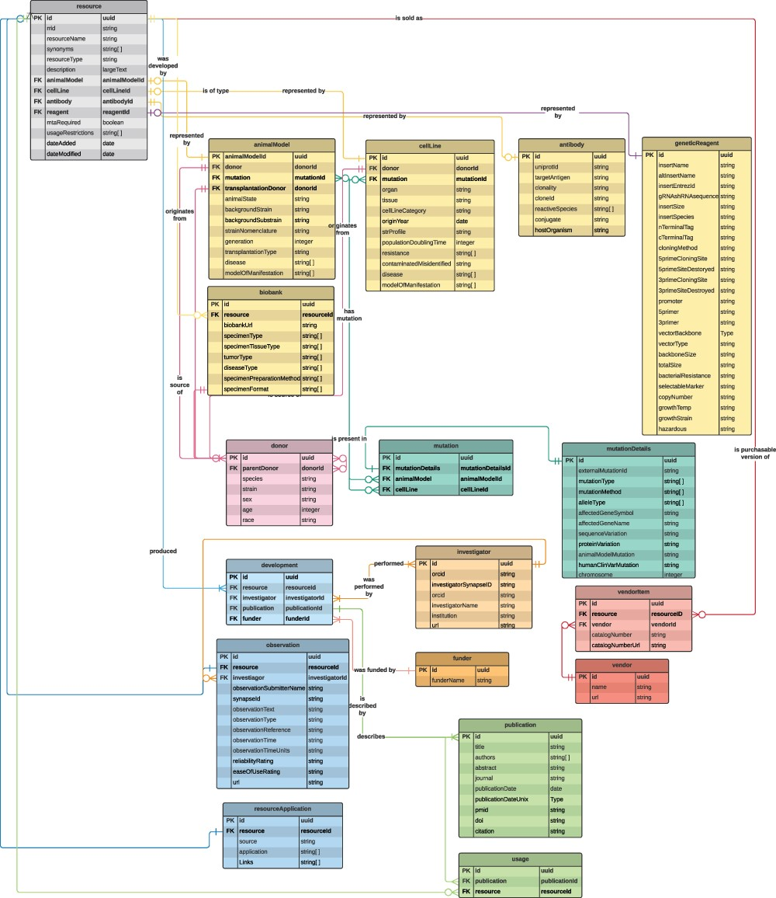
Figure 1. A data model diagram for the NF Research Tools Database. Each box describes one of the database tables, with ...
Notes:
Figure 1. A data model diagram for the NF Research Tools Database. Each box describes one of the database tables, with lines representing the relationships/connections between each table. Links between tables are the primary key (PK), which is a unique identifier for each row in the table, and the foreign key (FK), which is a PK found in another table. A machine-readable version of this data model is available on GitHub (see the ‘Database development’ section).
Unless provided in the caption above, the following copyright applies to the content of this slide: © The Author(s) 2022. Published by Oxford University Press.This is an Open Access article distributed under the terms of the Creative Commons Attribution-NonCommercial License (https://creativecommons.org/licenses/by-nc/4.0/), which permits non-commercial re-use, distribution, and reproduction in any medium, provided the original work is properly cited. For commercial re-use, please contact journals.permissions@oup.com

