Slide 1
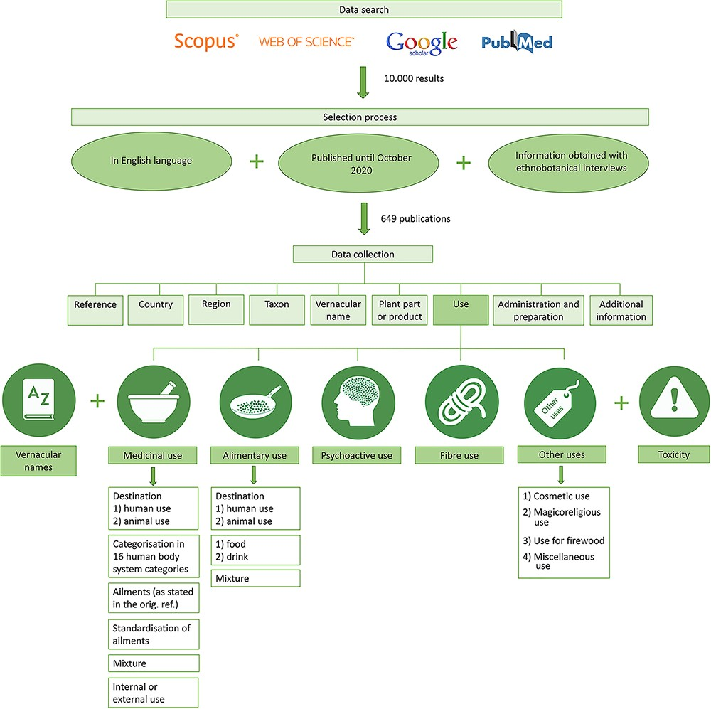
Figure 1. Workflow of the data search, selection process and data collection for the CANNUSE database construction.
Notes:
Figure 1. Workflow of the data search, selection process and data collection for the CANNUSE database construction.
Unless provided in the caption above, the following copyright applies to the content of this slide: © The Author(s) 2021. Published by Oxford University Press.This is an Open Access article distributed under the terms of the Creative Commons Attribution License (http://creativecommons.org/licenses/by/4.0/), which permits unrestricted reuse, distribution, and reproduction in any medium, provided the original work is properly cited.

Slide 2
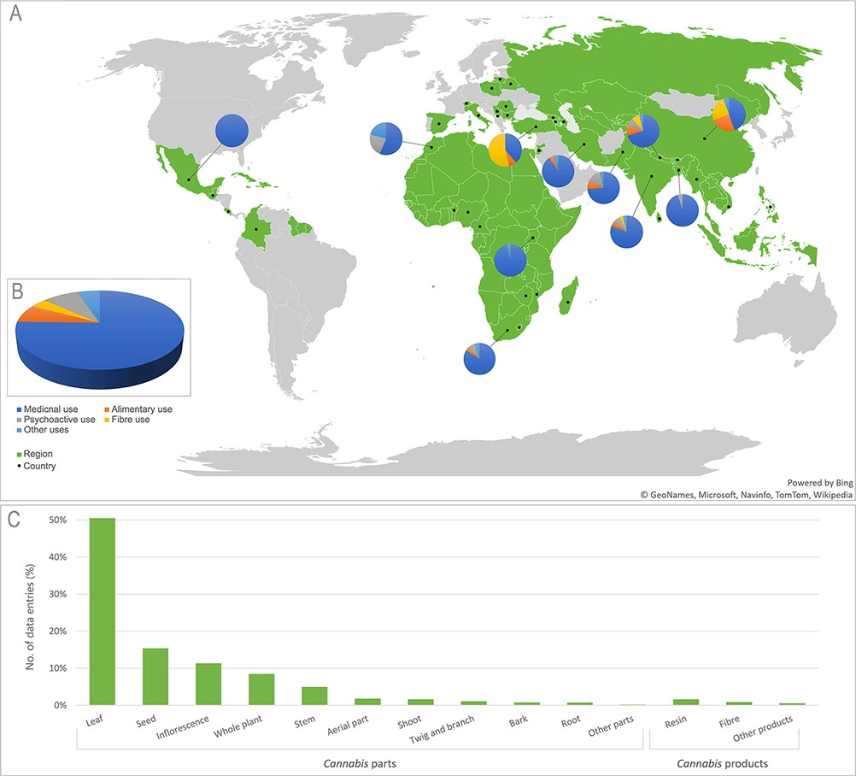
Figure 2. (A) Map of world regions (green) and countries (•) represented in the CANNUSE database, with pie charts ...
Notes:
Figure 2. (A) Map of world regions (green) and countries (•) represented in the CANNUSE database, with pie charts showing distribution of uses in the countries with over 50 records. The background map was produced using the Excel Office. (B) Distribution of Cannabis uses presented in the database. (C) Distribution of Cannabis parts and products presented in the CANNUSE database (in %).
Unless provided in the caption above, the following copyright applies to the content of this slide: © The Author(s) 2021. Published by Oxford University Press.This is an Open Access article distributed under the terms of the Creative Commons Attribution License (http://creativecommons.org/licenses/by/4.0/), which permits unrestricted reuse, distribution, and reproduction in any medium, provided the original work is properly cited.

Slide 3
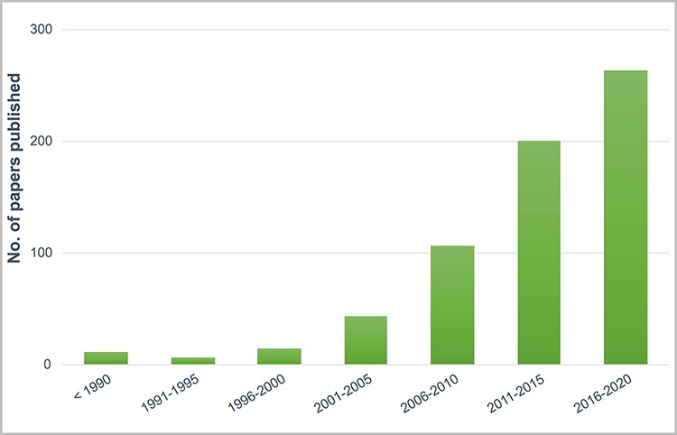
Figure 3. Number of publications in CANNUSE database containing information about Cannabis ethnobotanical uses ...
Notes:
Figure 3. Number of publications in CANNUSE database containing information about Cannabis ethnobotanical uses published over the years.
Unless provided in the caption above, the following copyright applies to the content of this slide: © The Author(s) 2021. Published by Oxford University Press.This is an Open Access article distributed under the terms of the Creative Commons Attribution License (http://creativecommons.org/licenses/by/4.0/), which permits unrestricted reuse, distribution, and reproduction in any medium, provided the original work is properly cited.

Slide 4
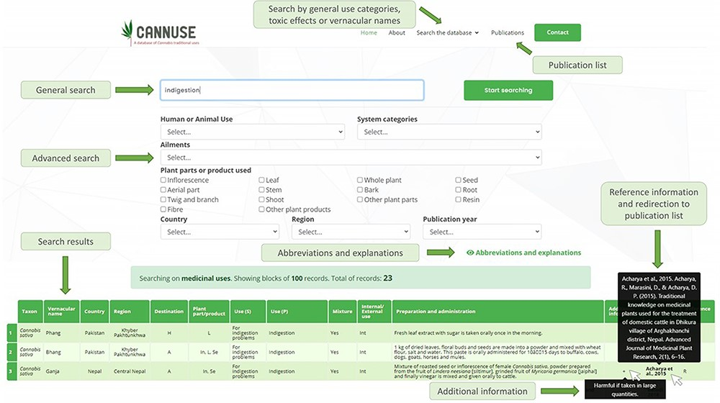
Figure 4. User interface of the Search the database function. The data can be filtered out using general search (search ...
Notes:
Figure 4. User interface of the Search the database function. The data can be filtered out using general search (search by key words) or by advanced search, where user is selecting the filters for the search.
Unless provided in the caption above, the following copyright applies to the content of this slide: © The Author(s) 2021. Published by Oxford University Press.This is an Open Access article distributed under the terms of the Creative Commons Attribution License (http://creativecommons.org/licenses/by/4.0/), which permits unrestricted reuse, distribution, and reproduction in any medium, provided the original work is properly cited.

