Slide 1
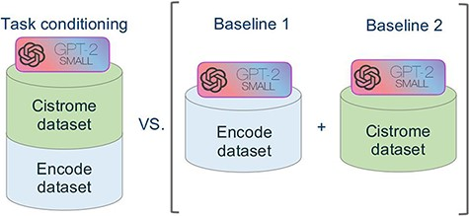
Figure 5. Schematic representation of the comparative experimental setting. On the right, separate models were trained ...
Notes:
Figure 5. Schematic representation of the comparative experimental setting. On the right, separate models were trained on the ENCODE and Cistrome datasets (as presented in (7)). On the left, the task conditional setting presented in this work, employing the two training datasets together.
Unless provided in the caption above, the following copyright applies to the content of this slide: © The Author(s) 2022. Published by Oxford University Press.This is an Open Access article distributed under the terms of the Creative Commons Attribution License (https://creativecommons.org/licenses/by/4.0/), which permits unrestricted reuse, distribution, and reproduction in any medium, provided the original work is properly cited.

