Slide 1
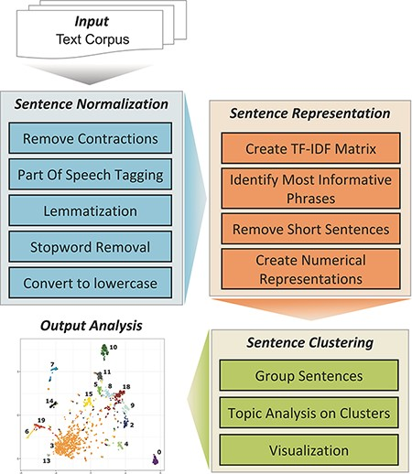
Figure 1. TopEx NLP pipeline.
Notes:
Figure 1. TopEx NLP pipeline.
Unless provided in the caption above, the following copyright applies to the content of this slide: © The Author(s) 2022. Published by Oxford University Press.This is an Open Access article distributed under the terms of the Creative Commons Attribution-NonCommercial License (https://creativecommons.org/licenses/by-nc/4.0/), which permits non-commercial re-use, distribution, and reproduction in any medium, provided the original work is properly cited. For commercial re-use, please contact journals.permissions@oup.com

Slide 2
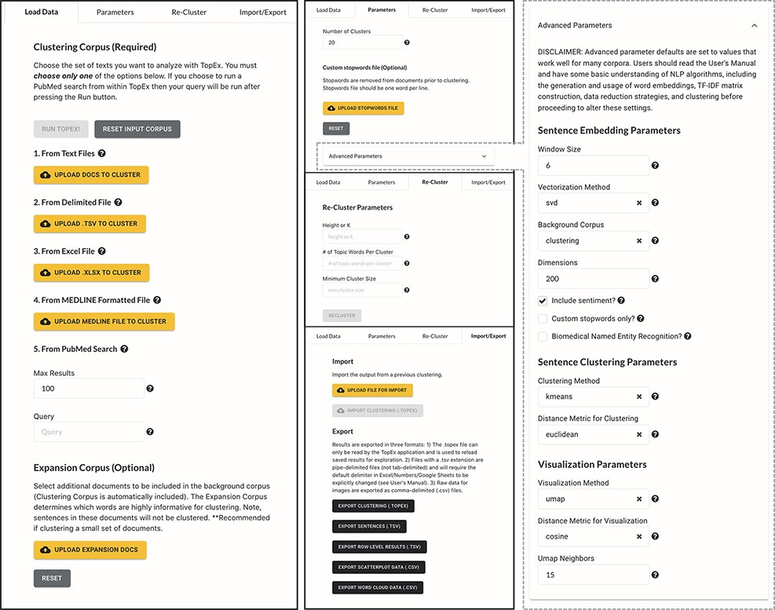
Figure 2. Screenshots of TopEx tabs and menu items. First panel shows the ‘Load Data’ tab with options for importing ...
Notes:
Figure 2. Screenshots of TopEx tabs and menu items. First panel shows the ‘Load Data’ tab with options for importing text data into TopEx. Second Panel shows the ‘Parameters’ (top), ‘Re-Cluster’ (middle) and ‘Import/Export’ (bottom) tabs. ‘Parameters’ tab allows customization of analysis and algorithm settings. ‘Re-Cluster’ enables quick adjustment of the cluster number without re-running the NLP pipeline from scratch. ‘Import/Export’ enables saving TopEx results or importing previous TopEx analyses. Third panel expands the ‘Advanced Parameters’ section of the ‘Parameters’ tab.
Unless provided in the caption above, the following copyright applies to the content of this slide: © The Author(s) 2022. Published by Oxford University Press.This is an Open Access article distributed under the terms of the Creative Commons Attribution-NonCommercial License (https://creativecommons.org/licenses/by-nc/4.0/), which permits non-commercial re-use, distribution, and reproduction in any medium, provided the original work is properly cited. For commercial re-use, please contact journals.permissions@oup.com

Slide 3
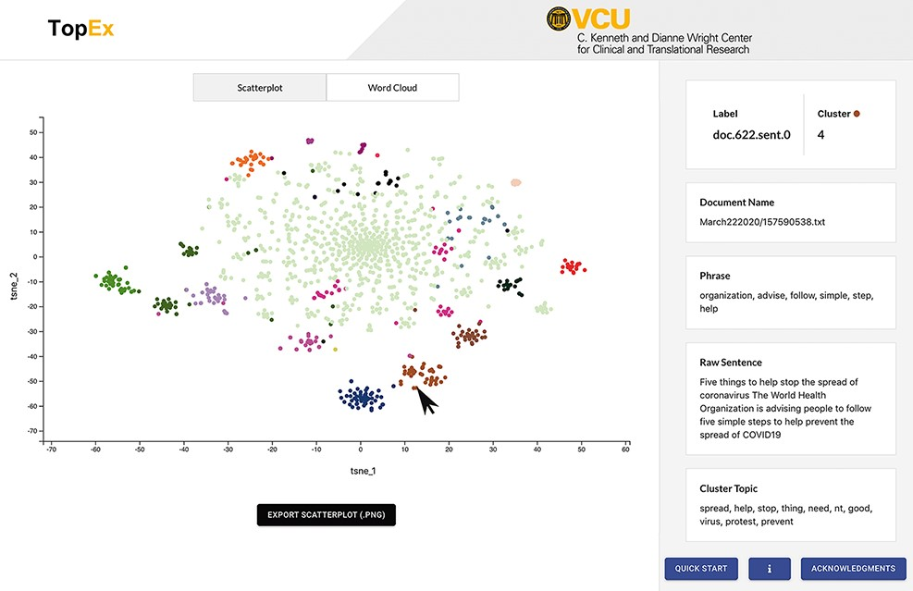
Figure 3. Screenshot of the TopEx interface showing results presented by a tSNE scatter plot and the sentence ...
Notes:
Figure 3. Screenshot of the TopEx interface showing results presented by a tSNE scatter plot and the sentence information displayed on the right when hovering over a point. Corpus used is a randomly sampled set of tweets from March 2020 in the COVID-19 Twitter Chatter data set discussed in the ‘Use Case’ section (same set of tweets that produced the UMAP visualization of Figure 4A).
Unless provided in the caption above, the following copyright applies to the content of this slide: © The Author(s) 2022. Published by Oxford University Press.This is an Open Access article distributed under the terms of the Creative Commons Attribution-NonCommercial License (https://creativecommons.org/licenses/by-nc/4.0/), which permits non-commercial re-use, distribution, and reproduction in any medium, provided the original work is properly cited. For commercial re-use, please contact journals.permissions@oup.com

Slide 4
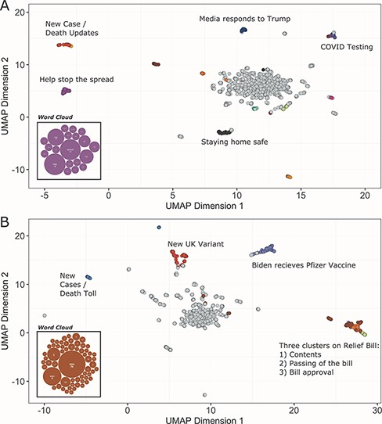
Figure 4. UMAP scatter plots and example word clouds from TopEx results for tweets from (A) March 2020 and (B) December ...
Notes:
Figure 4. UMAP scatter plots and example word clouds from TopEx results for tweets from (A) March 2020 and (B) December 2020. Scatter plots were generated in R from the coordinate text file output by TopEx.
Unless provided in the caption above, the following copyright applies to the content of this slide: © The Author(s) 2022. Published by Oxford University Press.This is an Open Access article distributed under the terms of the Creative Commons Attribution-NonCommercial License (https://creativecommons.org/licenses/by-nc/4.0/), which permits non-commercial re-use, distribution, and reproduction in any medium, provided the original work is properly cited. For commercial re-use, please contact journals.permissions@oup.com

