Slide 1
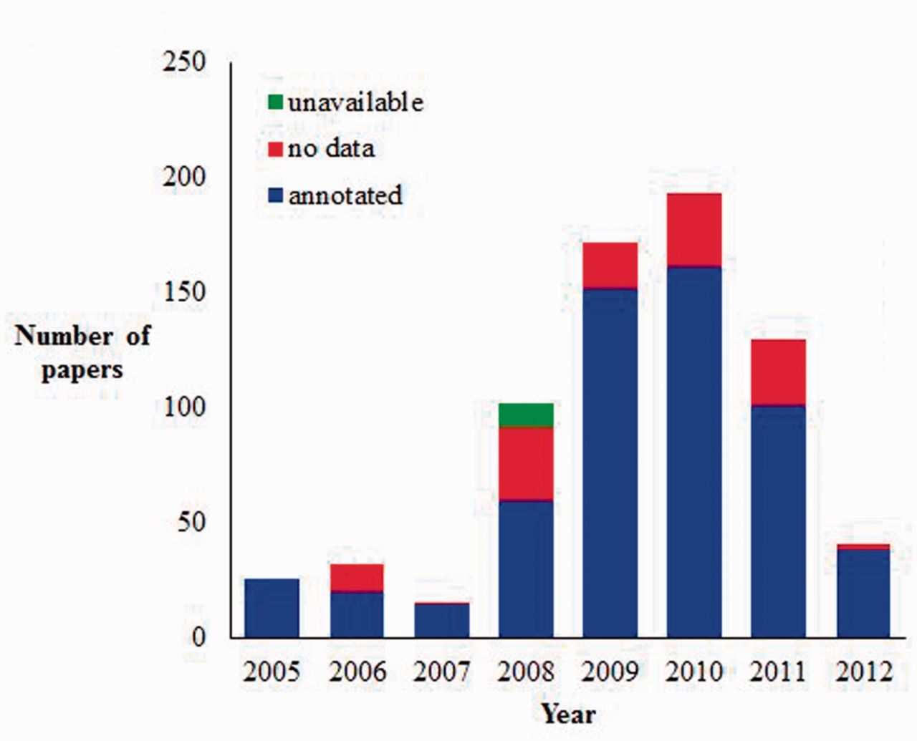
Figure 4 Current AgBase JDB statistics (as of July 2012). AgBase biocurators record the articles they look at for ...
Notes:
Figure 4 Current AgBase JDB statistics (as of July 2012). AgBase biocurators record the articles they look at for biocuration in JDB and classify them as annotated (contain information they annotate to the GO), no data (contain no GO data) or unavailable (likely to have GO data but unable to obtain full article for curation).
Unless provided in the caption above, the following copyright applies to the content of this slide: © The Author(s) 2012. Published by Oxford University Press.This is an Open Access article distributed under the terms of the Creative Commons Attribution License (http://creativecommons.org/licenses/by-nc/3.0/), which permits non-commercial reuse, distribution, and reproduction in any medium, provided the original work is properly cited. For commercial re-use, please contact journals.permissions@oup.com.

