Slide 1
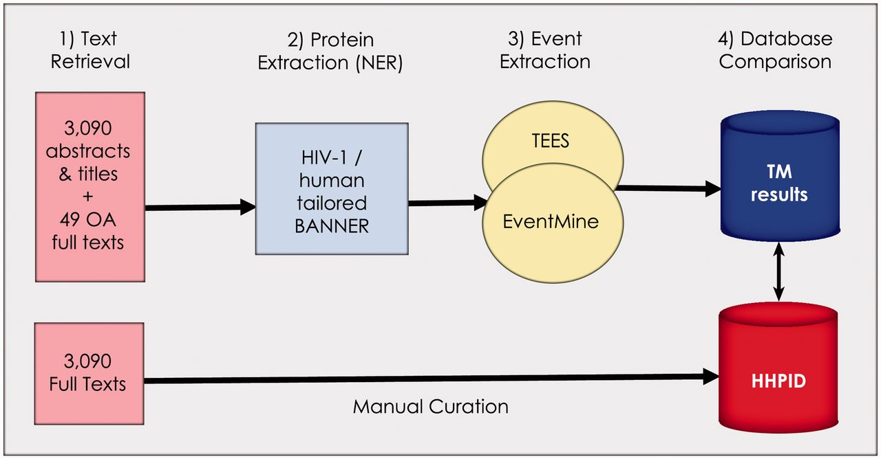
Figure 1. Summary of the methodology. Our methodology is divided into four stages: (1) retrieval of all abstracts and ...
Notes:
Figure 1. Summary of the methodology. Our methodology is divided into four stages: (1) retrieval of all abstracts and titles, as well as 49 open-access full texts from the 3090 citations in the HHPID, (2) proteins were extracted using an HIV-1/human tailored version of BANNER, (3) events were extracted using two event extraction tools (TEES and EventMine) and (4) a comparison of the results retrieved by TM was made with the manually curated HHPID.
Unless provided in the caption above, the following copyright applies to the content of this slide: © The Author(s) 2012. Published by Oxford University Press.This is an Open Access article distributed under the terms of the Creative Commons Attribution Non-Commercial License (http://creativecommons.org/licenses/by-nc/3.0), which permits unrestricted non-commercial use, distribution, and reproduction in any medium, provided the original work is properly cited.

Slide 2
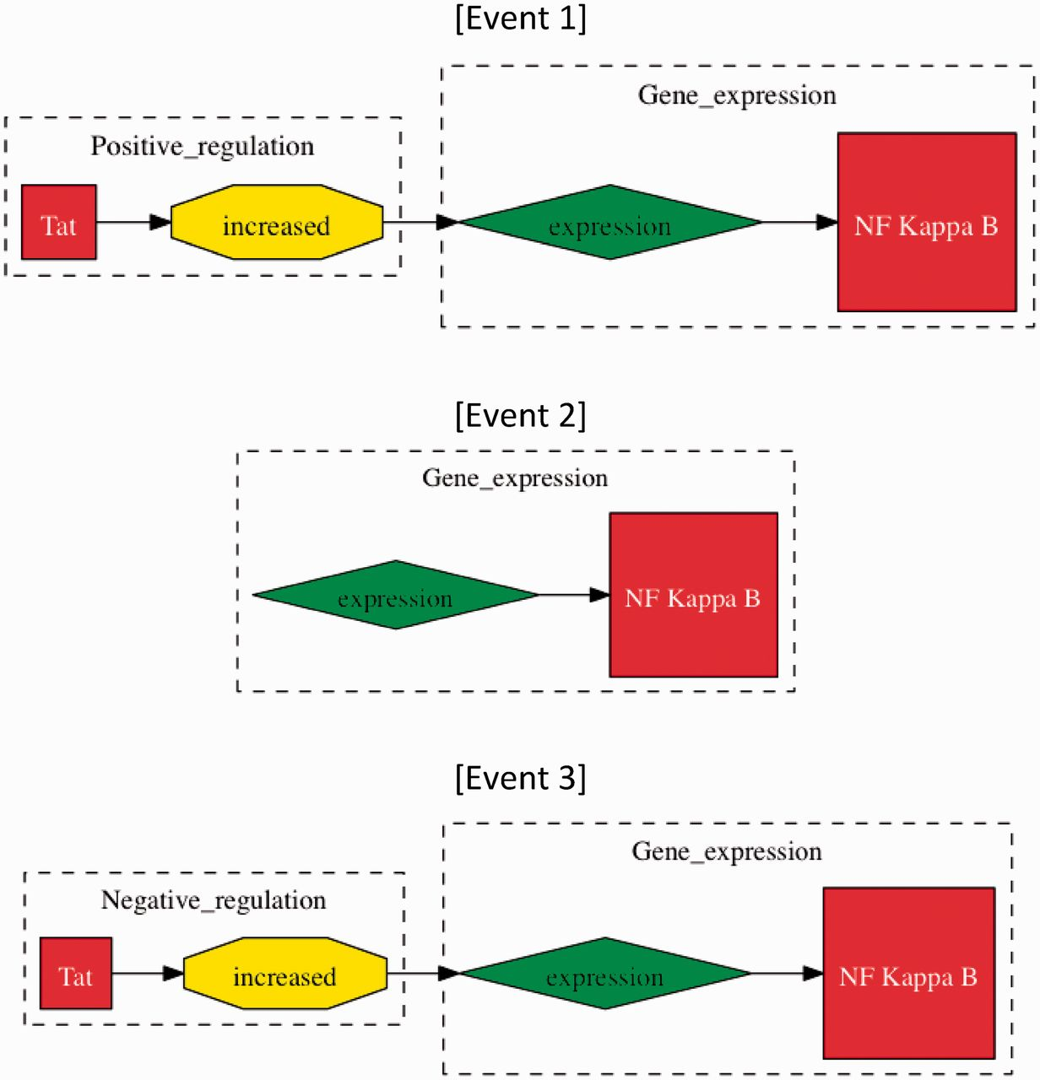
Figure 2. Methods of event evaluation. The three events have been extracted from the sentence “Tat increased the ...
Notes:
Figure 2. Methods of event evaluation. The three events have been extracted from the sentence “Tat increased the expression of NF kappa B”. In approximate evaluation, both events 1 and 2 would be counted as true positives, whereas only Event 1 would be considered a true positive in stringent event evaluation, as ‘Tat positive regulation (increased)’ is missing. Event 3 would be a false positive in both categories of evaluation, whereby ‘increased’ does not signify negative regulation.
Unless provided in the caption above, the following copyright applies to the content of this slide: © The Author(s) 2012. Published by Oxford University Press.This is an Open Access article distributed under the terms of the Creative Commons Attribution Non-Commercial License (http://creativecommons.org/licenses/by-nc/3.0), which permits unrestricted non-commercial use, distribution, and reproduction in any medium, provided the original work is properly cited.

Slide 3
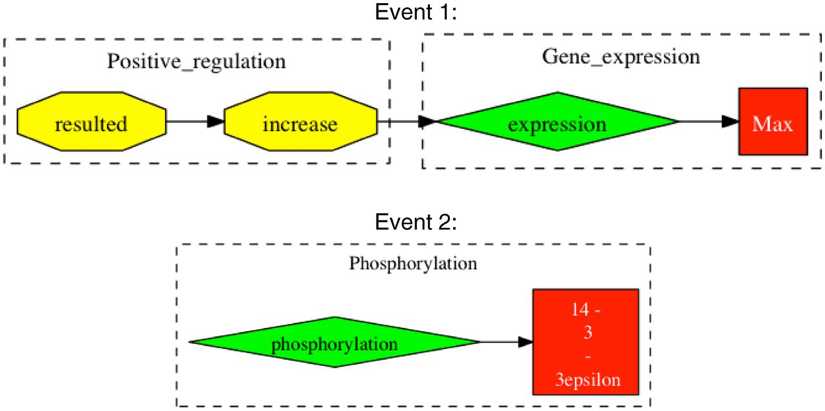
Figure 3. Examples of falsely reported event chains. Events are extracted from the sentence “In parallel to the ...
Notes:
Figure 3. Examples of falsely reported event chains. Events are extracted from the sentence “In parallel to the modulation of cell growth, gp 120 at low concentrations resulted in an increase in the expression of c-Myc, Max, and 14–3-3epsilon proteins and phosphorylation of ATP-dependent tyrosine kinases (Akt) at Ser (473)”. Taken from Ref. (20). Event 1 shows an example of an incomplete event chain, where gp120 is missing as the cause for positive regulation. In Event 2, there is falsely reported information in that 14-3-3epsilon is expressed and not phosphorylated.
Unless provided in the caption above, the following copyright applies to the content of this slide: © The Author(s) 2012. Published by Oxford University Press.This is an Open Access article distributed under the terms of the Creative Commons Attribution Non-Commercial License (http://creativecommons.org/licenses/by-nc/3.0), which permits unrestricted non-commercial use, distribution, and reproduction in any medium, provided the original work is properly cited.

Slide 4
Figure 4. TM interaction involving two or more participants. This event was extracted from the sentence “HIV-1 Tat can ...
Notes:
Figure 4. TM interaction involving two or more participants. This event was extracted from the sentence “HIV-1 Tat can substantially enhance the capacity of NIK to induce IkappaB degradation” (32). Here, we can see that the full interaction is identified by TM, across multiple participants and events. The HHPID documents this same interaction as ‘Tat enhances mitogen-activated protein kinase kinase kinase 14’, which is clearly a misrepresentation of the actual full interaction.
Unless provided in the caption above, the following copyright applies to the content of this slide: © The Author(s) 2012. Published by Oxford University Press.This is an Open Access article distributed under the terms of the Creative Commons Attribution Non-Commercial License (http://creativecommons.org/licenses/by-nc/3.0), which permits unrestricted non-commercial use, distribution, and reproduction in any medium, provided the original work is properly cited.

