Slide 1
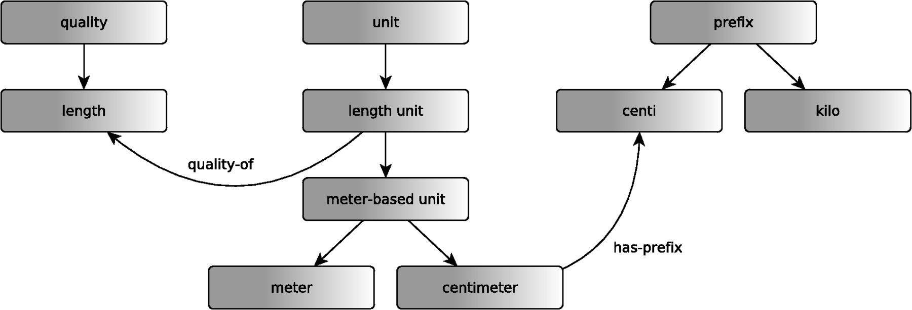
Figure 1 Schematic representation of an example of the mappings between PATO qualities and UO units. The figure is ...
Notes:
Figure 1 Schematic representation of an example of the mappings between PATO qualities and UO units. The figure is based on the OBO representation of UO in which units are treated as classes. Boxes in the figure represent classes and blue arrows represent subclass axioms between classes. If a grey arrow (labelled unit_of) connects the class A (from UO) and B (from PATO), then A SubClassOf: unit_of only B.
Unless provided in the caption above, the following copyright applies to the content of this slide: © The Author(s) 2012. Published by Oxford University Press.This is an Open Access article distributed under the terms of the Creative Commons Attribution Non-Commercial License (http://creativecommons.org/licenses/by-nc/3.0), which permits unrestricted non-commercial use, distribution, and reproduction in any medium, provided the original work is properly cited.

