Slide 1
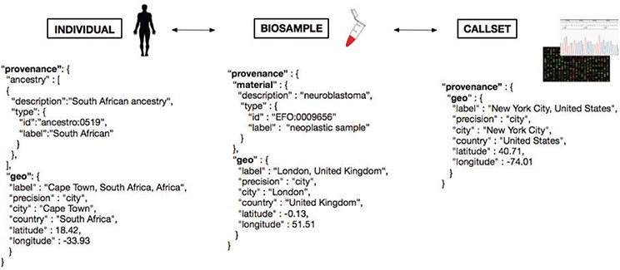
Figure 5 Metadata representation for a geolocation attribution approach based on concepts being developed at GA4GH. ...
Notes:
Figure 5 Metadata representation for a geolocation attribution approach based on concepts being developed at GA4GH. Each extracted ‘Biosample’ from an ‘Individual’ and its ‘Callset’ (i.e. experimental read-out) maintain a relation; ethnicity and geographical provenance of a biosample could be tracked through the attributes at the ‘Individual’ level.
Unless provided in the caption above, the following copyright applies to the content of this slide: © The Author(s) 2020. Published by Oxford University Press.This is an Open Access article distributed under the terms of the Creative Commons Attribution License (http://creativecommons.org/licenses/by/4.0/), which permits unrestricted reuse, distribution, and reproduction in any medium, provided the original work is properly cited.

