Slide 1
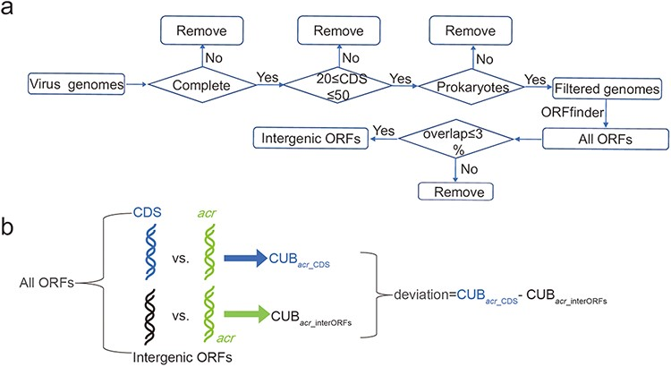
Figure 1. Construction of intergenic ORFs of virus genomes and comparison of CUB. (a) Pipeline of constructing ...
Notes:
Figure 1. Construction of intergenic ORFs of virus genomes and comparison of CUB. (a) Pipeline of constructing intergenic ORFs in virus genomes. The four diamonds represent our filtering conditions, where ‘complete’ means completely assembled level and ‘prokaryotes’ means virus hosts in bacteria or archaea; (b) A schematic workflow to illustrate the definition of deviation. ‘All ORFs’ means the ORFs annotated by ORFfinder. ‘CDS’ in light blue represents all CDS according to NCBI annotation. ‘intergenic ORFs’ in black represents ORFs that have overlapping ratio less 3% compared with CDS.
Unless provided in the caption above, the following copyright applies to the content of this slide: © The Author(s) 2022. Published by Oxford University Press.This is an Open Access article distributed under the terms of the Creative Commons Attribution License (https://creativecommons.org/licenses/by/4.0/), which permits unrestricted reuse, distribution, and reproduction in any medium, provided the original work is properly cited.

