Slide 1
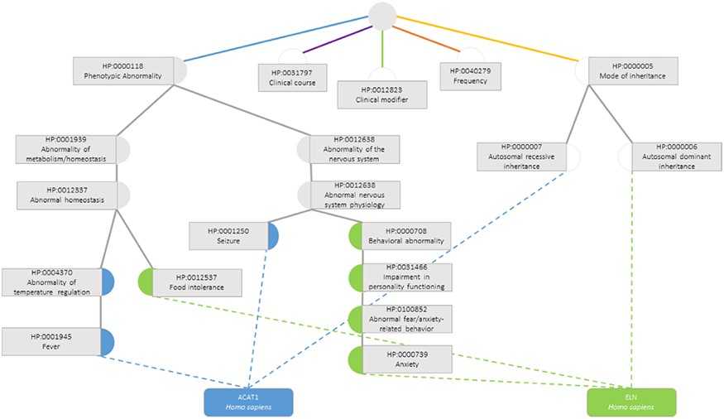
Figure 3. Semantic similarity inside the Phenotypic Abnormality sub-ontology in the Human Phenotype Ontology between ...
Notes:
Figure 3. Semantic similarity inside the Phenotypic Abnormality sub-ontology in the Human Phenotype Ontology between the genes ACAT1 and ELN. Blue circles are classes that only annotate gene ACAT1, green circles are terms that only annotate gene ELN, grey circles are classes that annotate both genes and white circles are classes whose annotations are discarded due to not belonging to the Phenotypic Abnormality sub-ontology.
Unless provided in the caption above, the following copyright applies to the content of this slide: © The Author(s) 2020. Published by Oxford University Press.This is an Open Access article distributed under the terms of the Creative Commons Attribution License (http://creativecommons.org/licenses/by/4.0/), which permits unrestricted reuse, distribution, and reproduction in any medium, provided the original work is properly cited.

