Slide 1
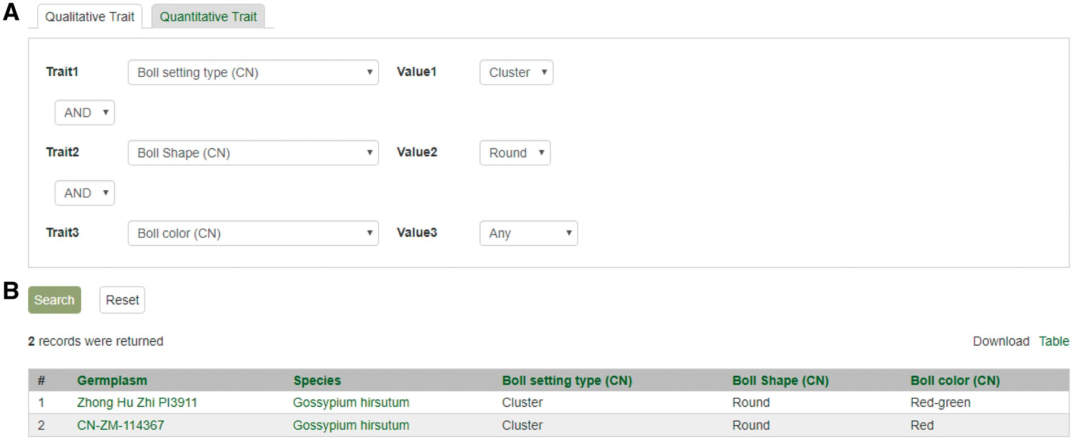
Figure 11. Search page for phenotype in CottonGEN. (A) There are two tabs, one for quantitative trait and the other for ...
Notes:
Figure 11. Search page for phenotype in CottonGEN. (A) There are two tabs, one for quantitative trait and the other for qualitative traits. In each page, users can choose up to three trait names and the range of phenotypic values to obtain germplasm that has the specified phenotype. (B) The returned search results show dataset name, germplasm, species and the trait values for the traits chosen.
Unless provided in the caption above, the following copyright applies to the content of this slide: © The Author(s) 2017. Published by Oxford University Press.This is an Open Access article distributed under the terms of the Creative Commons Attribution License (http://creativecommons.org/licenses/by/4.0/), which permits unrestricted reuse, distribution, and reproduction in any medium, provided the original work is properly cited.

