Slide 1
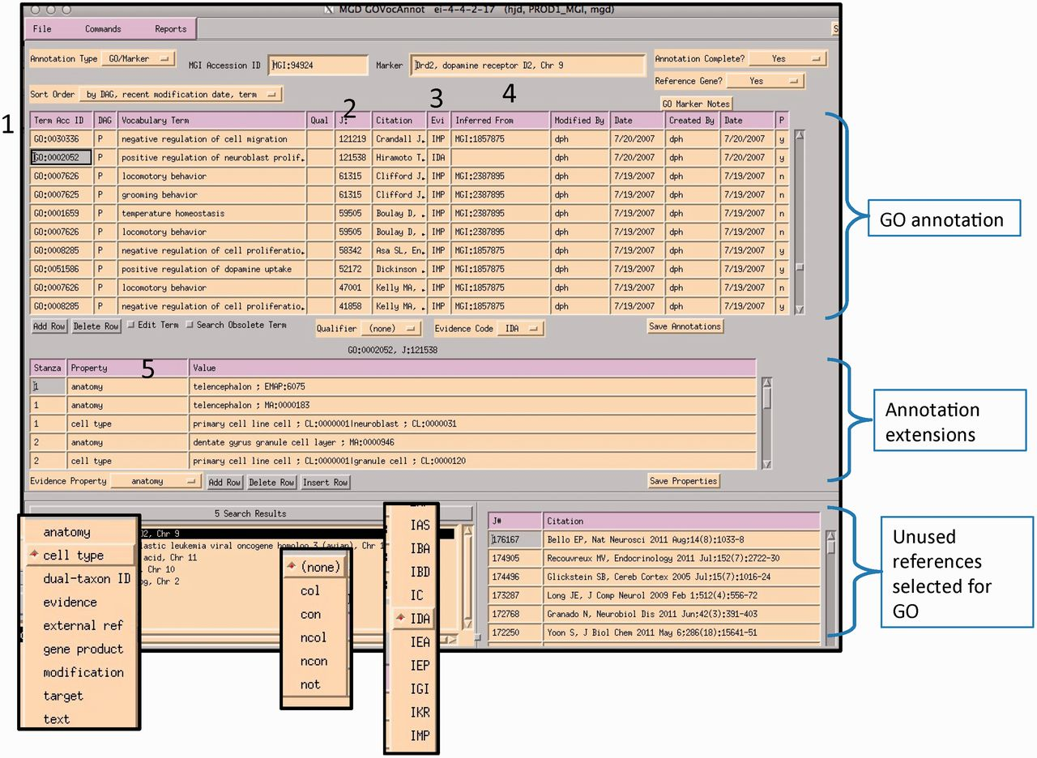
Figure 6. MGI GO data entry module: the interface is divided into three main sections: GO annotation, annotation ...
Notes:
Figure 6. MGI GO data entry module: the interface is divided into three main sections: GO annotation, annotation properties and search and reference tracking. Drop-down menus display pick-lists of allowed entries in various fields (evidence property, GO qualifier and evidence codes). Numbered areas: 1, GO ID entry; 2, reference entry; 3, evidence code entry; 4, ‘inferred_from’ entry required for certain evidence codes and 5, annotation properties entry.
Unless provided in the caption above, the following copyright applies to the content of this slide: © The Author(s) 2012. Published by Oxford University Press.This is an Open Access article distributed under the terms of the Creative Commons Attribution License (http://creativecommons.org/licenses/by-nc/3.0/), which permits non-commercial reuse, distribution, and reproduction in any medium, provided the original work is properly cited. For commercial re-use, please contact journals.permissions@oup.com.

