Slide 1
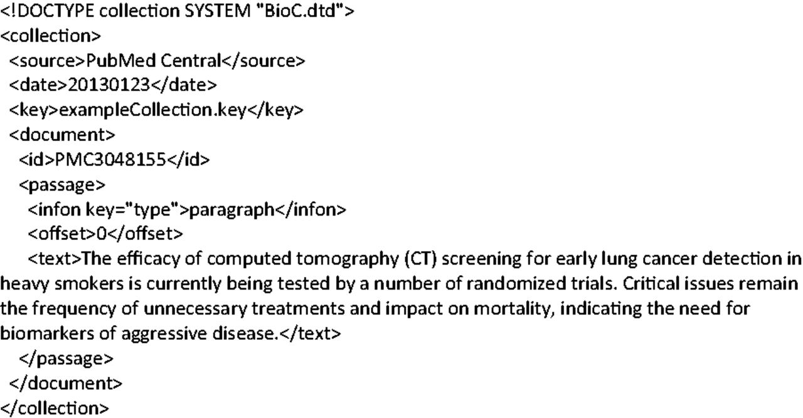
Figure 2. Simple example of a BioC file.
Notes:
Figure 2. Simple example of a BioC file.
Unless provided in the caption above, the following copyright applies to the content of this slide: Published by Oxford University 2014. This work is written by US Government employees and is in the public domain in the US.

