Slide 1
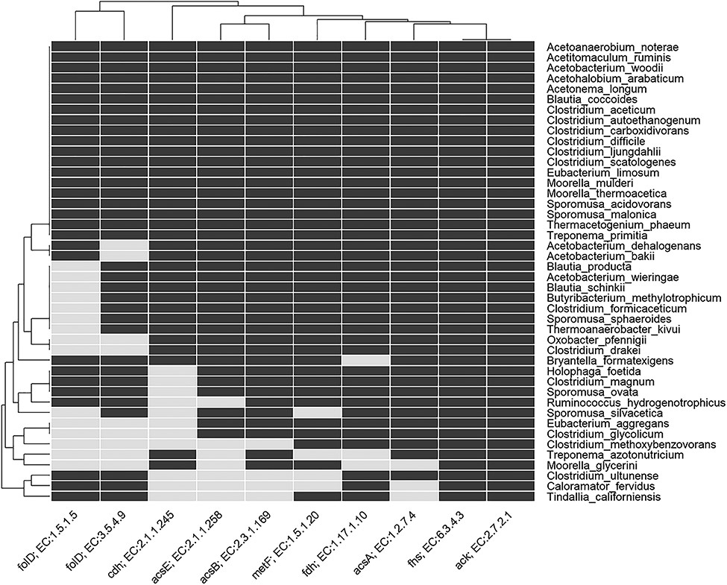
Figure 6 Heatmap indicating the presence and absence of enzymes involved in the Wood–Ljungdahl pathway in genome of ...
Notes:
Figure 6 Heatmap indicating the presence and absence of enzymes involved in the Wood–Ljungdahl pathway in genome of known acetogens. The rows show the named acetogens, and the columns show the EC number and gene name for the enzymes. For details of enzyme EC number, etc., see Table S2 in Supplementary Information.
Unless provided in the caption above, the following copyright applies to the content of this slide: © The Author(s) 2019. Published by Oxford University Press.This is an Open Access article distributed under the terms of the Creative Commons Attribution Non-Commercial License (http://creativecommons.org/licenses/by-nc/4.0/), which permits non-commercial re-use, distribution, and reproduction in any medium, provided the original work is properly cited. For commercial re-use, please contact journals.permissions@oup.com

