Slide 1
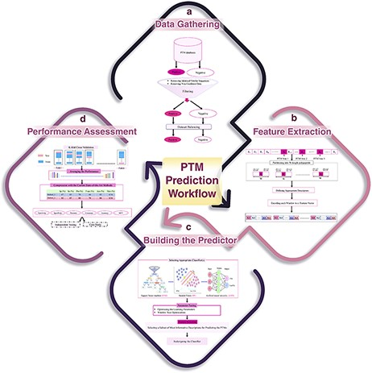
Figure 6. A schematic flowchart to show how a predictor works for PTM prediction. (A) Data collection and dataset ...
Notes:
Figure 6. A schematic flowchart to show how a predictor works for PTM prediction. (A) Data collection and dataset creation. (B) Feature selection. (C) Creating training and testing models. (D) Evaluation of the performance of the models.
Unless provided in the caption above, the following copyright applies to the content of this slide: © The Author(s) 2021. Published by Oxford University Press. All rights reserved. For permissions, please e-mail: journals.permissions@oup.comThis article is published and distributed under the terms of the Oxford University Press, Standard Journals Publication Model (https://academic.oup.com/journals/pages/open_access/funder_policies/chorus/standard_publication_model)

