Slide 1
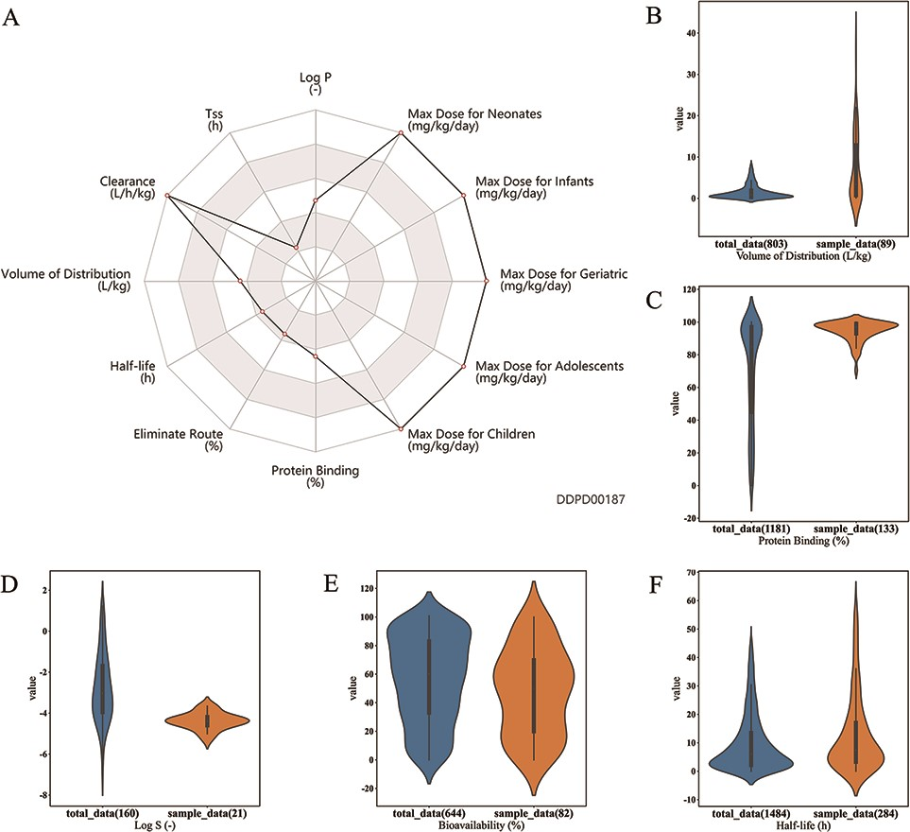
Figure 5. Case studies. (A) Case study 1. Radar chart for properties of esmolol. Property values related to maximum ...
Notes:
Figure 5. Case studies. (A) Case study 1. Radar chart for properties of esmolol. Property values related to maximum dosage and clearance are shown to be at the maximums of the corresponding ranges. (B, C, D, E). Case Study 2. Drugs with log P value greater than 4 are selected as the sample group; as shown, property value distributions for these drugs (orange plots) are significantly different from those of all approved small molecule drugs (blue plots): (B) Volume of distribution is significantly higher for the sample group (median 3.4 > 0.85, P-value = 3.1e–11); (C) Protein binding is significantly higher for the sample group (median 97 > 85, P-value = 9.8e-21); (D) Log S is significantly lower for the sample group (median −4.39 < −3.03, P-value= 1.6e-7); and (E) bioavailability is significantly lower for the sample group (median 50 6.04, P-value = 0.0003). All P-values are calculated using Mann–Whitney U Test performed by the developed analysis tool.
Unless provided in the caption above, the following copyright applies to the content of this slide: © The Author(s) 2022. Published by Oxford University Press.This is an Open Access article distributed under the terms of the Creative Commons Attribution License (https://creativecommons.org/licenses/by/4.0/), which permits unrestricted reuse, distribution, and reproduction in any medium, provided the original work is properly cited.

