Slide 1
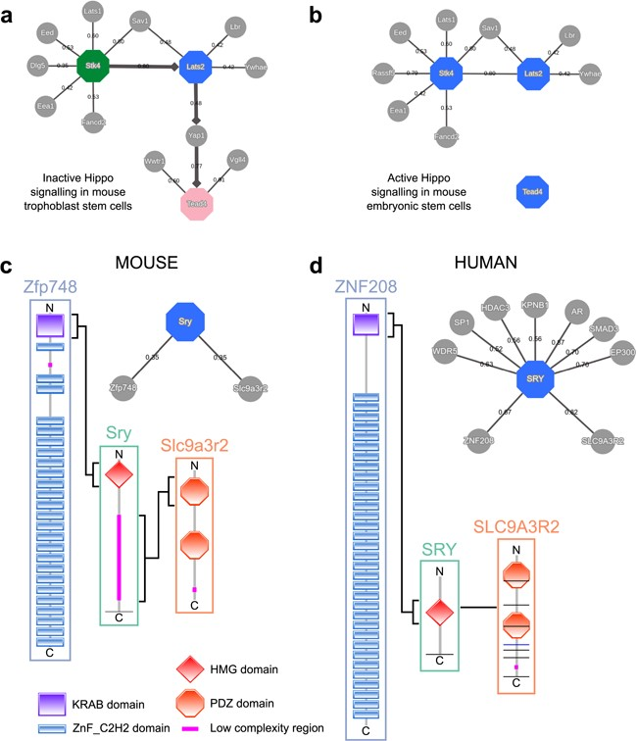
Figure 5 MIPPIE correctly reproduces the chain of Hippo signaling events that lead to (a) trophoblast specification or ...
Notes:
Figure 5 MIPPIE correctly reproduces the chain of Hippo signaling events that lead to (a) trophoblast specification or (b) pluripotency maintenance via the construction of cell type-specific networks with directionality inference using the NETWORK QUERY tab. (c) Interaction partners of the mouse Sry and (d) the human SRY proteins as reported in MIPPIE and HIPPIE, respectively. The accompanying diagrams highlight the domains that mediate conserved interactions.
Unless provided in the caption above, the following copyright applies to the content of this slide: © The Author(s) 2020. Published by Oxford University Press.This is an Open Access article distributed under the terms of the Creative Commons Attribution License (http://creativecommons.org/licenses/by/4.0/), which permits unrestricted reuse, distribution, and reproduction in any medium, provided the original work is properly cited.

