Slide 1
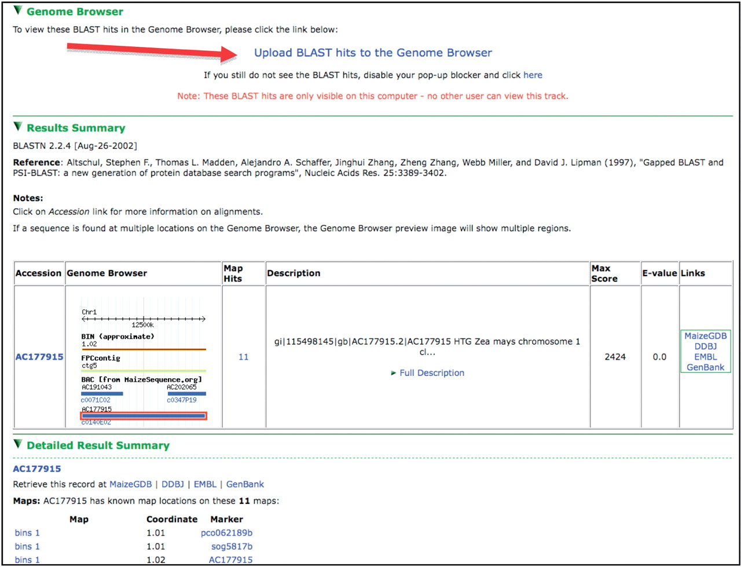
Figure 2. A view from the BLAST results interface. Note the link toward the top of the page allowing BLAST hits to be ...
Notes:
Figure 2. A view from the BLAST results interface. Note the link toward the top of the page allowing BLAST hits to be uploaded as a track in the Genome Browser, results table showing a thumbnail of the hit’s genomic context and hit assignment to BACs via the molecular markers associated with the hit sequence.
Unless provided in the caption above, the following copyright applies to the content of this slide: Published by Oxford University Press 2009.This is Open Access article distributed under the terms of the Creative Commons Attribution Non-Commercial License (http://creativecommons.org/licenses/by-nc/2.5/uk/) which permits unrestricted non-commercial use, distribution, and reproduction in any medium, provided the original work is properly cited.

