Slide 1
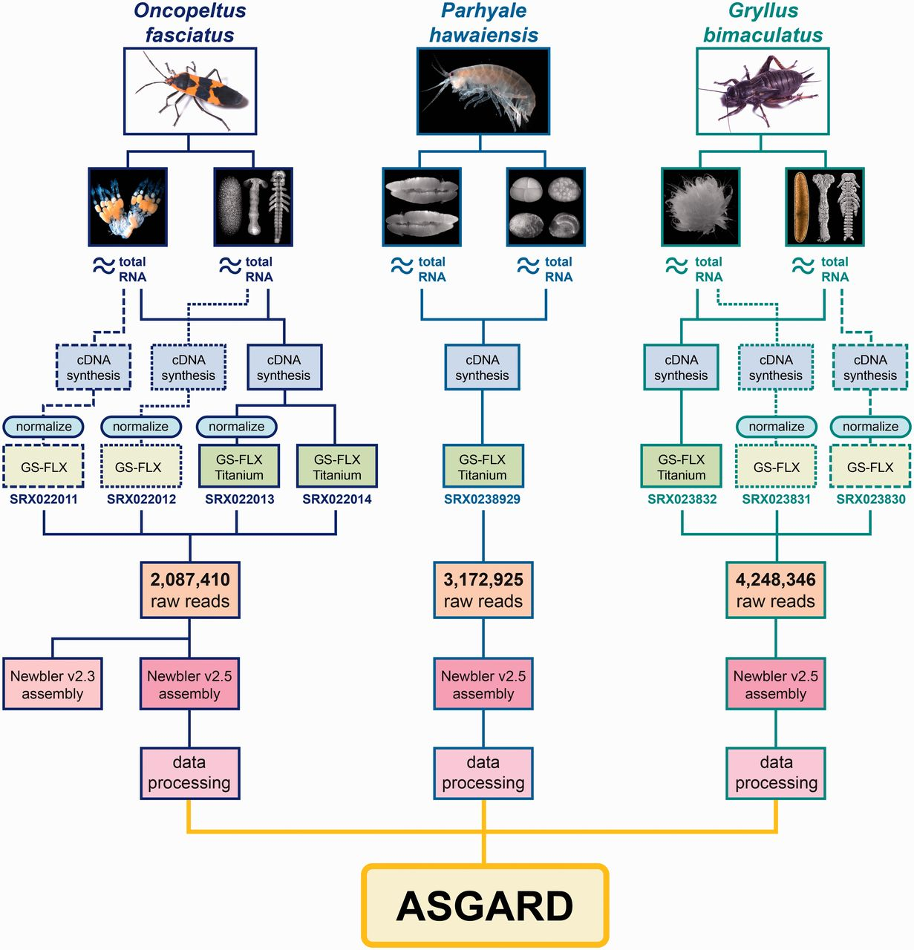
Figure 1 Origin and processing of data contained in ASGARD. Flowchart showing adult specimens and tissue types ...
Notes:
Figure 1 Origin and processing of data contained in ASGARD. Flowchart showing adult specimens and tissue types obtained for ASGARD v1.0 organisms O. fasciatus, P. hawaiensis and G. bimaculatus. Total RNA was prepared separately from ovaries and mixed-stage embryos and used for cDNA synthesis. For insect samples, some libraries were normalized in pilot experiments and sequenced using GS-FLX 454 pyrosequencing. The majority of reads used in the de novo assemblies were obtained using GS-FLX Titanium 454 pyrosequencing. SRA accession numbers are shown for each sequenced sample. Reads from each organism were pooled, assembled with Newbler v2.5 and annotated using the data processing pipeline described in the main text. The resulting data are searchable via the ASGARD web interface.
Unless provided in the caption above, the following copyright applies to the content of this slide: © The Author(s) 2012. Published by Oxford University Press.This is an Open Access article distributed under the terms of the Creative Commons Attribution License (http://creativecommons.org/licenses/by-nc/3.0/), which permits non-commercial reuse, distribution, and reproduction in any medium, provided the original work is properly cited. For commercial re-use, please contact journals.permissions@oup.com.

