Slide 1
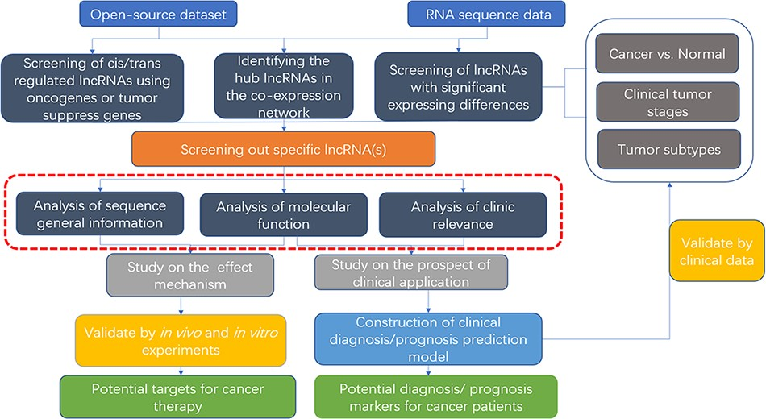
Figure 3. Flow chart of lncRNA in silico analysis and validation in oncology research. This flow chart indicates the ...
Notes:
Figure 3. Flow chart of lncRNA in silico analysis and validation in oncology research. This flow chart indicates the general process of lncRNA analysis and validation in cancer research, the purpose of which are searching for characteristic markers of diagnosis/prognosis or potential molecular targets for treatment. Both data from open-source datasets or high-throughput sequencing results of clinical samples can be utilized. The specific lncRNA can be screened out by analysis of expressing differences, co-expressing network or cis/trans regulating of oncogenes or tumor suppressors. To clarify its roles, researchers can use web tools (the red dotted line area, which is described detailed in Table 2) to analysis the specific functions, including sequence general information, molecular function, and clinic relevance. It is essential to verify the results of the functional analysis by molecular experiments and animal models. For the establishment of diagnostic/prognostic markers, in addition to validation, lncRNAs also need to be compared with the existing clinical criteria to evaluation.
Unless provided in the caption above, the following copyright applies to the content of this slide: © The Author(s) 2021. Published by Oxford University Press.This is an Open Access article distributed under the terms of the Creative Commons Attribution License (http://creativecommons.org/licenses/by/4.0/), which permits unrestricted reuse, distribution, and reproduction in any medium, provided the original work is properly cited.

