Slide 1
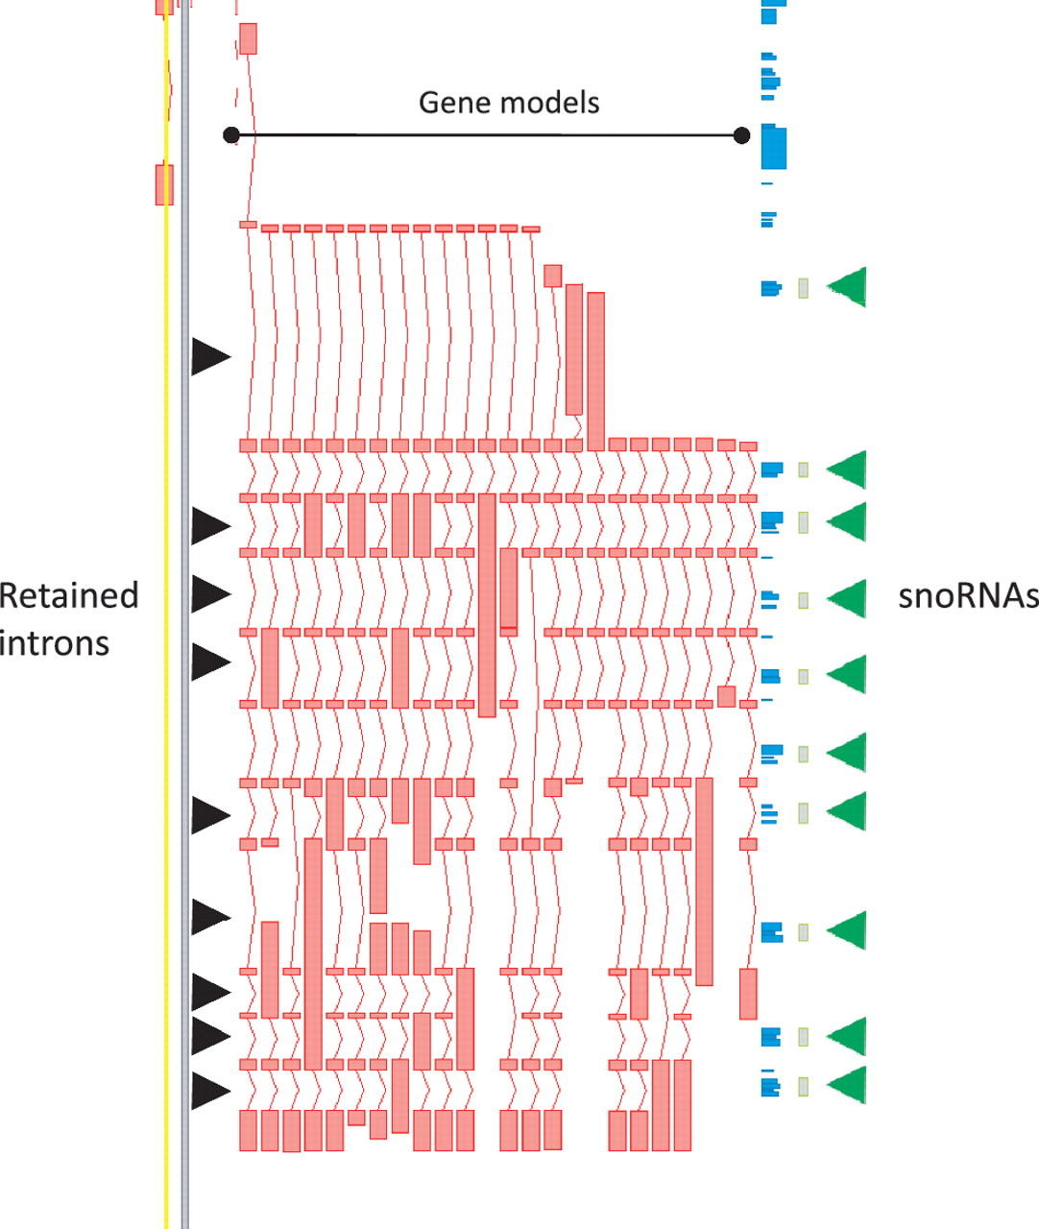
Figure 3 Zmap screenshot of the GAS5 locus encoding growth arrest-specific 5 (non-protein coding). This locus has 29 ...
Notes:
Figure 3 Zmap screenshot of the GAS5 locus encoding growth arrest-specific 5 (non-protein coding). This locus has 29 non-redundant AS transcripts, including many containing retained introns. Black arrowheads indicate those introns retained in at least one transcript. Green arrowheads indicate intronic snoRNAs.
Unless provided in the caption above, the following copyright applies to the content of this slide: © The Author(s) 2012. Published by Oxford University Press.This is an Open Access article distributed under the terms of the Creative Commons Attribution Non-Commercial License (http://creativecommons.org/licenses/by-nc/3.0), which permits unrestricted non-commercial use, distribution, and reproduction in any medium, provided the original work is properly cited.

