Slide 1
Figure 1. Time-course gene expression analytic pipeline.
Notes:
Figure 1. Time-course gene expression analytic pipeline.
Unless provided in the caption above, the following copyright applies to the content of this slide: © The Author(s) 2020. Published by Oxford University Press.This is an Open Access article distributed under the terms of the Creative Commons Attribution License (http://creativecommons.org/licenses/by/4.0/), which permits unrestricted reuse, distribution, and reproduction in any medium, provided the original work is properly cited.

Slide 2
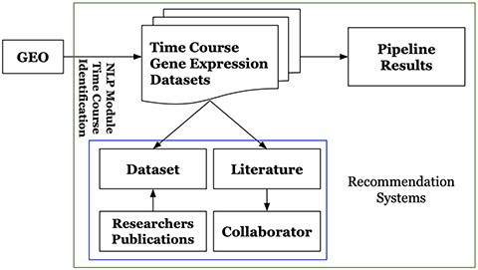
Figure 2. High-level architecture of the GETc platform.
Notes:
Figure 2. High-level architecture of the GETc platform.
Unless provided in the caption above, the following copyright applies to the content of this slide: © The Author(s) 2020. Published by Oxford University Press.This is an Open Access article distributed under the terms of the Creative Commons Attribution License (http://creativecommons.org/licenses/by/4.0/), which permits unrestricted reuse, distribution, and reproduction in any medium, provided the original work is properly cited.

Slide 3
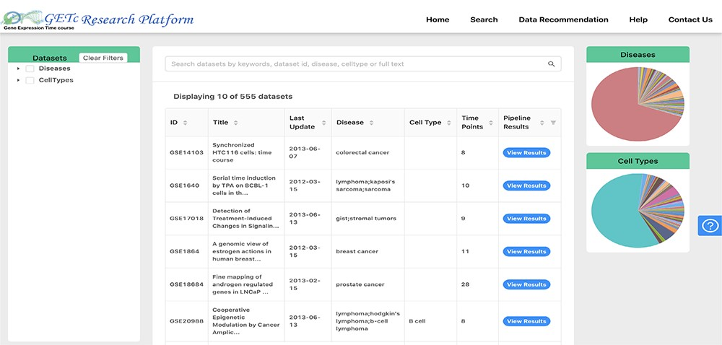
Figure 3. Search and view datasets in GETc research platform.
Notes:
Figure 3. Search and view datasets in GETc research platform.
Unless provided in the caption above, the following copyright applies to the content of this slide: © The Author(s) 2020. Published by Oxford University Press.This is an Open Access article distributed under the terms of the Creative Commons Attribution License (http://creativecommons.org/licenses/by/4.0/), which permits unrestricted reuse, distribution, and reproduction in any medium, provided the original work is properly cited.

Slide 4
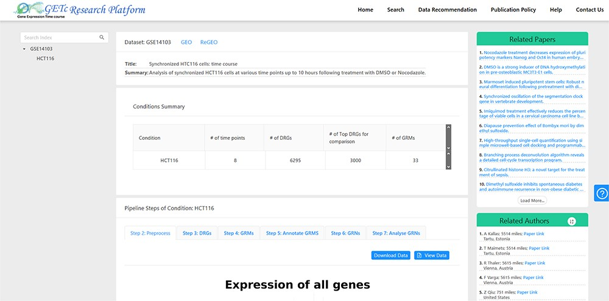
Figure 4. A screenshot of recommended literature and collaborators for GSE14103.
Notes:
Figure 4. A screenshot of recommended literature and collaborators for GSE14103.
Unless provided in the caption above, the following copyright applies to the content of this slide: © The Author(s) 2020. Published by Oxford University Press.This is an Open Access article distributed under the terms of the Creative Commons Attribution License (http://creativecommons.org/licenses/by/4.0/), which permits unrestricted reuse, distribution, and reproduction in any medium, provided the original work is properly cited.

