Slide 1
Figure 1 The RNA CoSSMos average structure page showing the average and representative structure for all GNRA ...
Notes:
Figure 1 The RNA CoSSMos average structure page showing the average and representative structure for all GNRA tetraloops. A total of 4724 GNRA tetraloops were included in the calculations using the backbone and three atoms from each base.
Unless provided in the caption above, the following copyright applies to the content of this slide: © The Author(s) 2020. Published by Oxford University Press.This is an Open Access article distributed under the terms of the Creative Commons Attribution License (http://creativecommons.org/licenses/by/4.0/), which permits unrestricted reuse, distribution, and reproduction in any medium, provided the original work is properly cited.

Slide 2
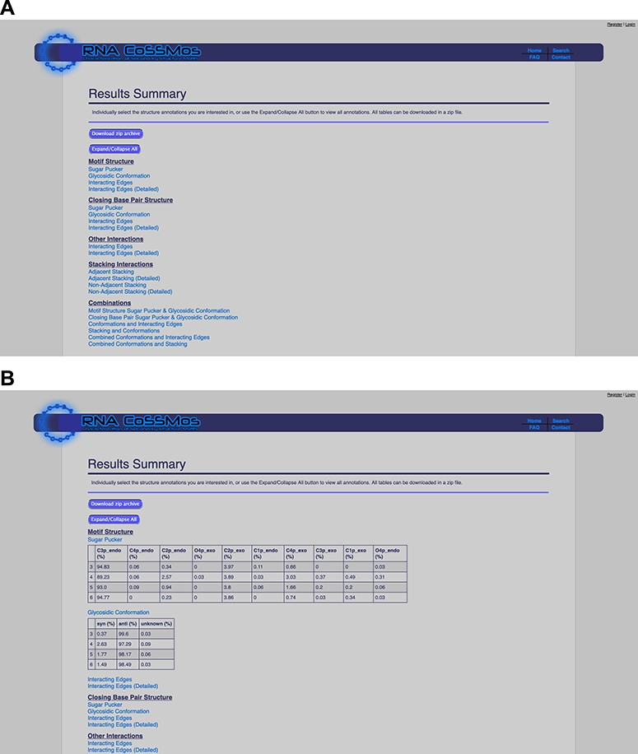
Figure 2 The RNA CoSSMos results summary page (A) collapsed and (B) expanded for ‘Sugar Pucker’ and ‘Glycosidic ...
Notes:
Figure 2 The RNA CoSSMos results summary page (A) collapsed and (B) expanded for ‘Sugar Pucker’ and ‘Glycosidic Conformation’.
Unless provided in the caption above, the following copyright applies to the content of this slide: © The Author(s) 2020. Published by Oxford University Press.This is an Open Access article distributed under the terms of the Creative Commons Attribution License (http://creativecommons.org/licenses/by/4.0/), which permits unrestricted reuse, distribution, and reproduction in any medium, provided the original work is properly cited.

Slide 3
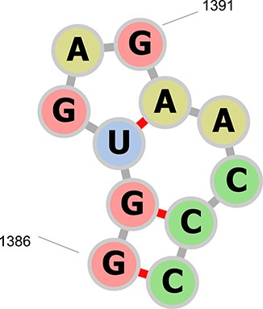
Figure 3 The secondary structure representation of residues A1386–A1396 in PDB ID 1N8R drawn with forna (24). The ...
Notes:
Figure 3 The secondary structure representation of residues A1386–A1396 in PDB ID 1N8R drawn with forna (24). The previous RNA CoSSMos database contained a hairpin of seven nucleotides in residues A1387–A1395, a hairpin of three nucleotides in residues A1388–A1392, and a bulge of two nucleotides in residues A1387–A1388 and A1392–A1395. RNA CoSSMos 2.0 only contains a hairpin of seven nucleotides in residues 1386–1396.
Unless provided in the caption above, the following copyright applies to the content of this slide: © The Author(s) 2020. Published by Oxford University Press.This is an Open Access article distributed under the terms of the Creative Commons Attribution License (http://creativecommons.org/licenses/by/4.0/), which permits unrestricted reuse, distribution, and reproduction in any medium, provided the original work is properly cited.

Slide 4
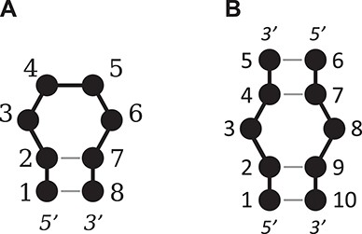
Figure 4 An illustration of the numbering system used for (A) a tetraloop and (B) a 1 × 1 nucleotide internal loop.
Notes:
Figure 4 An illustration of the numbering system used for (A) a tetraloop and (B) a 1 × 1 nucleotide internal loop.
Unless provided in the caption above, the following copyright applies to the content of this slide: © The Author(s) 2020. Published by Oxford University Press.This is an Open Access article distributed under the terms of the Creative Commons Attribution License (http://creativecommons.org/licenses/by/4.0/), which permits unrestricted reuse, distribution, and reproduction in any medium, provided the original work is properly cited.

