Slide 1
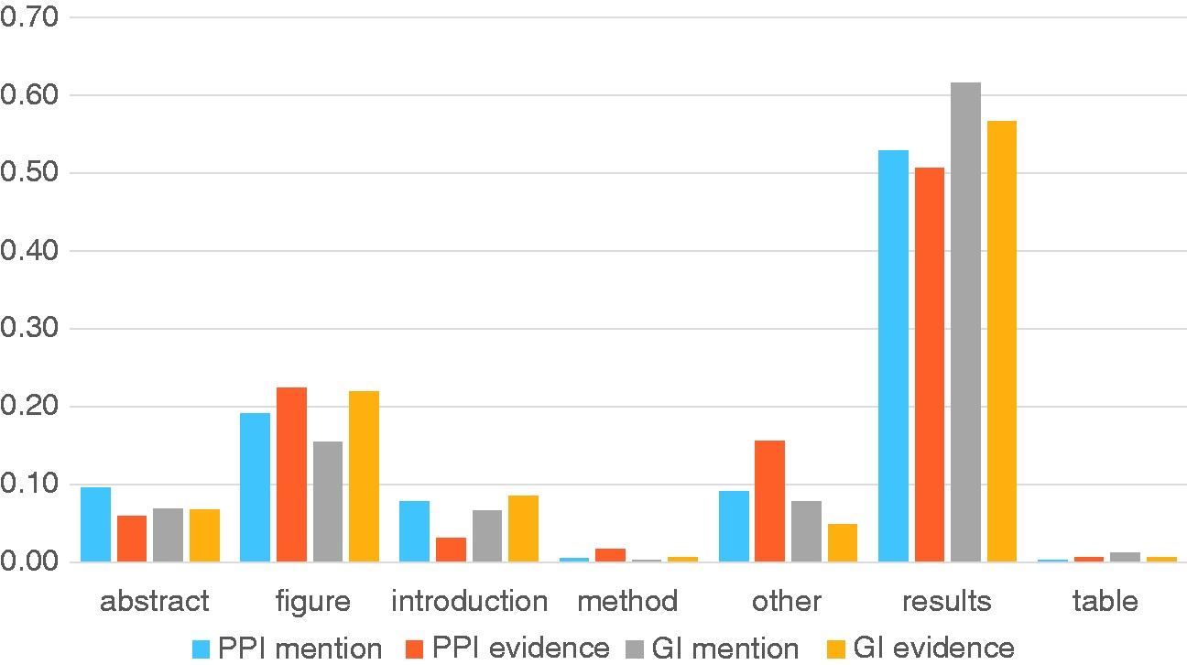
Figure 5. Analysis of section titles of full text articles showing where different annotation types are highlighted by ...
Notes:
Figure 5. Analysis of section titles of full text articles showing where different annotation types are highlighted by curators. The Y-axis shows the proportion of annotations for each annotation type.
Unless provided in the caption above, the following copyright applies to the content of this slide: Published by Oxford University Press 2017. This work is written by US Government employees and is in the public domain in the US.

