Slide 1
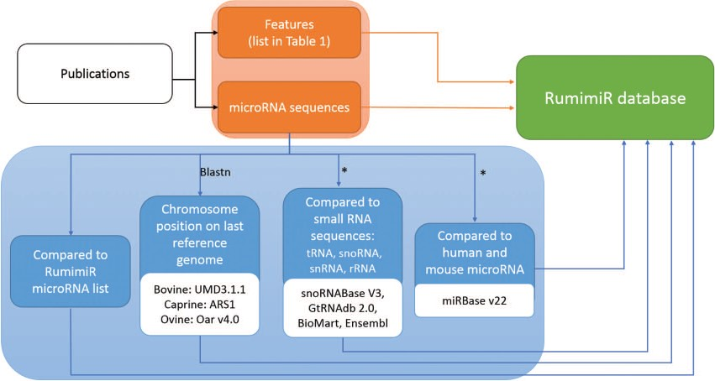
Figure 1 Procedure followed to include microRNAs and their associated features in the RumimiR database. From each ...
Notes:
Figure 1 Procedure followed to include microRNAs and their associated features in the RumimiR database. From each publication (black rectangle), the microRNA sequences and their features (orange rectangles) were extracted and included in the RumimiR database. Several analyses were performed to expand the description of the microRNAs collected (blue rectangles): determination of chromosomal position in the latest reference genome of each species (using the NCBI Blastn tool), search for redundancy with microRNAs already present in the RumimiR database, search for identity with other small microRNAs to compare the sequences, search for identity with human or mouse microRNAs present in miRBase. *, using a home-made Python script (Supplementary Figure 2).
Unless provided in the caption above, the following copyright applies to the content of this slide: © The Author(s) 2019. Published by Oxford University Press.This is an Open Access article distributed under the terms of the Creative Commons Attribution License (http://creativecommons.org/licenses/by/4.0/), which permits unrestricted reuse, distribution, and reproduction in any medium, provided the original work is properly cited.

Slide 2
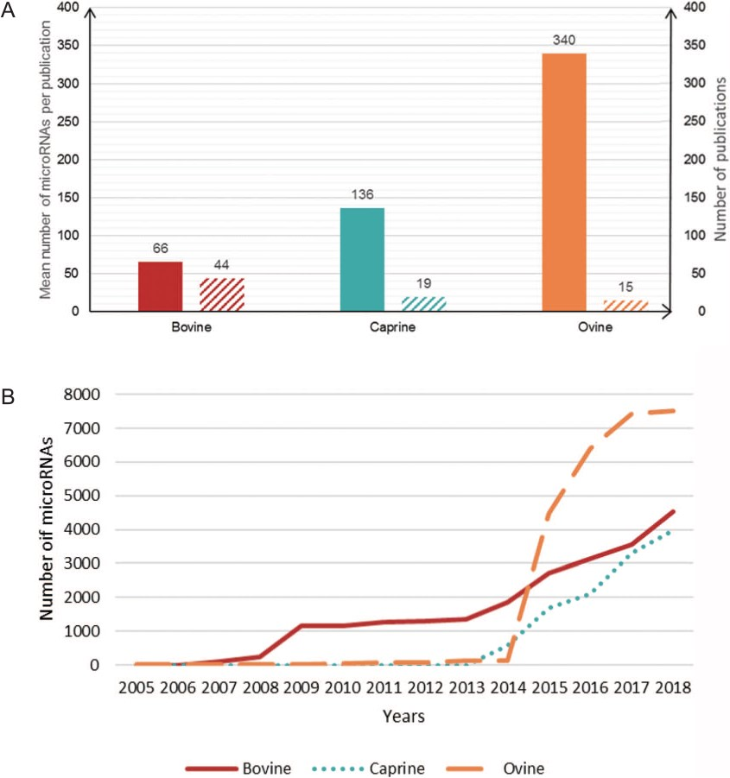
Figure 2 Number of microRNAs per publication. (A) Plain bars, average number of microRNAs described per publication ...
Notes:
Figure 2 Number of microRNAs per publication. (A) Plain bars, average number of microRNAs described per publication for each species. Hatched bars, the number of publications on each species. (B) Cumulative number of microRNAs described per year in each species.
Unless provided in the caption above, the following copyright applies to the content of this slide: © The Author(s) 2019. Published by Oxford University Press.This is an Open Access article distributed under the terms of the Creative Commons Attribution License (http://creativecommons.org/licenses/by/4.0/), which permits unrestricted reuse, distribution, and reproduction in any medium, provided the original work is properly cited.

Slide 3
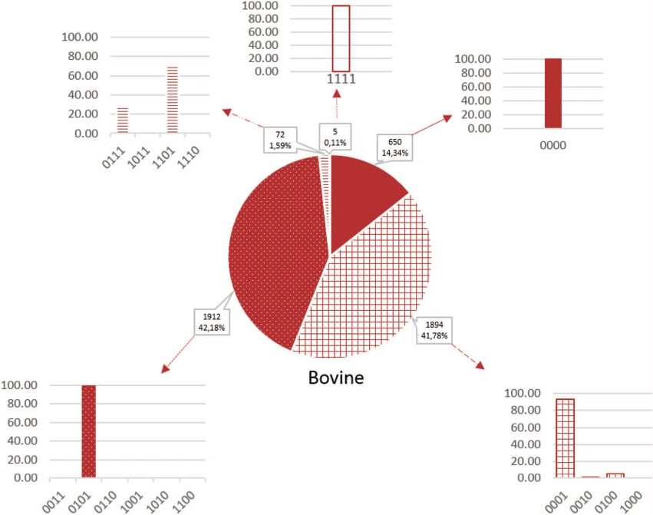
Figure 3 Proportion of microRNAs according to the false-positive codes in cattle. Sequences without a `1’-value are ...
Notes:
Figure 3 Proportion of microRNAs according to the false-positive codes in cattle. Sequences without a `1’-value are more likely to be true microRNAs and those with 4 1-values are less likely to be microRNAs. Plain color, codes without `1’; gridded color, codes with one `1’; dotted color, codes with two `1’, hatched color, codes with three `1’; empty color, codes with four `1’.
Unless provided in the caption above, the following copyright applies to the content of this slide: © The Author(s) 2019. Published by Oxford University Press.This is an Open Access article distributed under the terms of the Creative Commons Attribution License (http://creativecommons.org/licenses/by/4.0/), which permits unrestricted reuse, distribution, and reproduction in any medium, provided the original work is properly cited.

Slide 4
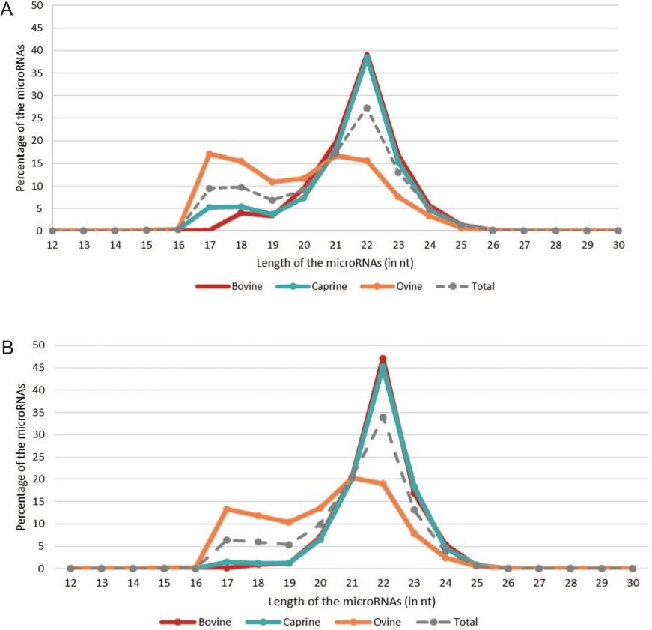
Figure 4 microRNA length distributions across species. The red, blue and orange lines correspond to the percentages of ...
Notes:
Figure 4 microRNA length distributions across species. The red, blue and orange lines correspond to the percentages of bovine, caprine and ovine microRNAs, respectively, based on their length [in nucleotides (nt)]. The gray dotted line represents all the microRNAs listed in RumimiR. (A) Percentage of all sequences collected in RumimiR. (B) Percentage of sequences with a low false-positive score (code containing 0 and 1 `1’).
Unless provided in the caption above, the following copyright applies to the content of this slide: © The Author(s) 2019. Published by Oxford University Press.This is an Open Access article distributed under the terms of the Creative Commons Attribution License (http://creativecommons.org/licenses/by/4.0/), which permits unrestricted reuse, distribution, and reproduction in any medium, provided the original work is properly cited.

Slide 5
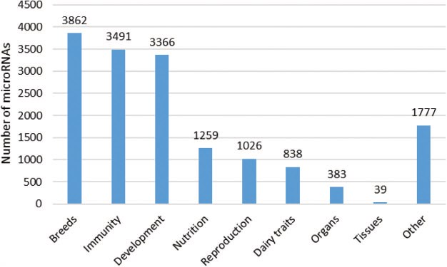
Figure 5 Number of microRNAs according to the conditions studied. The different topics presented here are in line with ...
Notes:
Figure 5 Number of microRNAs according to the conditions studied. The different topics presented here are in line with the issues addressed in the publications. A total of 78 publications were considered, and each article is mentioned only once. Each microRNA was counted several times, if they were described in several publications corresponding to different topics.
Unless provided in the caption above, the following copyright applies to the content of this slide: © The Author(s) 2019. Published by Oxford University Press.This is an Open Access article distributed under the terms of the Creative Commons Attribution License (http://creativecommons.org/licenses/by/4.0/), which permits unrestricted reuse, distribution, and reproduction in any medium, provided the original work is properly cited.

Slide 6
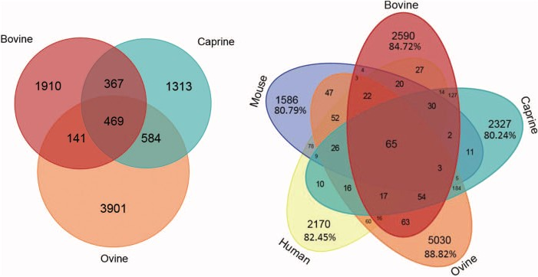
Figure 6 Number of microRNAs common to different species. Venn diagram showing bovine, caprine and ovine unique ...
Notes:
Figure 6 Number of microRNAs common to different species. Venn diagram showing bovine, caprine and ovine unique microRNAs listed in the RumimiR database. Venn diagram showing bovine, caprine and ovine microRNAs listed in the RumimiR database together with the human and mouse microRNAs listed in miRBase (release 22).
Unless provided in the caption above, the following copyright applies to the content of this slide: © The Author(s) 2019. Published by Oxford University Press.This is an Open Access article distributed under the terms of the Creative Commons Attribution License (http://creativecommons.org/licenses/by/4.0/), which permits unrestricted reuse, distribution, and reproduction in any medium, provided the original work is properly cited.

Slide 7
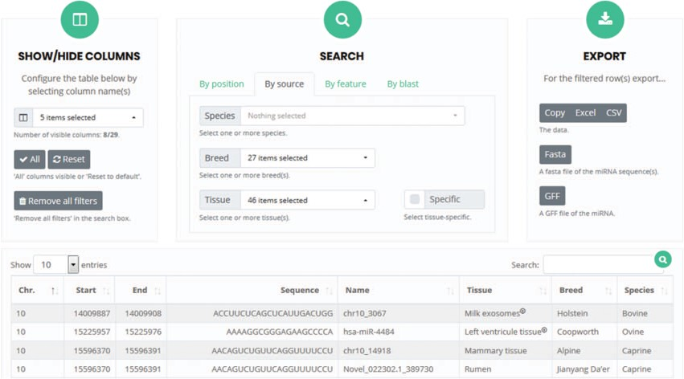
Figure 7 User interface for `search and browse’. Columns can be selected so that only specific features will be ...
Notes:
Figure 7 User interface for `search and browse’. Columns can be selected so that only specific features will be visible. The search box allows the detection of microRNAs present in the RumimiR database as a function of the selected choices. The results can be exported in different formats, such as Excel or Fasta.
Unless provided in the caption above, the following copyright applies to the content of this slide: © The Author(s) 2019. Published by Oxford University Press.This is an Open Access article distributed under the terms of the Creative Commons Attribution License (http://creativecommons.org/licenses/by/4.0/), which permits unrestricted reuse, distribution, and reproduction in any medium, provided the original work is properly cited.

