Slide 1
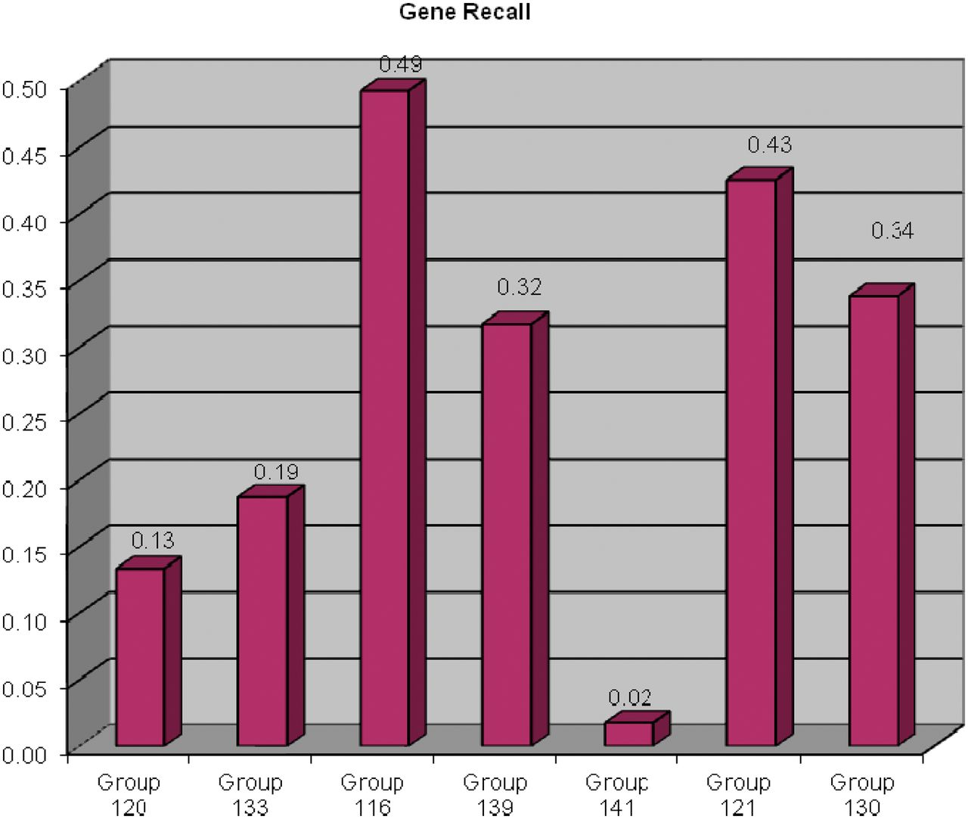
Figure 3 Gene recall results for each participating group. The ability for text-mining tools to recognize curated ...
Notes:
Figure 3 Gene recall results for each participating group. The ability for text-mining tools to recognize curated genes was measured; terms and synonyms to terms were counted as matches. Gene recall ranged from 2% to 49%.
Unless provided in the caption above, the following copyright applies to the content of this slide: © The Author(s) 2012. Published by Oxford University Press.This is an Open Access article distributed under the terms of the Creative Commons Attribution License (http://creativecommons.org/licenses/by-nc/3.0/), which permits non-commercial reuse, distribution, and reproduction in any medium, provided the original work is properly cited. For commercial re-use, please contact journals.permissions@oup.com.

Slide 2
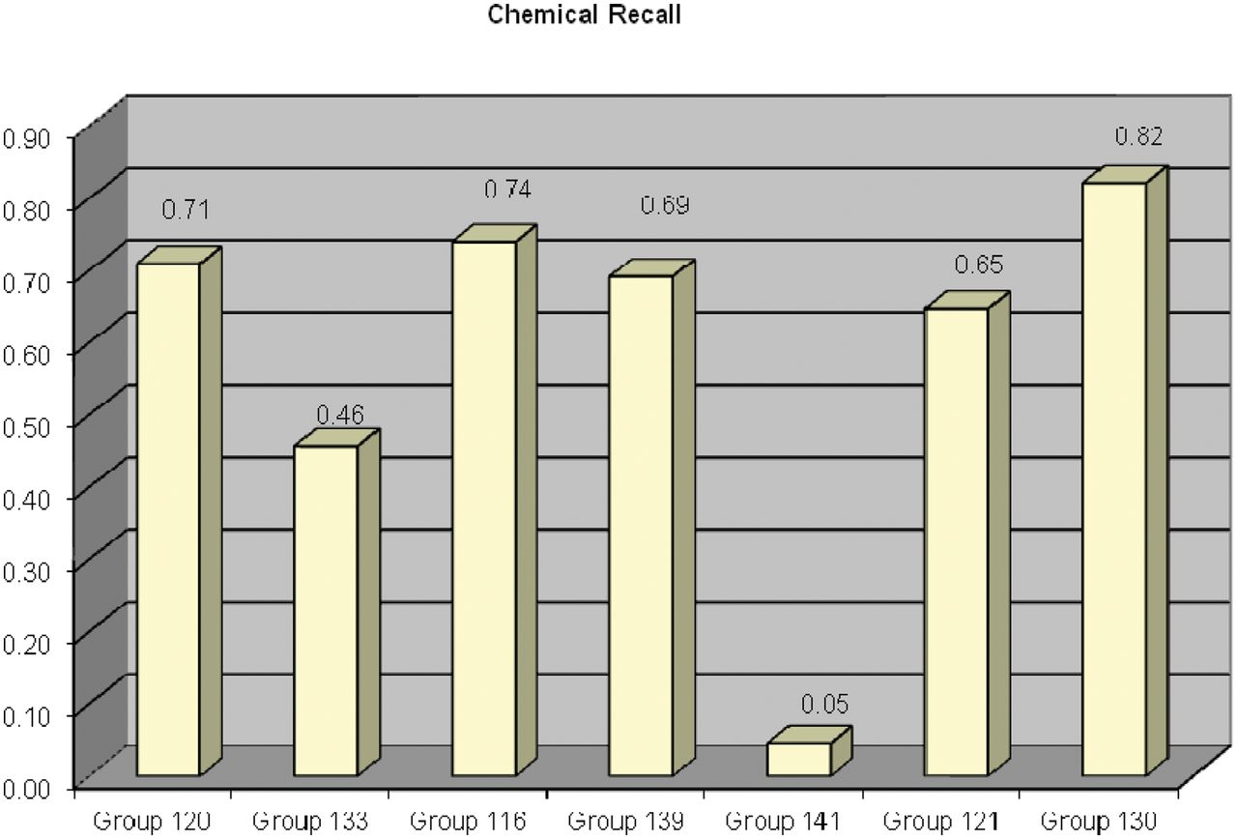
Figure 4 Chemical recall results for each participating group. The ability for text-mining tools to recognize curated ...
Notes:
Figure 4 Chemical recall results for each participating group. The ability for text-mining tools to recognize curated chemicals was measured; terms and synonyms to terms were counted as matches. Chemical recall ranged from 5% to 82%.
Unless provided in the caption above, the following copyright applies to the content of this slide: © The Author(s) 2012. Published by Oxford University Press.This is an Open Access article distributed under the terms of the Creative Commons Attribution License (http://creativecommons.org/licenses/by-nc/3.0/), which permits non-commercial reuse, distribution, and reproduction in any medium, provided the original work is properly cited. For commercial re-use, please contact journals.permissions@oup.com.

Slide 3
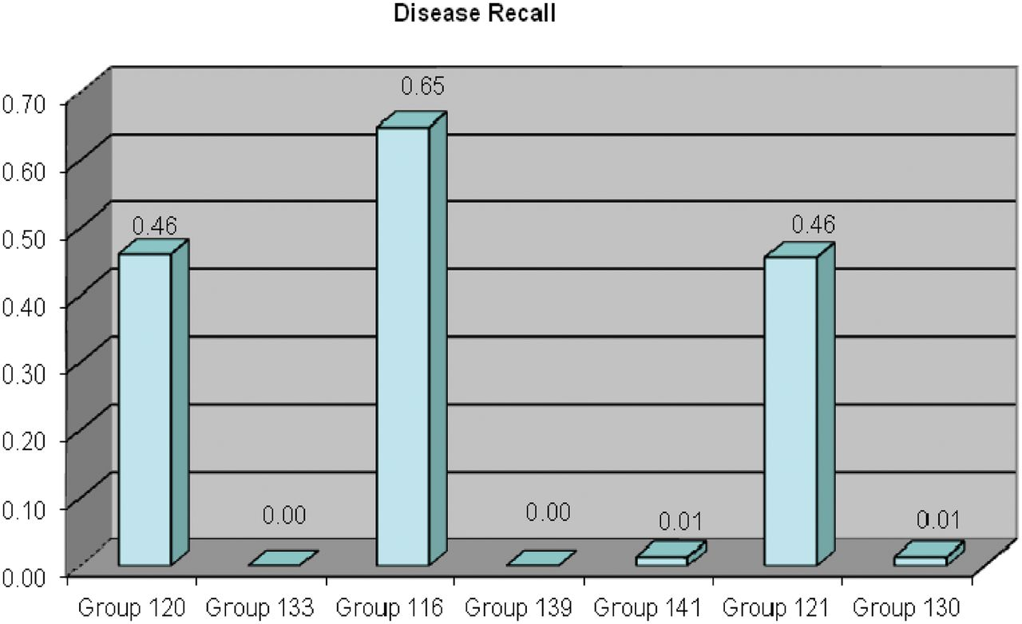
Figure 5 Disease recall results for each participating group. The ability for text-mining tools to recognize curated ...
Notes:
Figure 5 Disease recall results for each participating group. The ability for text-mining tools to recognize curated diseases was measured; terms and synonyms to terms were counted as matches. Disease recall ranged from <1% to 65%.
Unless provided in the caption above, the following copyright applies to the content of this slide: © The Author(s) 2012. Published by Oxford University Press.This is an Open Access article distributed under the terms of the Creative Commons Attribution License (http://creativecommons.org/licenses/by-nc/3.0/), which permits non-commercial reuse, distribution, and reproduction in any medium, provided the original work is properly cited. For commercial re-use, please contact journals.permissions@oup.com.

Slide 4
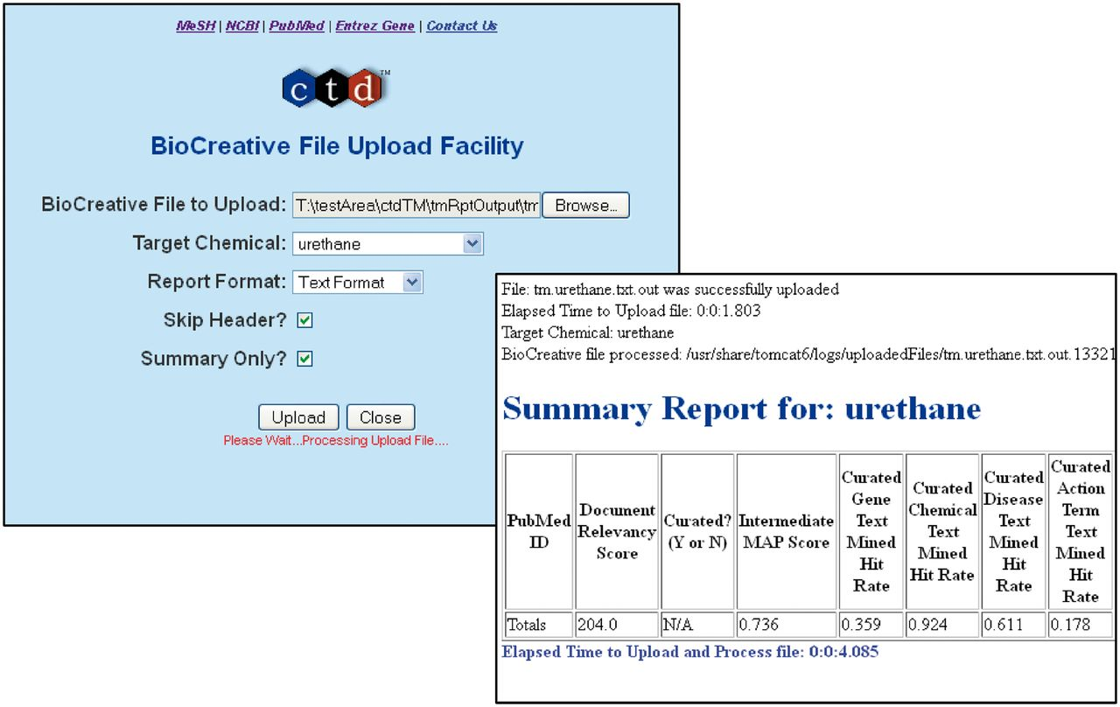
Figure 1 The BioCreative Track I File Upload Facility. A web interface was developed to allow participants to upload ...
Notes:
Figure 1 The BioCreative Track I File Upload Facility. A web interface was developed to allow participants to upload their results (back panel). Following successful uploads, a report was generated and returned to each participant that contained summary or detailed information for each dataset; a summary report is shown.
Unless provided in the caption above, the following copyright applies to the content of this slide: © The Author(s) 2012. Published by Oxford University Press.This is an Open Access article distributed under the terms of the Creative Commons Attribution License (http://creativecommons.org/licenses/by-nc/3.0/), which permits non-commercial reuse, distribution, and reproduction in any medium, provided the original work is properly cited. For commercial re-use, please contact journals.permissions@oup.com.

Slide 5
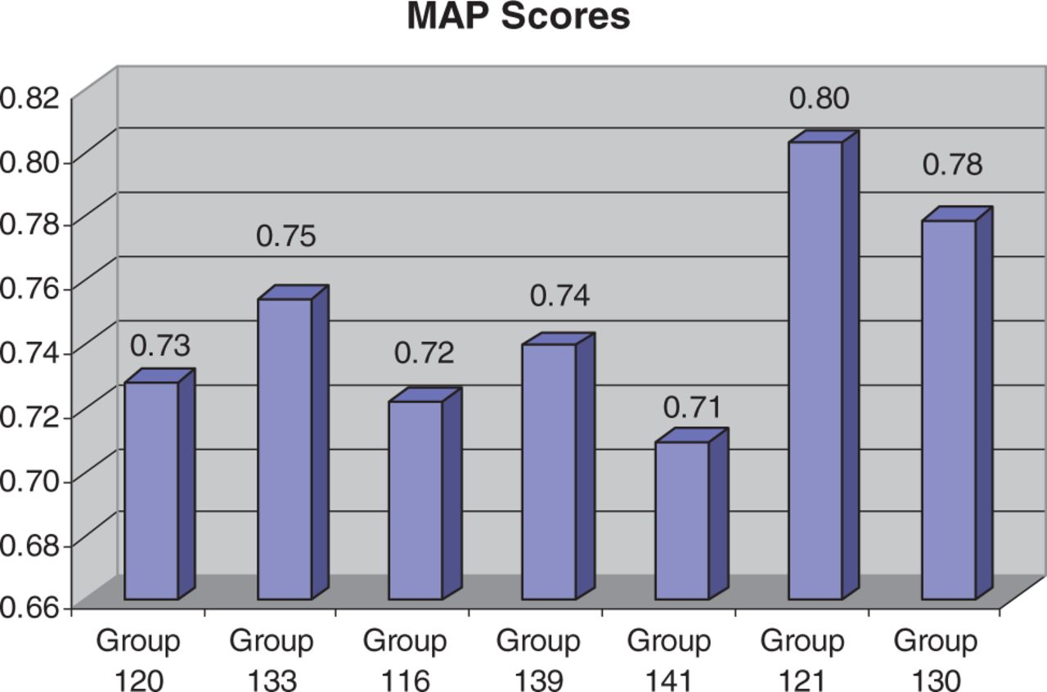
Figure 2 MAP (9) score results for each participating group. For MAP score calculations, an article was counted as ...
Notes:
Figure 2 MAP (9) score results for each participating group. For MAP score calculations, an article was counted as relevant if it had one or more associated curated interactions. Across the groups, MAP scores were fairly high and consistent, ranging from 71% to 80%.
Unless provided in the caption above, the following copyright applies to the content of this slide: © The Author(s) 2012. Published by Oxford University Press.This is an Open Access article distributed under the terms of the Creative Commons Attribution License (http://creativecommons.org/licenses/by-nc/3.0/), which permits non-commercial reuse, distribution, and reproduction in any medium, provided the original work is properly cited. For commercial re-use, please contact journals.permissions@oup.com.

Slide 6
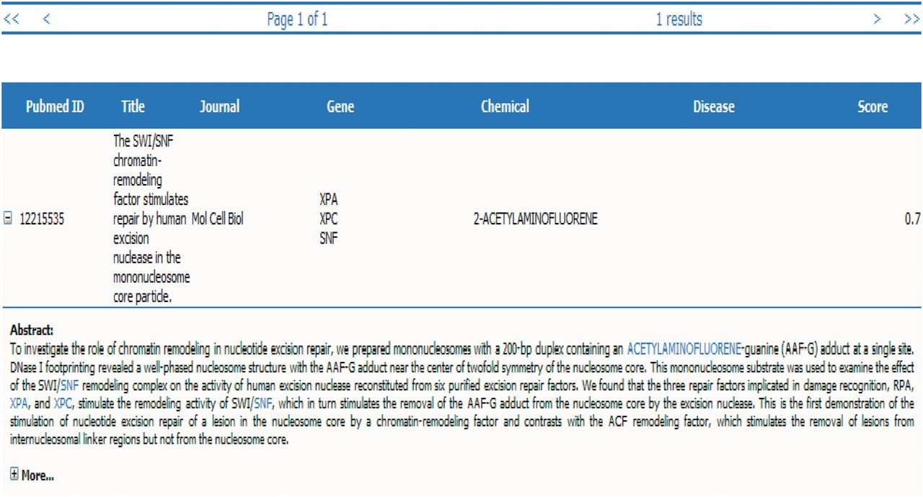
Figure 10 Group 120 web interface. A screenshot of Group 120’s web interface.
Notes:
Figure 10 Group 120 web interface. A screenshot of Group 120’s web interface.
Unless provided in the caption above, the following copyright applies to the content of this slide: © The Author(s) 2012. Published by Oxford University Press.This is an Open Access article distributed under the terms of the Creative Commons Attribution License (http://creativecommons.org/licenses/by-nc/3.0/), which permits non-commercial reuse, distribution, and reproduction in any medium, provided the original work is properly cited. For commercial re-use, please contact journals.permissions@oup.com.

Slide 7
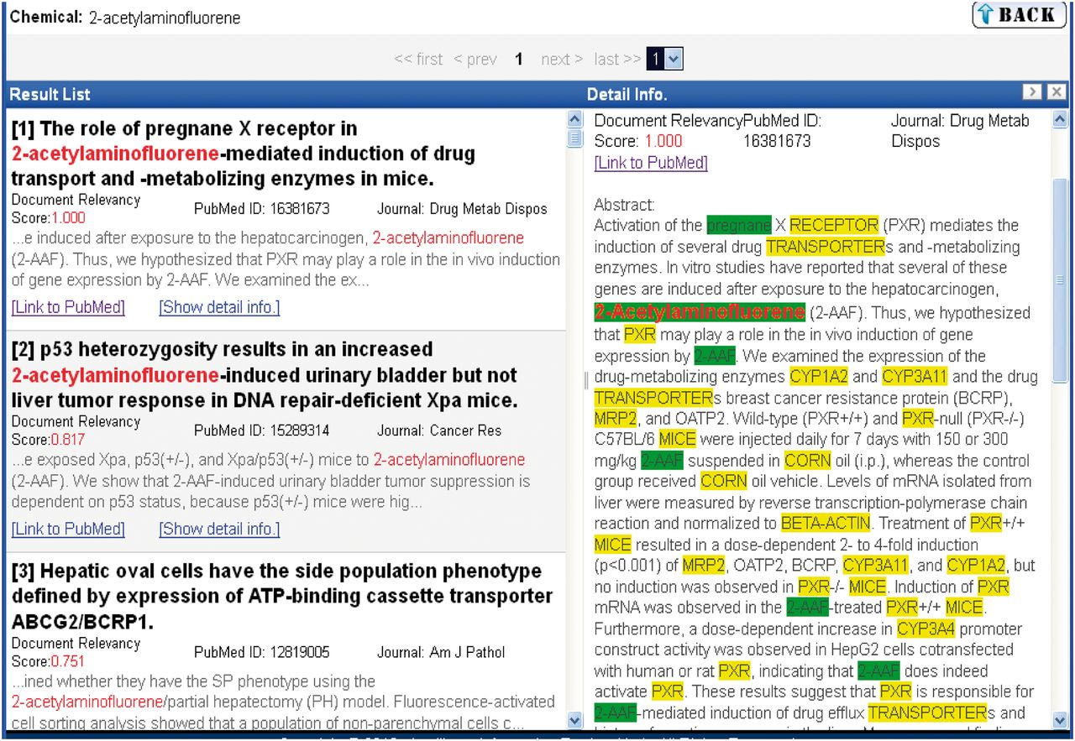
Figure 11 Group 139 web interface. A screenshot of Group 139’s web interface.
Notes:
Figure 11 Group 139 web interface. A screenshot of Group 139’s web interface.
Unless provided in the caption above, the following copyright applies to the content of this slide: © The Author(s) 2012. Published by Oxford University Press.This is an Open Access article distributed under the terms of the Creative Commons Attribution License (http://creativecommons.org/licenses/by-nc/3.0/), which permits non-commercial reuse, distribution, and reproduction in any medium, provided the original work is properly cited. For commercial re-use, please contact journals.permissions@oup.com.

Slide 8
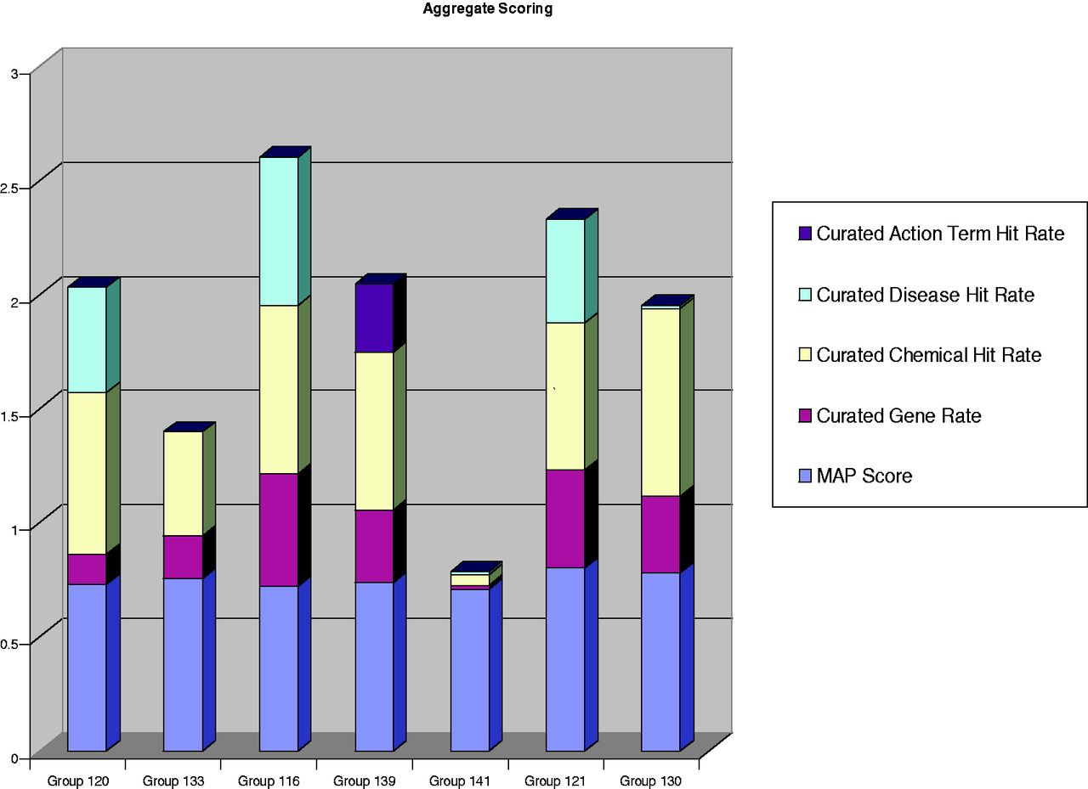
Figure 6 Aggregate metrics for each participating group. The results of MAP (9) scores and chemical, gene, disease and ...
Notes:
Figure 6 Aggregate metrics for each participating group. The results of MAP (9) scores and chemical, gene, disease and action term recall scores are aggregated onto a single bar graph for each participating group. Two of the groups clearly distinguished themselves with respect to aggregate benchmarking results. Group 121 held the highest MAP score (80%) while also delivering strong recall scores in the three major recall categories (chemicals, genes and diseases). Group 116 delivered the highest recall scores in two of the three major data categories (i.e. gene and disease recall). Three other groups (120, 139 and 130) had respectable recall scores in most, if not all, of the major data categories.
Unless provided in the caption above, the following copyright applies to the content of this slide: © The Author(s) 2012. Published by Oxford University Press.This is an Open Access article distributed under the terms of the Creative Commons Attribution License (http://creativecommons.org/licenses/by-nc/3.0/), which permits non-commercial reuse, distribution, and reproduction in any medium, provided the original work is properly cited. For commercial re-use, please contact journals.permissions@oup.com.

Slide 9
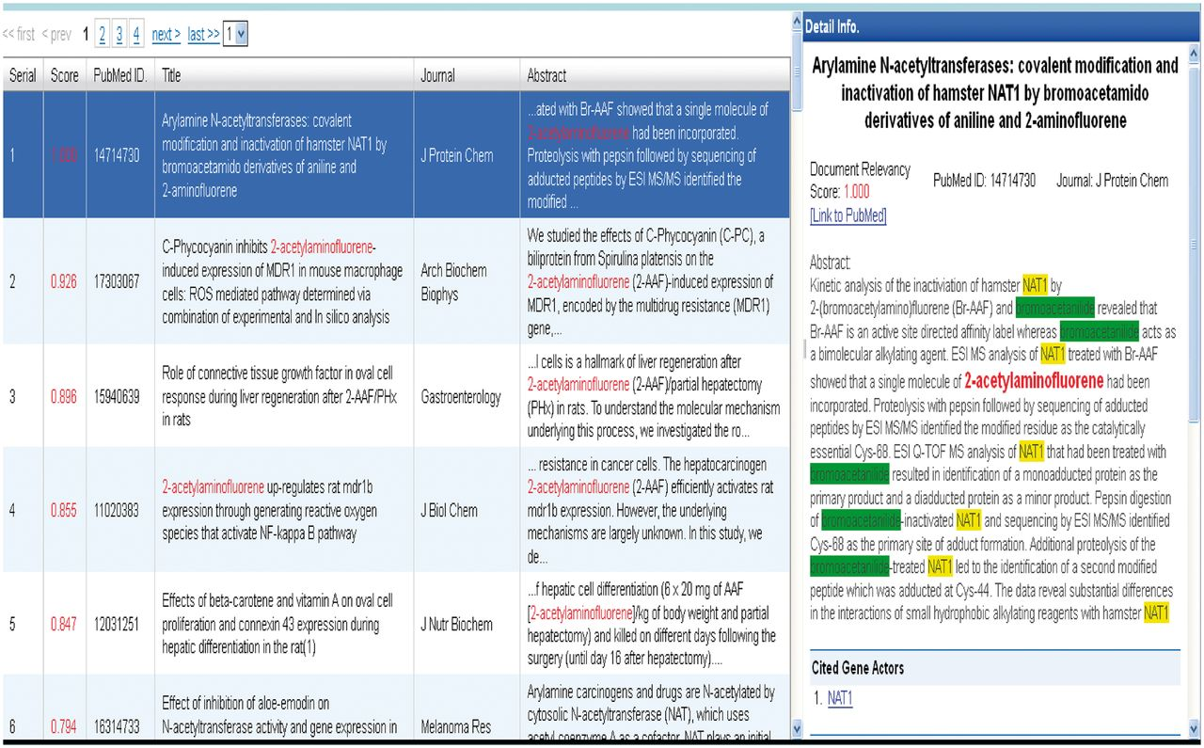
Figure 9 Group 133 web interface. A screenshot of Group 133’s web interface.
Notes:
Figure 9 Group 133 web interface. A screenshot of Group 133’s web interface.
Unless provided in the caption above, the following copyright applies to the content of this slide: © The Author(s) 2012. Published by Oxford University Press.This is an Open Access article distributed under the terms of the Creative Commons Attribution License (http://creativecommons.org/licenses/by-nc/3.0/), which permits non-commercial reuse, distribution, and reproduction in any medium, provided the original work is properly cited. For commercial re-use, please contact journals.permissions@oup.com.

Slide 10
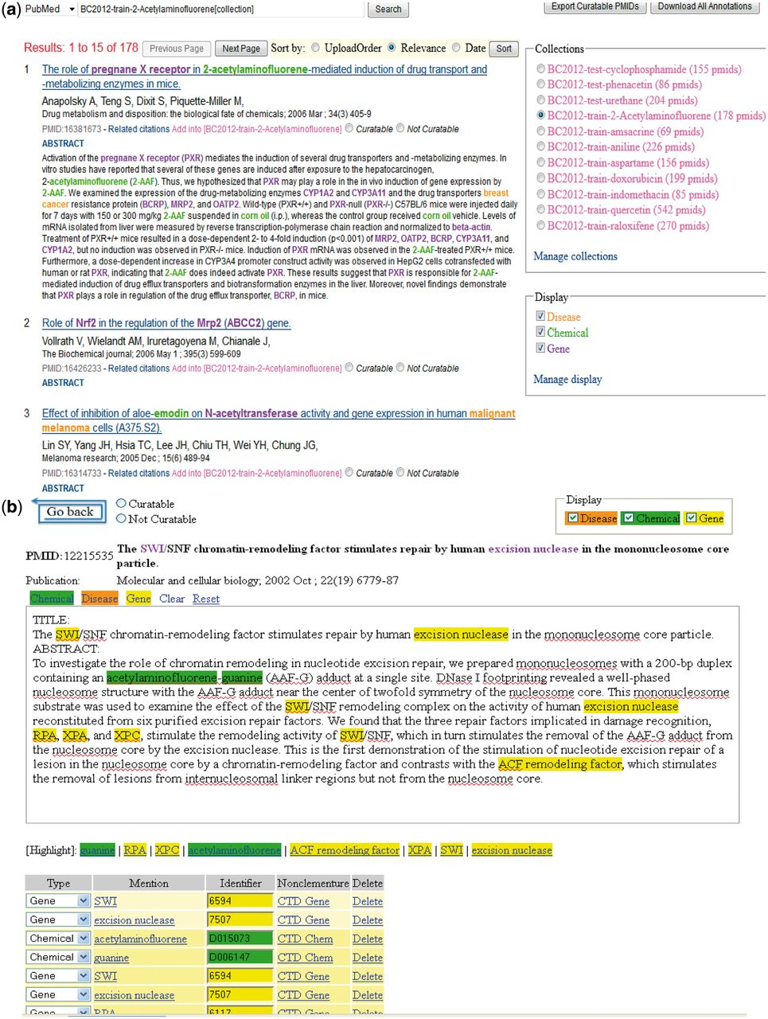
Figure 7 (a) Group 121 web interface. A screenshot of Group 121’s ranked list of chemicals for curation in their web ...
Notes:
Figure 7 (a) Group 121 web interface. A screenshot of Group 121’s ranked list of chemicals for curation in their web interface. (b) A screenshot of Group 121’s curation detail page in their web interface. (c) Screenshots of two of Group 121’s data management-related pages in their web interface.
Unless provided in the caption above, the following copyright applies to the content of this slide: © The Author(s) 2012. Published by Oxford University Press.This is an Open Access article distributed under the terms of the Creative Commons Attribution License (http://creativecommons.org/licenses/by-nc/3.0/), which permits non-commercial reuse, distribution, and reproduction in any medium, provided the original work is properly cited. For commercial re-use, please contact journals.permissions@oup.com.

Slide 11
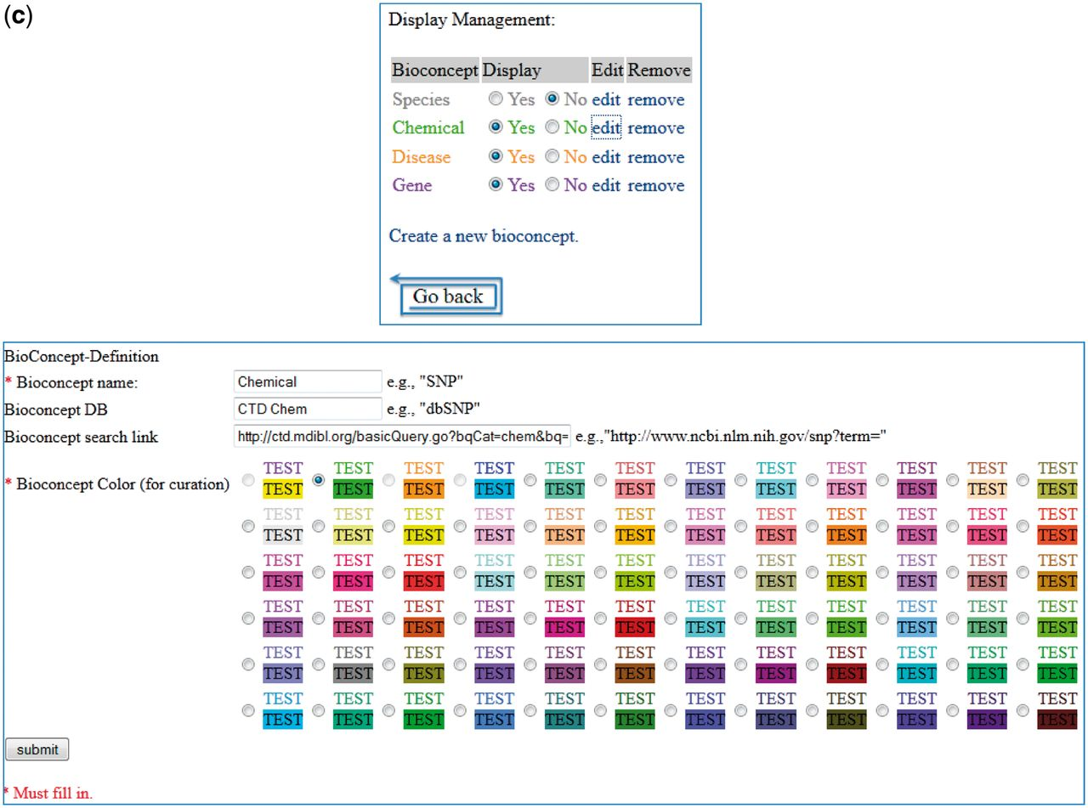
Figure 7 (a) Group 121 web interface. A screenshot of Group 121’s ranked list of chemicals for curation in their web ...
Notes:
Figure 7 (a) Group 121 web interface. A screenshot of Group 121’s ranked list of chemicals for curation in their web interface. (b) A screenshot of Group 121’s curation detail page in their web interface. (c) Screenshots of two of Group 121’s data management-related pages in their web interface.
Unless provided in the caption above, the following copyright applies to the content of this slide: © The Author(s) 2012. Published by Oxford University Press.This is an Open Access article distributed under the terms of the Creative Commons Attribution License (http://creativecommons.org/licenses/by-nc/3.0/), which permits non-commercial reuse, distribution, and reproduction in any medium, provided the original work is properly cited. For commercial re-use, please contact journals.permissions@oup.com.

Slide 12
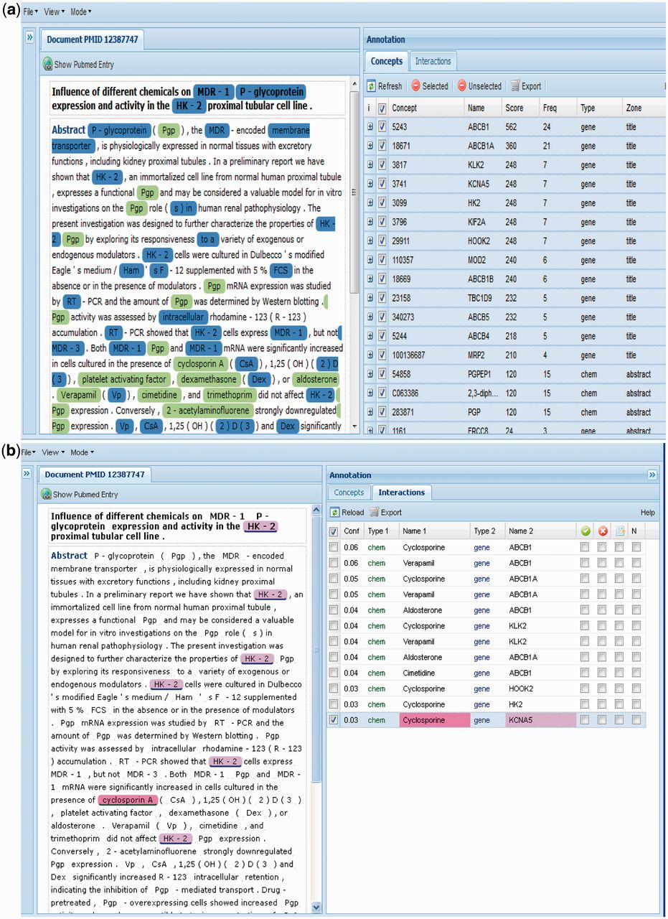
Figure 8 (a) Group 116 web interface. A screenshot of Group 116’s Concepts tab in their web interface. (b) A ...
Notes:
Figure 8 (a) Group 116 web interface. A screenshot of Group 116’s Concepts tab in their web interface. (b) A screenshot of Group 116’s Interactions tab in their web interface. (c) A screenshot of Group 116’s Terms tab in their web interface.
Unless provided in the caption above, the following copyright applies to the content of this slide: © The Author(s) 2012. Published by Oxford University Press.This is an Open Access article distributed under the terms of the Creative Commons Attribution License (http://creativecommons.org/licenses/by-nc/3.0/), which permits non-commercial reuse, distribution, and reproduction in any medium, provided the original work is properly cited. For commercial re-use, please contact journals.permissions@oup.com.

Slide 13
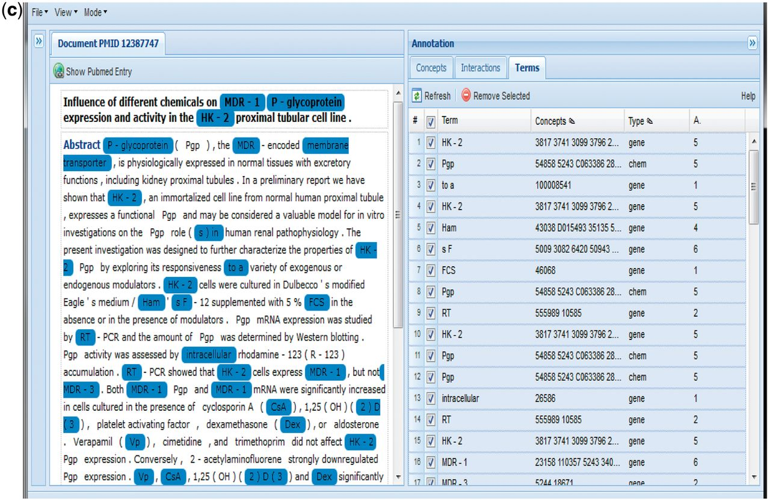
Figure 8 (a) Group 116 web interface. A screenshot of Group 116’s Concepts tab in their web interface. (b) A ...
Notes:
Figure 8 (a) Group 116 web interface. A screenshot of Group 116’s Concepts tab in their web interface. (b) A screenshot of Group 116’s Interactions tab in their web interface. (c) A screenshot of Group 116’s Terms tab in their web interface.
Unless provided in the caption above, the following copyright applies to the content of this slide: © The Author(s) 2012. Published by Oxford University Press.This is an Open Access article distributed under the terms of the Creative Commons Attribution License (http://creativecommons.org/licenses/by-nc/3.0/), which permits non-commercial reuse, distribution, and reproduction in any medium, provided the original work is properly cited. For commercial re-use, please contact journals.permissions@oup.com.

Slide 14
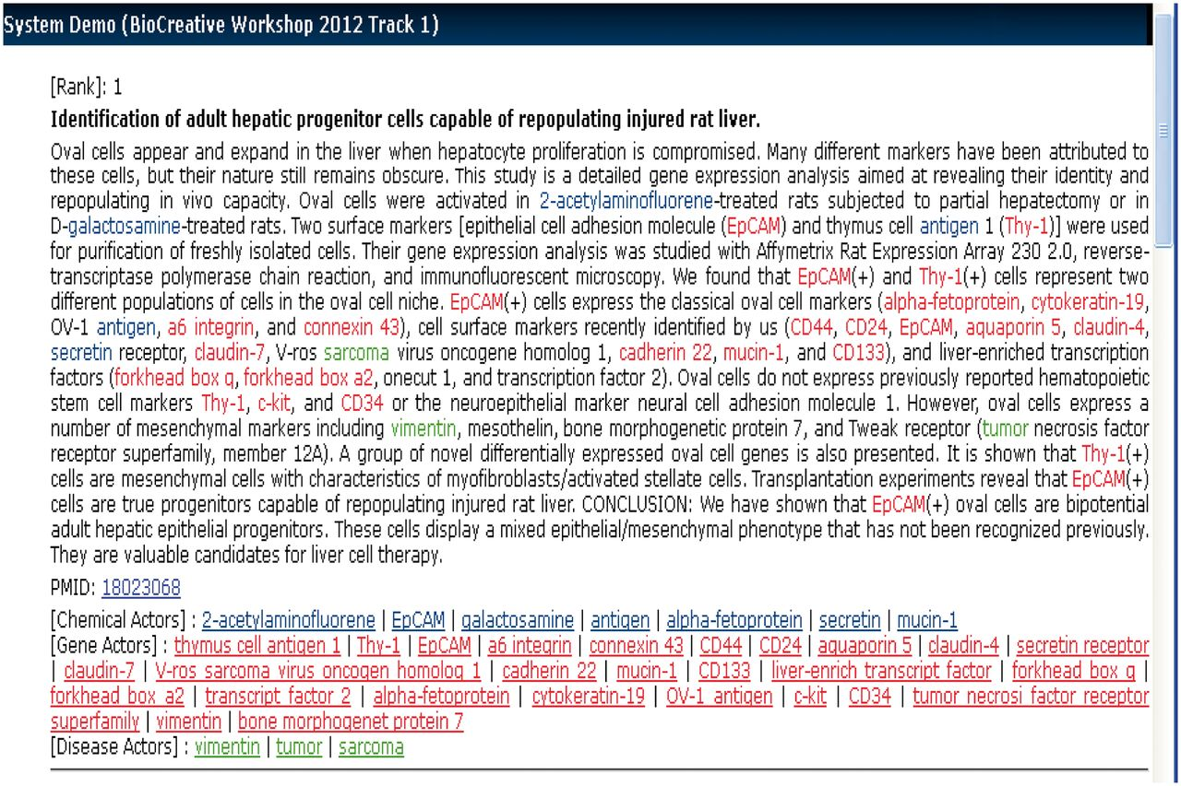
Figure 12 Group 130 web interface. A screenshot of Group 130’s web interface.
Notes:
Figure 12 Group 130 web interface. A screenshot of Group 130’s web interface.
Unless provided in the caption above, the following copyright applies to the content of this slide: © The Author(s) 2012. Published by Oxford University Press.This is an Open Access article distributed under the terms of the Creative Commons Attribution License (http://creativecommons.org/licenses/by-nc/3.0/), which permits non-commercial reuse, distribution, and reproduction in any medium, provided the original work is properly cited. For commercial re-use, please contact journals.permissions@oup.com.

Slide 15
Figure 13 Group 141 web interface. A screenshot of Group 141’s web interface.
Notes:
Figure 13 Group 141 web interface. A screenshot of Group 141’s web interface.
Unless provided in the caption above, the following copyright applies to the content of this slide: © The Author(s) 2012. Published by Oxford University Press.This is an Open Access article distributed under the terms of the Creative Commons Attribution License (http://creativecommons.org/licenses/by-nc/3.0/), which permits non-commercial reuse, distribution, and reproduction in any medium, provided the original work is properly cited. For commercial re-use, please contact journals.permissions@oup.com.

