Slide 1
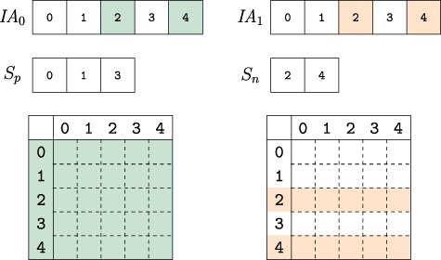
Fig. 5 Composing versions. The uncompressed IA array segments for the versions composed are compared. Colored ...
Notes:
Fig. 5 Composing versions. The uncompressed IA array segments for the versions composed are compared. Colored indexes represent elements that are changed from their parent version. The vertex indexes are partitioned into two sets based on whether they are identical across all composed versions $S_p$ or not $S_n$. When collecting the edge weights from each version, the indexes in $S_p$ only need to be accessed from one version while those in set $S_n$ must be accessed for each version, thus reducing the number of memory accesses to extract and compose network versions.
Unless provided in the caption above, the following copyright applies to the content of this slide: © The Author(s) 2020. Published by Oxford University Press.This is an Open Access article distributed under the terms of the Creative Commons Attribution License (http://creativecommons.org/licenses/by/4.0/), which permits unrestricted reuse, distribution, and reproduction in any medium, provided the original work is properly cited.

