Slide 1
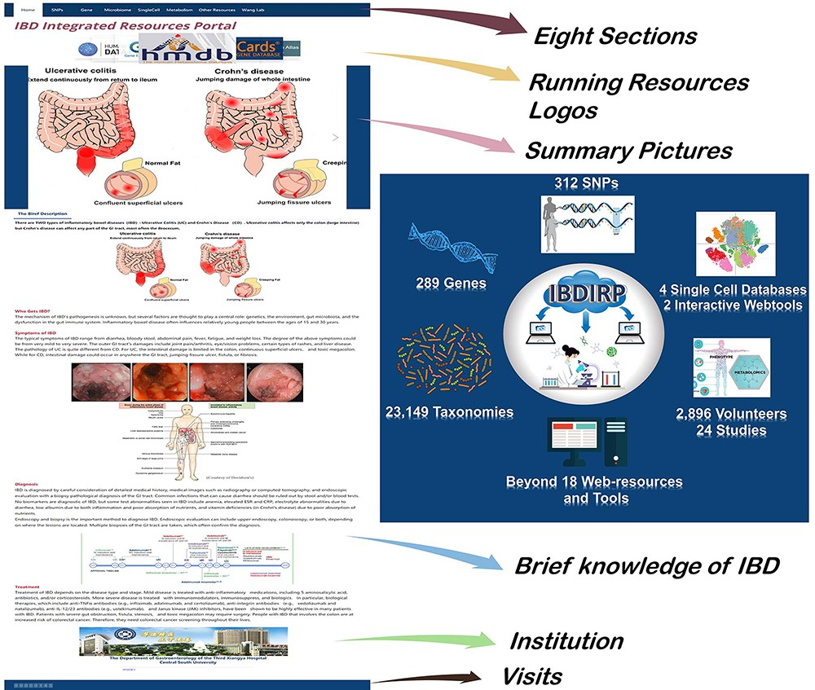
Figure 1. The homepage’s introduction and the overview of IBDIRP website. IBDIRP sorted and cataloged more than 320 ...
Notes:
Figure 1. The homepage’s introduction and the overview of IBDIRP website. IBDIRP sorted and cataloged more than 320 unique risk SNPs associated with IBD, 289 IBD-related genes, 153 IBD transcriptomics data, including 12 388 samples, 23 149 IBD-related taxonomic records, 24 IBD metabolomics studies with 2896 participants, 18 significant IBD web resources and other useful research resources. Alt Text: The homepage’s introduction and the brief overview of IBDIRP website.
Unless provided in the caption above, the following copyright applies to the content of this slide: © The Author(s) 2024. Published by Oxford University Press.This is an Open Access article distributed under the terms of the Creative Commons Attribution License (https://creativecommons.org/licenses/by/4.0/), which permits unrestricted reuse, distribution, and reproduction in any medium, provided the original work is properly cited.

Slide 2
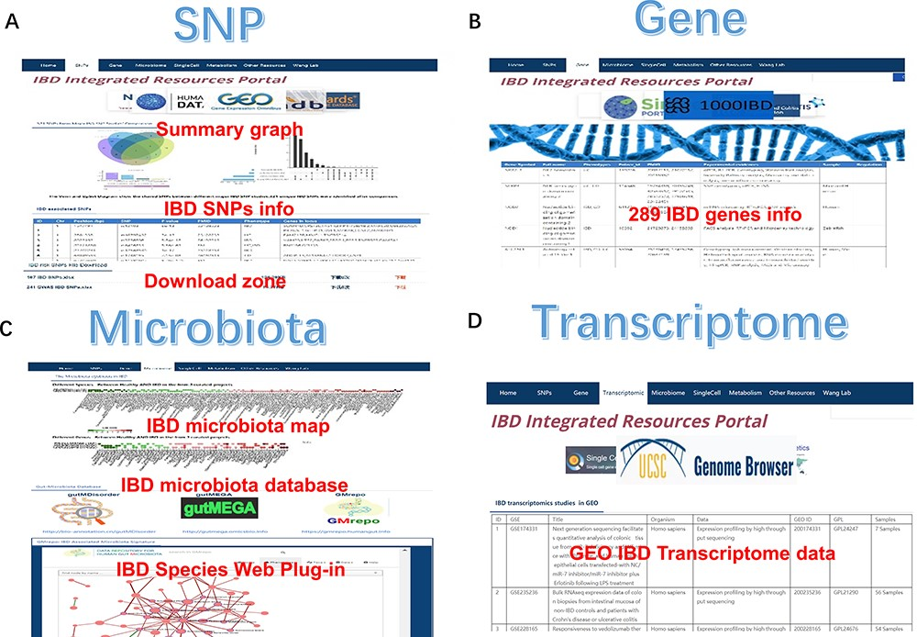
Figure 2. The SNP, gene, microbiota and transcriptome section of IBDIRP. (A) The SNP section conllected more than 320 ...
Notes:
Figure 2. The SNP, gene, microbiota and transcriptome section of IBDIRP. (A) The SNP section conllected more than 320 unique risk SNPs associated with IBD. (B) The gene section displays 289 IBD-related genes based on the database’s collection. (C) The sorted IBD-related microbiota data are available in microbiota section. (D) The transcriptome section displays 153 IBD-related transcriptome data. Alt Text: The brief introduction of SNP, gene, microbiota and transcriptome section in IBDIRP website.
Unless provided in the caption above, the following copyright applies to the content of this slide: © The Author(s) 2024. Published by Oxford University Press.This is an Open Access article distributed under the terms of the Creative Commons Attribution License (https://creativecommons.org/licenses/by/4.0/), which permits unrestricted reuse, distribution, and reproduction in any medium, provided the original work is properly cited.

Slide 3
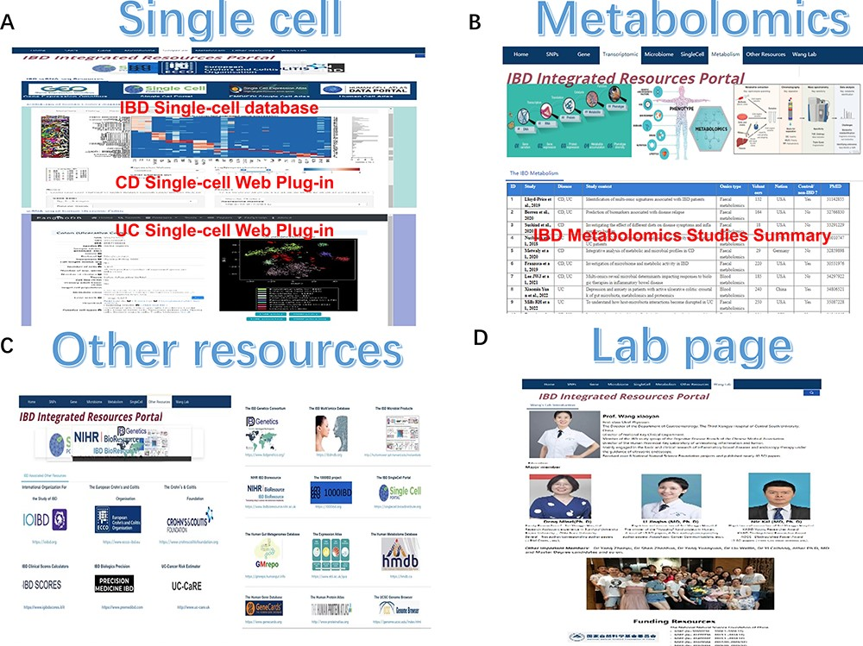
Figure 3. The single-cell, metabolomics, other resources and lab page section of IBDIRP. (A) The single-cell section ...
Notes:
Figure 3. The single-cell, metabolomics, other resources and lab page section of IBDIRP. (A) The single-cell section exhibited major IBD-related database and introduced IBD single-cell interactive visualization. (B) More than 24 primary recently published large-scale IBD metabolomics studies are displayed in the metabolomics section. (C) The other research resource listed 18 important IBD web resources. (D) The lab page introduces our lab briefly. Alt Text: The brief introduction of single-cell, metabolomics, other resources and lab page section in IBDIRP website.
Unless provided in the caption above, the following copyright applies to the content of this slide: © The Author(s) 2024. Published by Oxford University Press.This is an Open Access article distributed under the terms of the Creative Commons Attribution License (https://creativecommons.org/licenses/by/4.0/), which permits unrestricted reuse, distribution, and reproduction in any medium, provided the original work is properly cited.

