Slide 1
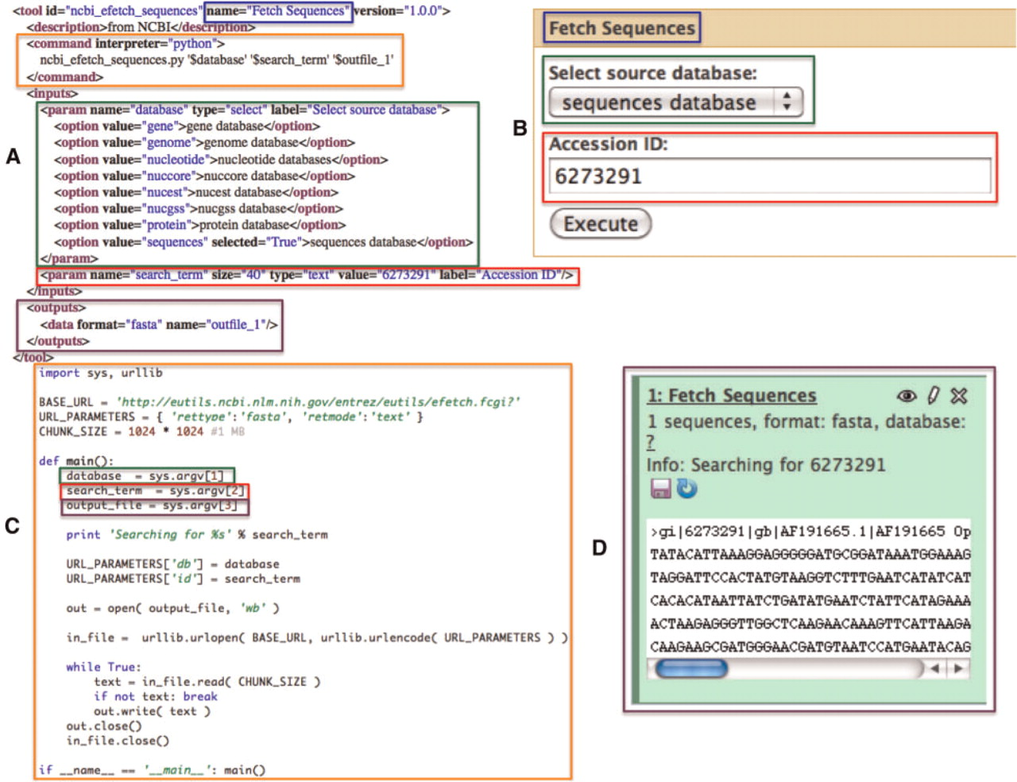
Figure 3. A simple NCBI sequence retrieval tool. This minimal tool interface (A: Galaxy tool description and B: Galaxy ...
Notes:
Figure 3. A simple NCBI sequence retrieval tool. This minimal tool interface (A: Galaxy tool description and B: Galaxy generated user interface) consists of a single textbox that allows the user to manually enter an accession number and a select list that allows the user to specify the target sequence database to search. When a user executes this tool, a simple script (C) is run by Galaxy which fetches the FASTA sequence data (D) for the user provided accession number. Color-matched boxes have been added to indicate the interrelatedness of various elements of the panels.
Unless provided in the caption above, the following copyright applies to the content of this slide: © The Author(s) 2011. Published by Oxford University Press.This is Open Access article distributed under the terms of the Creative Commons Attribution Non-Commercial License (http://creativecommons.org/licenses/by-nc/2.5), which permits unrestricted non-commercial use, distribution, and reproduction in any medium, provided the original work is properly cited.

