Slide 1
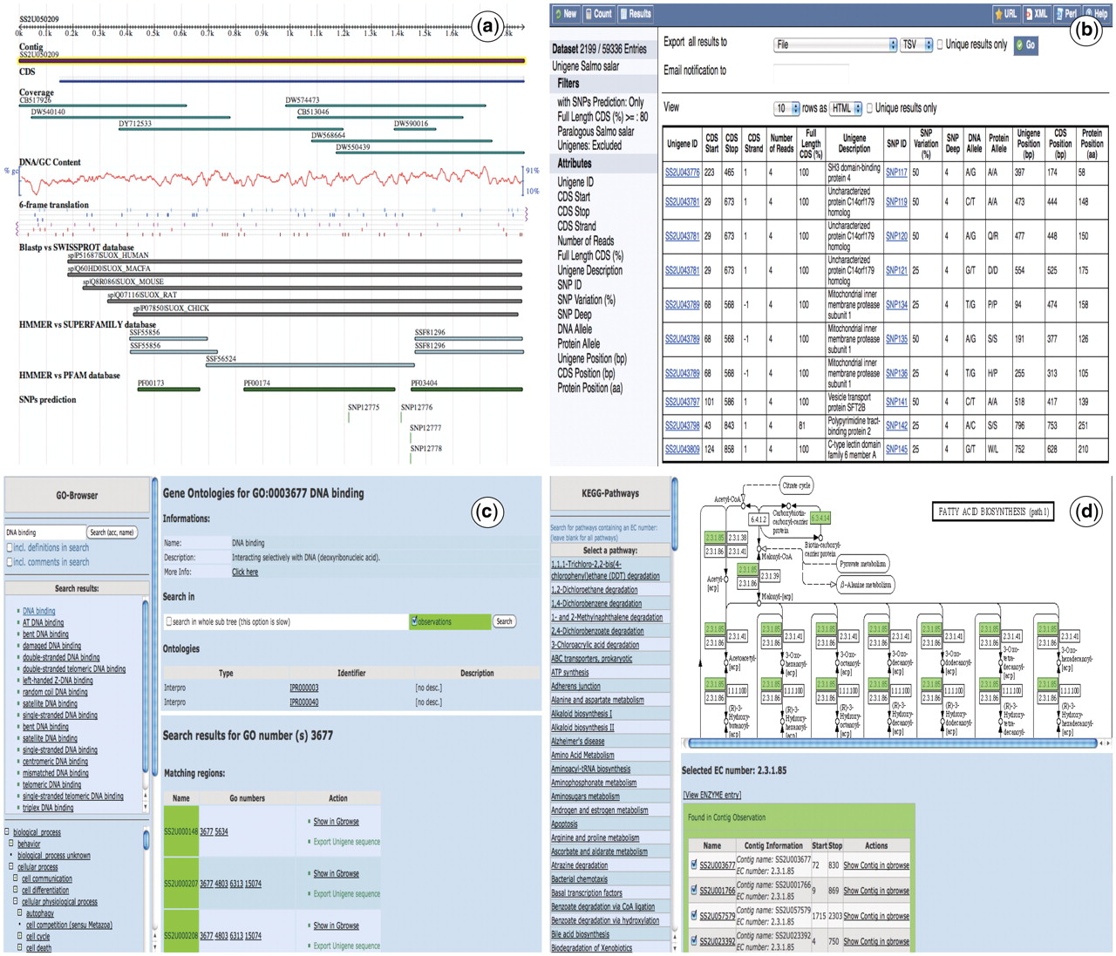
Figure 2. Snapshots of the SalmonDB web interface. (a) Unigene browser: the Unigene SS2U057650 is shown with several ...
Notes:
Figure 2. Snapshots of the SalmonDB web interface. (a) Unigene browser: the Unigene SS2U057650 is shown with several tracks (features), the blast alignment can be shown for each hit. (b) Biomart: the MartView interface is shown using the S. salar dataset and several filters selected on the left navigation panel. It also shows the ouptut table with multiple attributes shown on the left. (c) Go Browser: result of the search for GO term GO:003872 in the S. salar Unigene database. (d) KEGG Browser: the pathway associated to alanine and aspartate metabolism is shown using the S. salar Unigene database.
Unless provided in the caption above, the following copyright applies to the content of this slide: © The Author(s) 2011. Published by Oxford University Press.This is an Open Access article distributed under the terms of the Creative Commons Attribution Non-Commercial License (http://creativecommons.org/licenses/by-nc/3.0), which permits unrestricted non-commercial use, distribution, and reproduction in any medium, provided the original work is properly cited.

