Slide 1
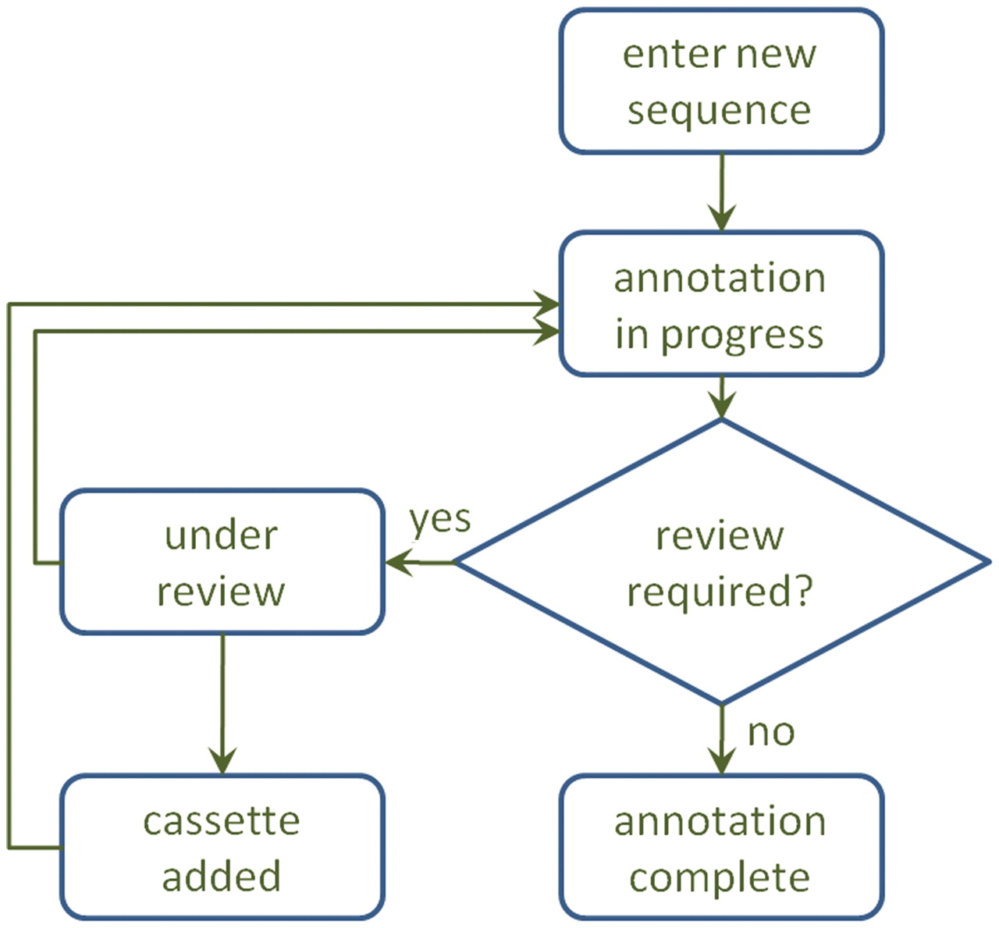
Figure 2. A diagram of the annotation process. After annotation, a sequence may be sent for review, which may result in ...
Notes:
Figure 2. A diagram of the annotation process. After annotation, a sequence may be sent for review, which may result in a manual adjustment to the annotation and/or inclusion of a new cassette in the database.
Unless provided in the caption above, the following copyright applies to the content of this slide: © The Author(s) 2011. Published by Oxford University Press.This is an Open Access article distributed under the terms of the Creative Commons Attribution Non-Commercial License (http://creativecommons.org/licenses/by-nc/3.0), which permits unrestricted non-commercial use, distribution, and reproduction in any medium, provided the original work is properly cited.

