Slide 1
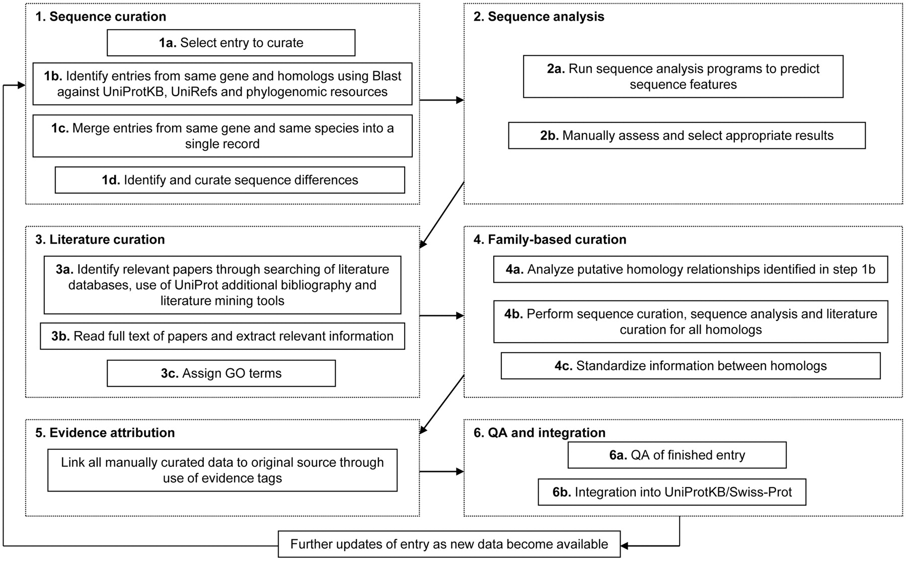
Figure 1. Flow diagram showing an outline of the UniProtKB manual curation process.
Notes:
Figure 1. Flow diagram showing an outline of the UniProtKB manual curation process.
Unless provided in the caption above, the following copyright applies to the content of this slide: © The Author(s) 2011. Published by Oxford University Press.This is Open Access article distributed under the terms of the Creative Commons Attribution Non-Commercial License (http://creativecommons.org/licenses/by-nc/2.5), which permits unrestricted non-commercial use, distribution, and reproduction in any medium, provided the original work is properly cited.

Slide 2
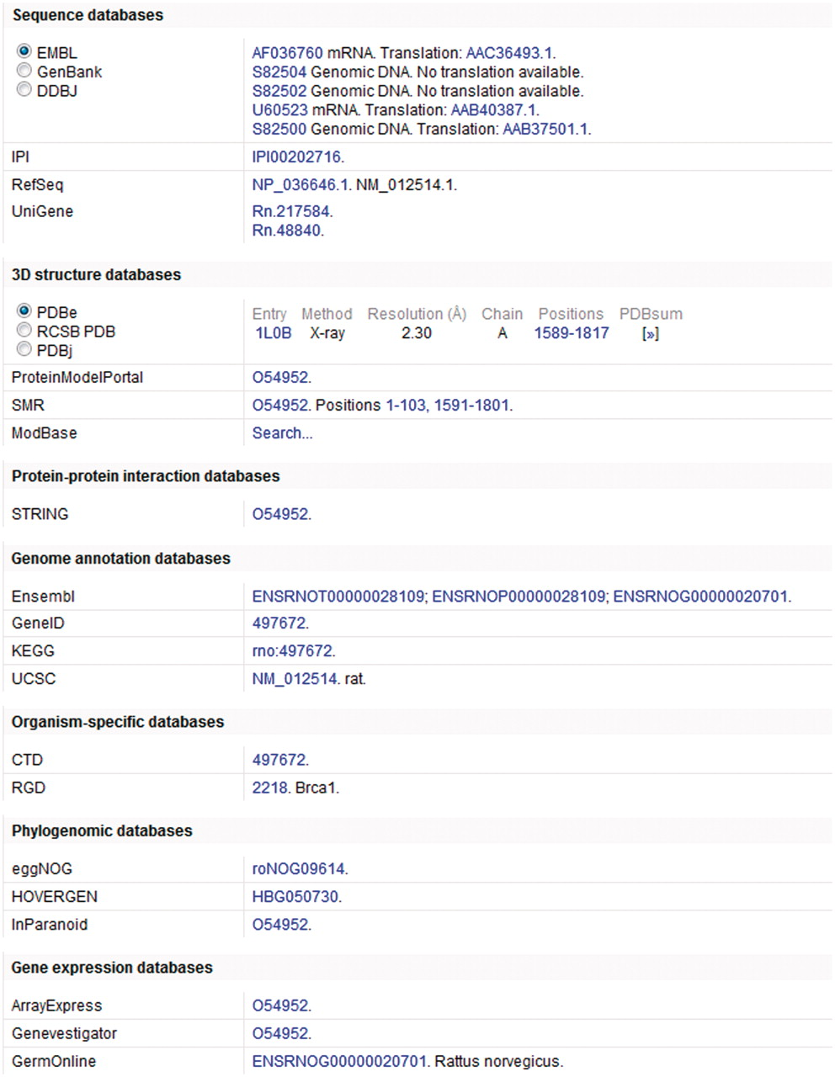
Figure 2. Cross-references in a UniProtKB entry. This figure shows a subset of the cross-references provided in ...
Notes:
Figure 2. Cross-references in a UniProtKB entry. This figure shows a subset of the cross-references provided in UniProtKB entry O54952.
Unless provided in the caption above, the following copyright applies to the content of this slide: © The Author(s) 2011. Published by Oxford University Press.This is Open Access article distributed under the terms of the Creative Commons Attribution Non-Commercial License (http://creativecommons.org/licenses/by-nc/2.5), which permits unrestricted non-commercial use, distribution, and reproduction in any medium, provided the original work is properly cited.

Slide 3
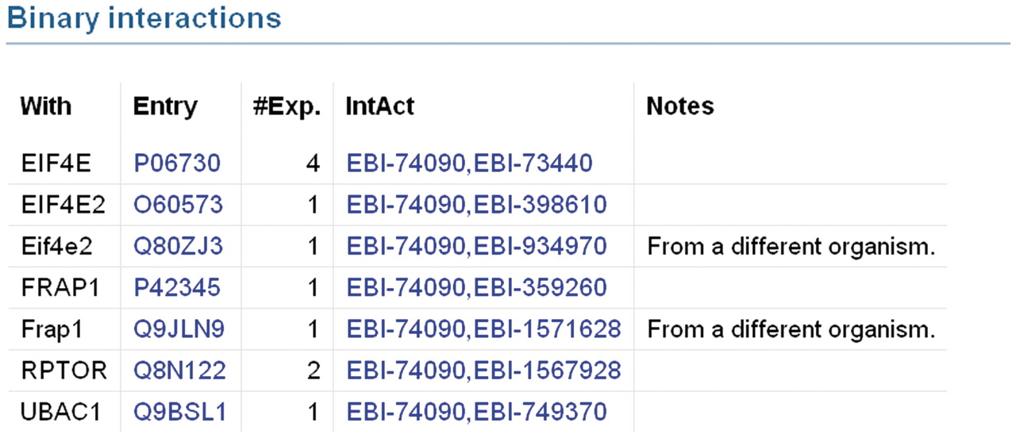
Figure 3. Binary protein–protein interactions in UniProtKB entry Q13541 which have been imported from IntAct. Each ...
Notes:
Figure 3. Binary protein–protein interactions in UniProtKB entry Q13541 which have been imported from IntAct. Each interaction is displayed on a separate line. The ‘With’ column contains the gene names of the interacting proteins. Accession numbers of interacting proteins are listed in the ‘Entry’ column. The ‘#Exp’ column provides the number of experiments in which an interaction has been observed. The ‘IntAct’ column contains the IntAct database accession numbers of the two interacting proteins. These are hyperlinked to provide users with access to the underlying data in the IntAct database. Specific information regarding the interaction may be present in the ‘Notes’ column.
Unless provided in the caption above, the following copyright applies to the content of this slide: © The Author(s) 2011. Published by Oxford University Press.This is Open Access article distributed under the terms of the Creative Commons Attribution Non-Commercial License (http://creativecommons.org/licenses/by-nc/2.5), which permits unrestricted non-commercial use, distribution, and reproduction in any medium, provided the original work is properly cited.

Slide 4
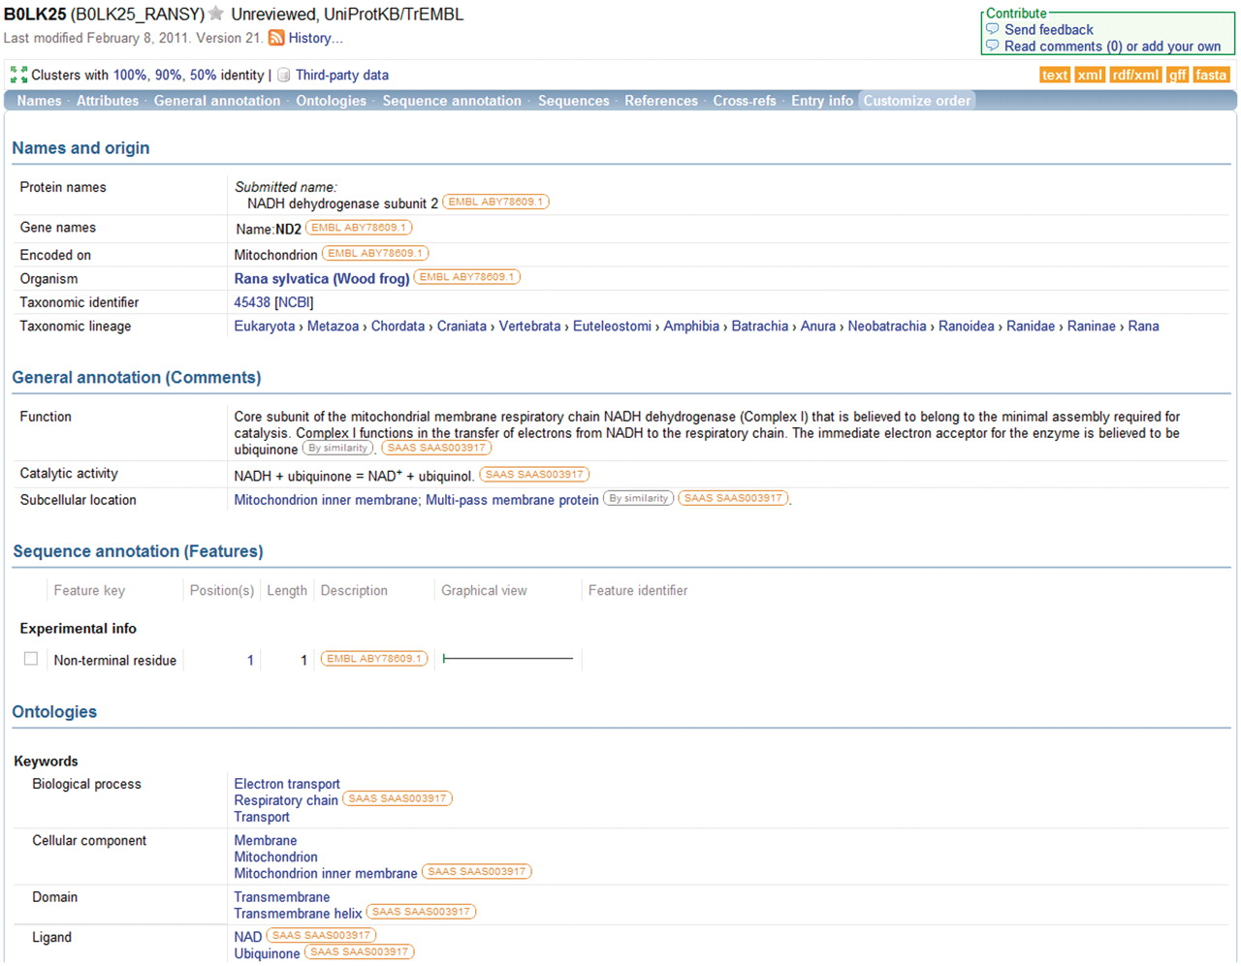
Figure 4. Information in a UniProtKB entry is linked to underlying data sources. The source of each data item is ...
Notes:
Figure 4. Information in a UniProtKB entry is linked to underlying data sources. The source of each data item is indicated and the source information is hyperlinked to allow users to access the original data source directly.
Unless provided in the caption above, the following copyright applies to the content of this slide: © The Author(s) 2011. Published by Oxford University Press.This is Open Access article distributed under the terms of the Creative Commons Attribution Non-Commercial License (http://creativecommons.org/licenses/by-nc/2.5), which permits unrestricted non-commercial use, distribution, and reproduction in any medium, provided the original work is properly cited.

Slide 5
Figure 5. Using the query builder on the UniProt website to refine a search. An initial query for insulin is further ...
Notes:
Figure 5. Using the query builder on the UniProt website to refine a search. An initial query for insulin is further refined using the query builder to include a taxonomic restriction.
Unless provided in the caption above, the following copyright applies to the content of this slide: © The Author(s) 2011. Published by Oxford University Press.This is Open Access article distributed under the terms of the Creative Commons Attribution Non-Commercial License (http://creativecommons.org/licenses/by-nc/2.5), which permits unrestricted non-commercial use, distribution, and reproduction in any medium, provided the original work is properly cited.

Slide 6
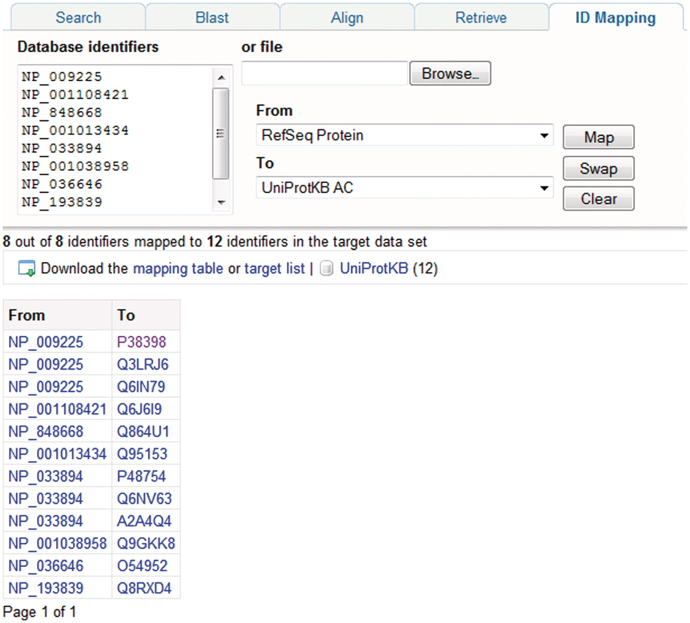
Figure 6. Mapping database identifiers using the identifier mapping tool on the UniProt website. The identifier mapping ...
Notes:
Figure 6. Mapping database identifiers using the identifier mapping tool on the UniProt website. The identifier mapping tool allows mapping of UniProt identifiers to identifiers in a database referenced from UniProt or vice versa. Here, a set of RefSeq identifiers are mapped to the corresponding UniProtKB entries.
Unless provided in the caption above, the following copyright applies to the content of this slide: © The Author(s) 2011. Published by Oxford University Press.This is Open Access article distributed under the terms of the Creative Commons Attribution Non-Commercial License (http://creativecommons.org/licenses/by-nc/2.5), which permits unrestricted non-commercial use, distribution, and reproduction in any medium, provided the original work is properly cited.

