Slide 1
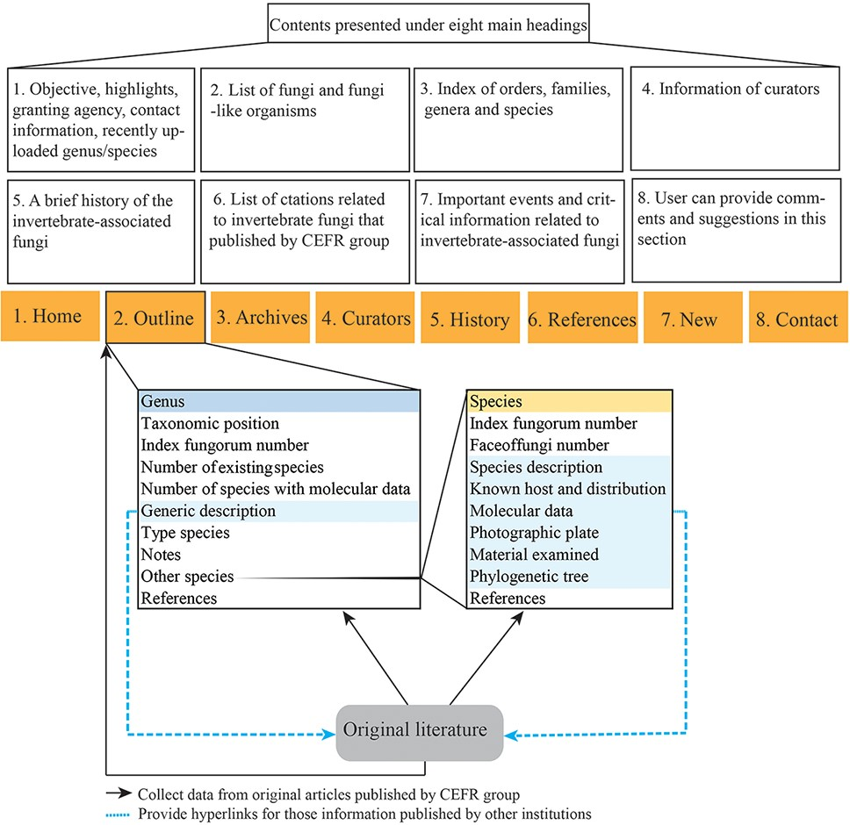
Figure 1. A schematic of the database structure.
Notes:
Figure 1. A schematic of the database structure.
Unless provided in the caption above, the following copyright applies to the content of this slide: © The Author(s) 2022. Published by Oxford University Press.This is an Open Access article distributed under the terms of the Creative Commons Attribution License (https://creativecommons.org/licenses/by/4.0/), which permits unrestricted reuse, distribution, and reproduction in any medium, provided the original work is properly cited.

Slide 2
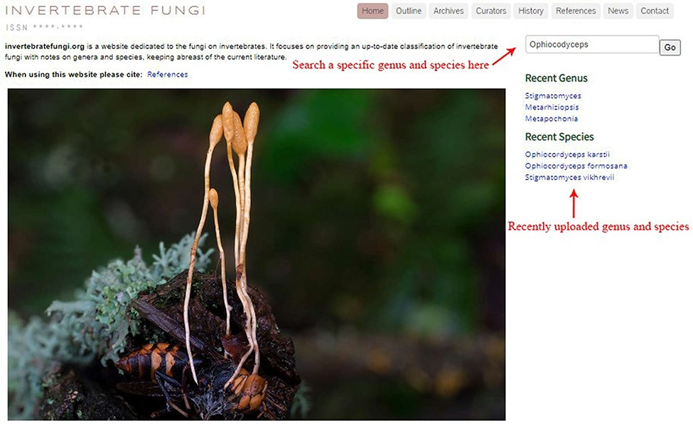
Figure 2. Top view of the homepage.
Notes:
Figure 2. Top view of the homepage.
Unless provided in the caption above, the following copyright applies to the content of this slide: © The Author(s) 2022. Published by Oxford University Press.This is an Open Access article distributed under the terms of the Creative Commons Attribution License (https://creativecommons.org/licenses/by/4.0/), which permits unrestricted reuse, distribution, and reproduction in any medium, provided the original work is properly cited.

Slide 3
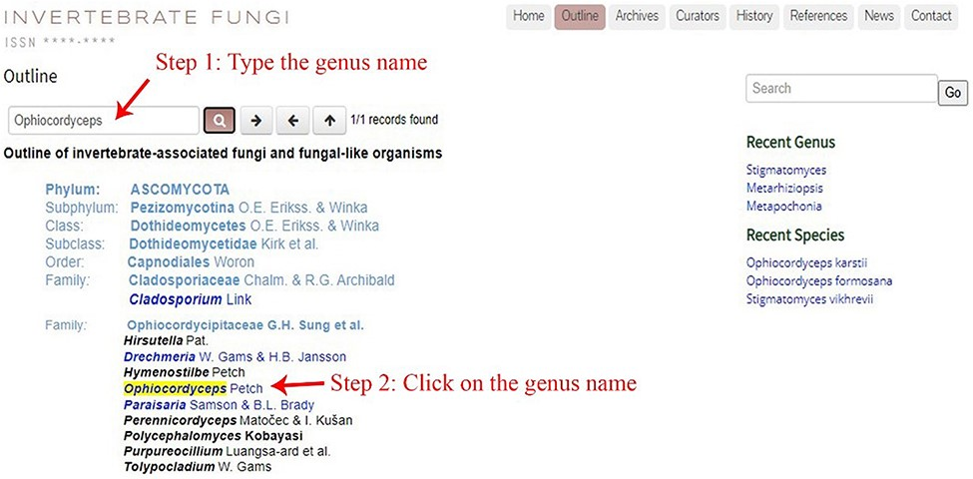
Figure 3. The outline of invertebrate-associated fungi and fungi-like organisms.
Notes:
Figure 3. The outline of invertebrate-associated fungi and fungi-like organisms.
Unless provided in the caption above, the following copyright applies to the content of this slide: © The Author(s) 2022. Published by Oxford University Press.This is an Open Access article distributed under the terms of the Creative Commons Attribution License (https://creativecommons.org/licenses/by/4.0/), which permits unrestricted reuse, distribution, and reproduction in any medium, provided the original work is properly cited.

Slide 4
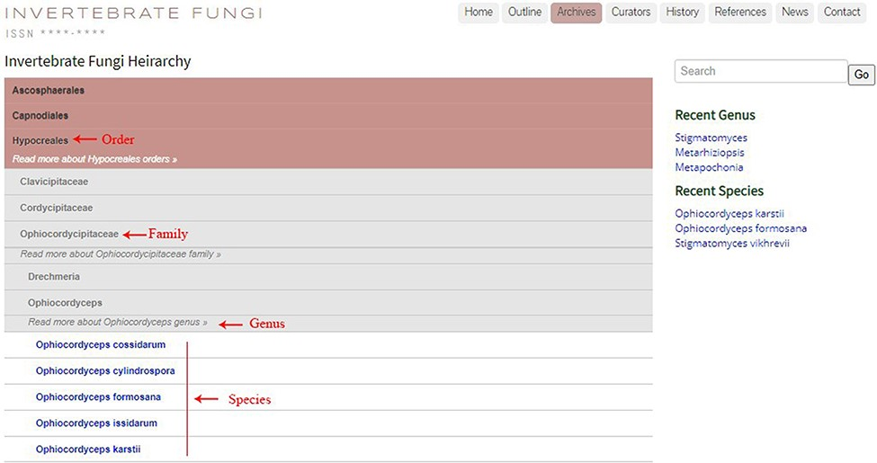
Figure 4. The ‘Archives’ section exhibiting fungal taxa in hierarchical order.
Notes:
Figure 4. The ‘Archives’ section exhibiting fungal taxa in hierarchical order.
Unless provided in the caption above, the following copyright applies to the content of this slide: © The Author(s) 2022. Published by Oxford University Press.This is an Open Access article distributed under the terms of the Creative Commons Attribution License (https://creativecommons.org/licenses/by/4.0/), which permits unrestricted reuse, distribution, and reproduction in any medium, provided the original work is properly cited.

Slide 5
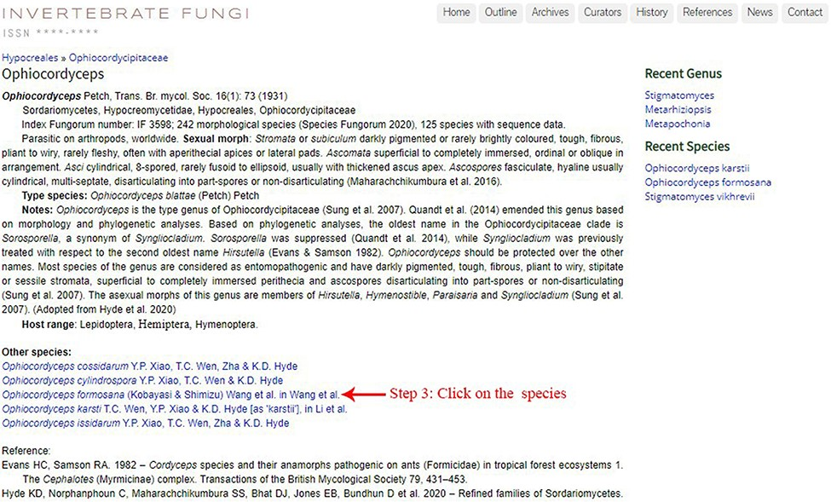
Figure 5. Information on the entomopathogenic genus Ophiocordyceps.
Notes:
Figure 5. Information on the entomopathogenic genus Ophiocordyceps.
Unless provided in the caption above, the following copyright applies to the content of this slide: © The Author(s) 2022. Published by Oxford University Press.This is an Open Access article distributed under the terms of the Creative Commons Attribution License (https://creativecommons.org/licenses/by/4.0/), which permits unrestricted reuse, distribution, and reproduction in any medium, provided the original work is properly cited.

Slide 6
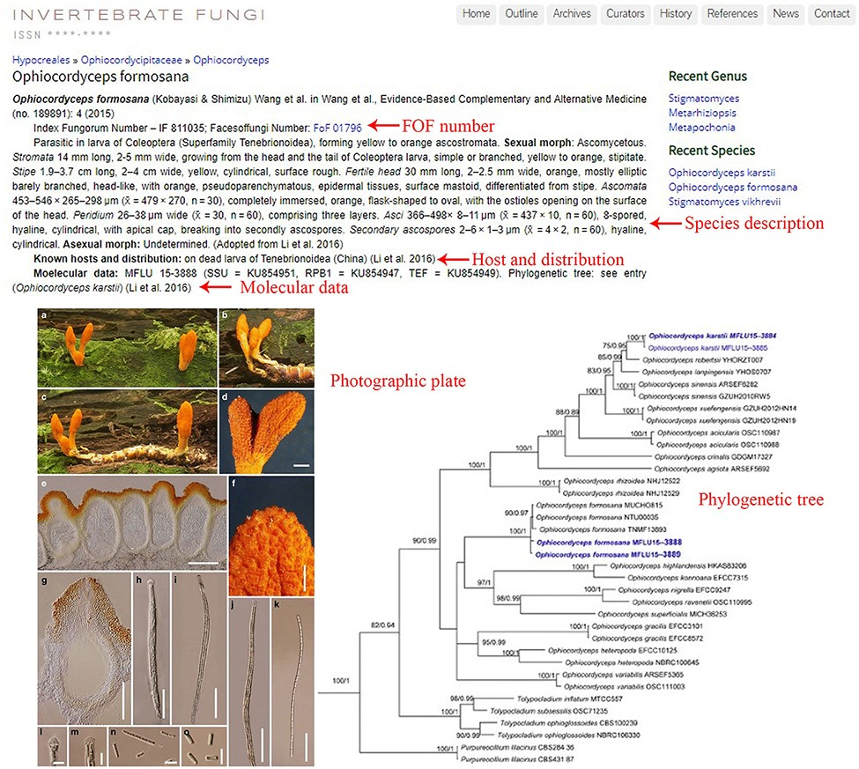
Figure 6. Information of the entomopathogenic species Ophiocordyceps formosana.
Notes:
Figure 6. Information of the entomopathogenic species Ophiocordyceps formosana.
Unless provided in the caption above, the following copyright applies to the content of this slide: © The Author(s) 2022. Published by Oxford University Press.This is an Open Access article distributed under the terms of the Creative Commons Attribution License (https://creativecommons.org/licenses/by/4.0/), which permits unrestricted reuse, distribution, and reproduction in any medium, provided the original work is properly cited.

Slide 7
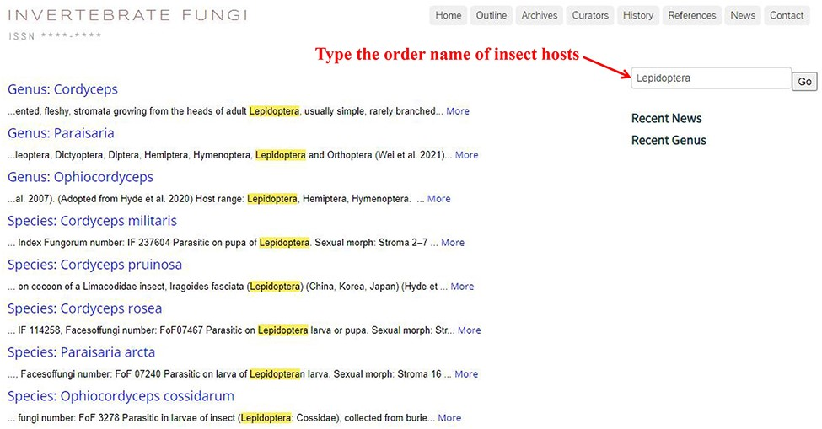
Figure 7. List of fungal species associated with Lepidopteran hosts.
Notes:
Figure 7. List of fungal species associated with Lepidopteran hosts.
Unless provided in the caption above, the following copyright applies to the content of this slide: © The Author(s) 2022. Published by Oxford University Press.This is an Open Access article distributed under the terms of the Creative Commons Attribution License (https://creativecommons.org/licenses/by/4.0/), which permits unrestricted reuse, distribution, and reproduction in any medium, provided the original work is properly cited.

