Slide 1
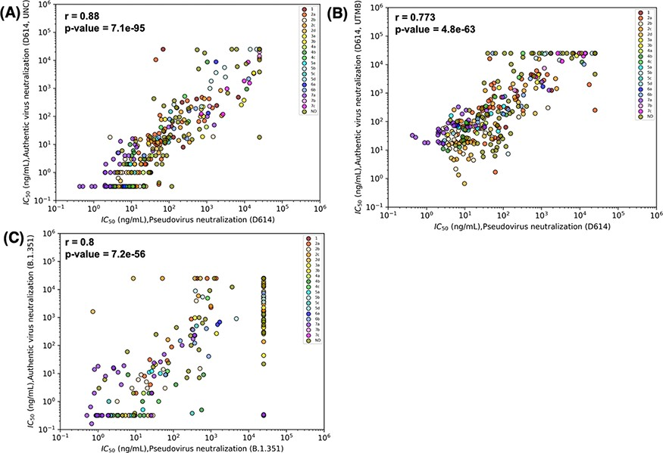
Figure 3. Results for pseudovirus and authentic virus neutralization assays strongly correlate. Correlations were ...
Notes:
Figure 3. Results for pseudovirus and authentic virus neutralization assays strongly correlate. Correlations were estimated by Spearman’s correlation coefficients and relate neutralization of pseudovirus bearing D614 and (A) authentic D614 virus (measured at University of North Carolina, Chapel Hill (UNC)), (B) D614 (measured at University of Texas Medical Branch at Galveston (UTMB)) and (C) authentic Beta (B.1.351) virus (measured at UNC). Data points are colored according to the epitope community to which the antibody belongs. ND: Epitope community not determined.
Unless provided in the caption above, the following copyright applies to the content of this slide: © The Author(s) 2023. Published by Oxford University Press.This is an Open Access article distributed under the terms of the Creative Commons Attribution License (https://creativecommons.org/licenses/by/4.0/), which permits unrestricted reuse, distribution, and reproduction in any medium, provided the original work is properly cited.

