Slide 1
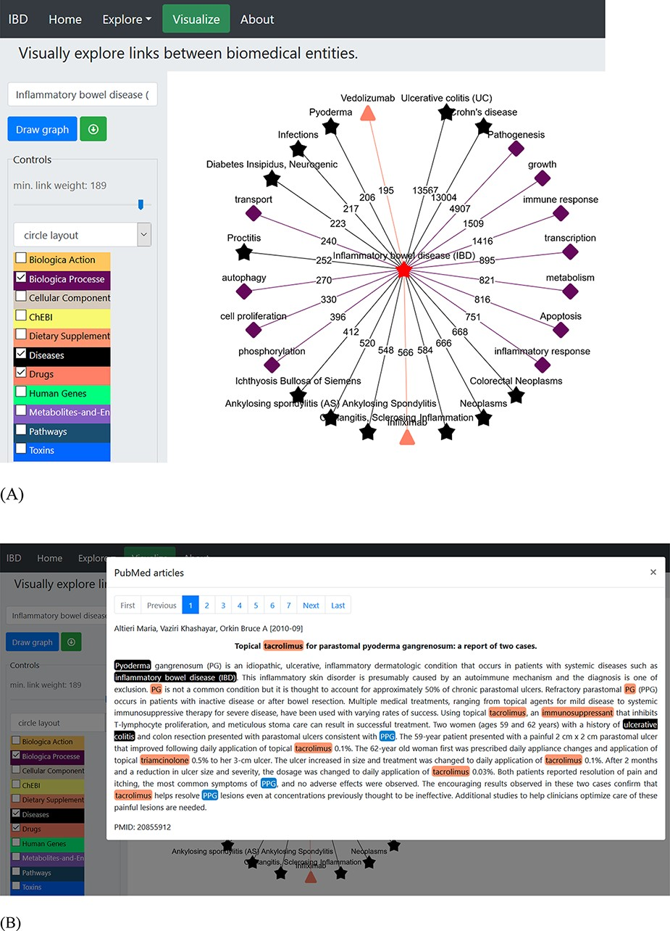
Figure 2. An example of a term-specific network. The network was generated using ‘inflammatory bowel disease’ as the ...
Notes:
Figure 2. An example of a term-specific network. The network was generated using ‘inflammatory bowel disease’ as the search term, and the network represents the connections with terms from three different dictionaries (biological process, diseases and drugs). (A) The layout of the displayed network is circle with colour-coded nodes representing the colour of the dictionary they belong to. The digits on the edges represent the number of PubMed records, where co-occurrence of the two terms was found. (B) The PubMed literature appearing as the edge linking ‘pyoderma and inflammatory bowel disease’ was clicked. The terms are colour-coded based on the colour of the dictionary they belong to (shown in the left panel).
Unless provided in the caption above, the following copyright applies to the content of this slide: © The Author(s) 2021. Published by Oxford University Press.This is an Open Access article distributed under the terms of the Creative Commons Attribution License (http://creativecommons.org/licenses/by/4.0/), which permits unrestricted reuse, distribution, and reproduction in any medium, provided the original work is properly cited.

