Slide 1
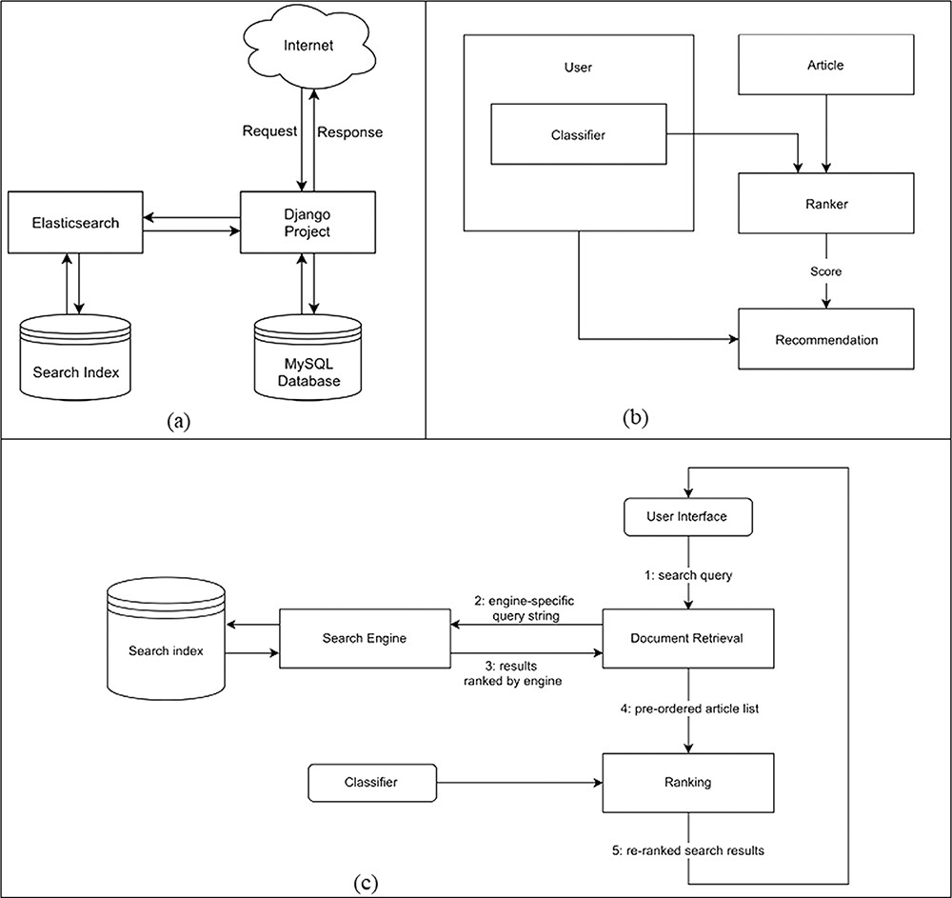
Figure 2. (a) High-level system design that shows how components of the system are connected and communicate with each ...
Notes:
Figure 2. (a) High-level system design that shows how components of the system are connected and communicate with each other. (b) Data flow diagram for the creation of recommendations. (c) Personalized search pipeline that shows how a query term is searched from the search engine and returned results are reordered by the classifier.
Unless provided in the caption above, the following copyright applies to the content of this slide: © The Author(s) 2022. Published by Oxford University Press.This is an Open Access article distributed under the terms of the Creative Commons Attribution-NonCommercial License (https://creativecommons.org/licenses/by-nc/4.0/), which permits non-commercial re-use, distribution, and reproduction in any medium, provided the original work is properly cited. For commercial re-use, please contact journals.permissions@oup.com

