Slide 1
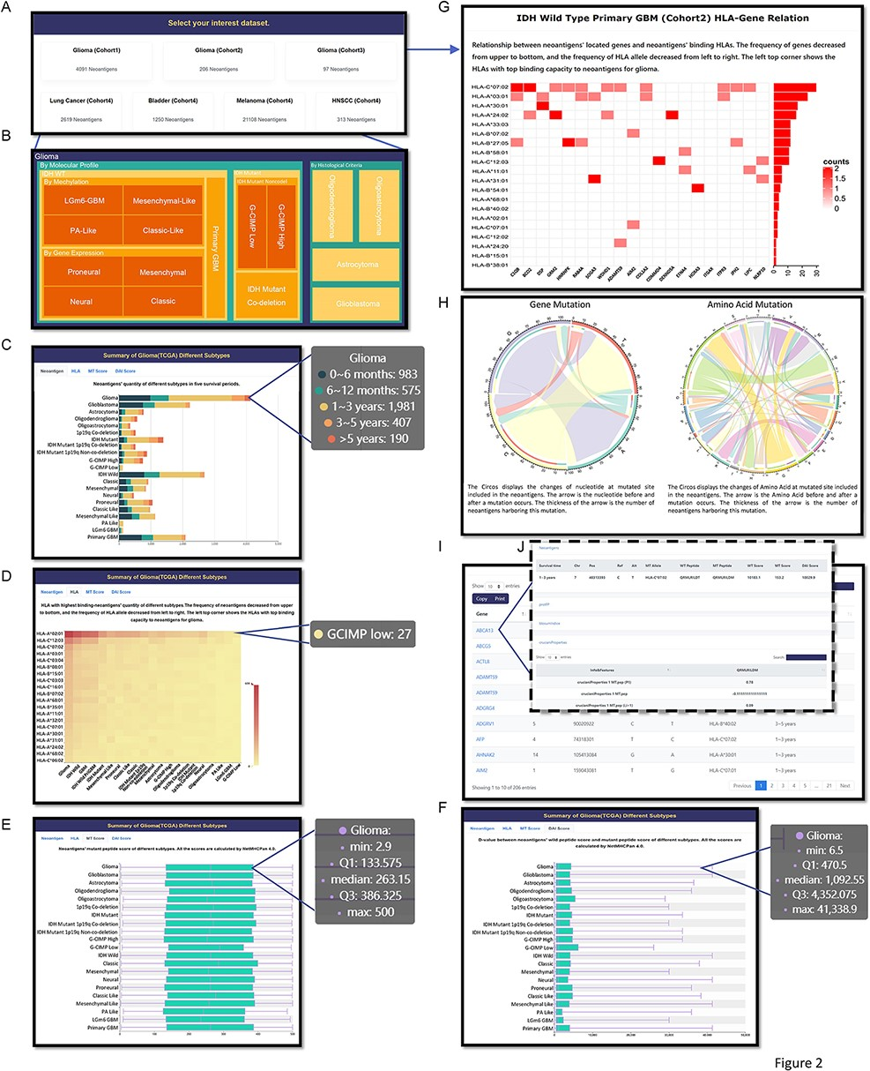
Figure 2. Browse page in GNIFdb showing information of neoantigens and their intrinsic features. (A) All cohorts. (B) ...
Notes:
Figure 2. Browse page in GNIFdb showing information of neoantigens and their intrinsic features. (A) All cohorts. (B) The glioma subtypes in Cohort 1. (C) Neoantigens’ quantity of different glioma subtypes with five survival periods in Cohort 1. (D) The frequency of neoantigens and their corresponding HLA-I subtypes in different glioma subtypes of Cohort 1. (E) The distribution of neoantigens’ binding affinity score with their corresponding HLA-I subtypes in different glioma subtypes of Cohort 1. (F) The distribution of neoantigens’ DAI score in different glioma subtypes of Cohort 1. (G) The relationship between genes generating neoantigens and the HLA-I interacting with neoantigens. (H) The distribution of nucleotide or amino acid changes at mutated site in the neoantigens. (I) The list of genes harboring neoantigens, associated mutation site, the corresponding HLA-I subtypes interacting with the neoantigens and the survival time periods. (J) The intrinsic features of neoantigens associated with each gene.
Unless provided in the caption above, the following copyright applies to the content of this slide: © The Author(s) 2022. Published by Oxford University Press.This is an Open Access article distributed under the terms of the Creative Commons Attribution License (https://creativecommons.org/licenses/by/4.0/), which permits unrestricted reuse, distribution, and reproduction in any medium, provided the original work is properly cited.

