Slide 1
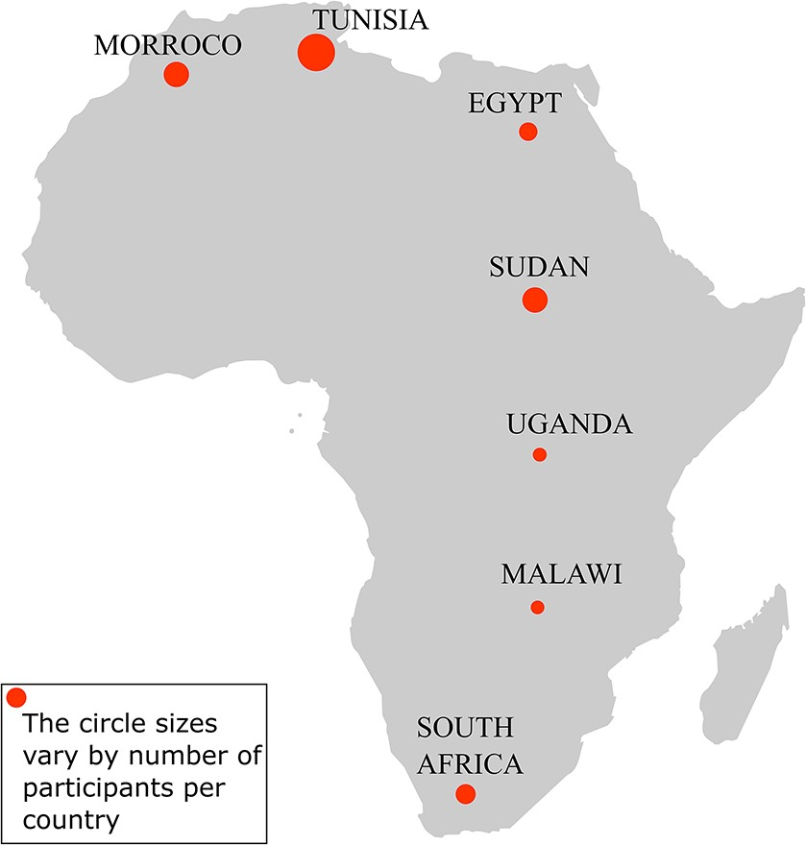
Figure 1. Participants’ representation by country in the hackathon. The hackathon involved 24 participants from seven ...
Notes:
Figure 1. Participants’ representation by country in the hackathon. The hackathon involved 24 participants from seven African countries: Tunisia (8), Morocco (4), Sudan (4), South Africa (3), Egypt (3), Uganda (1) and Malawi (1).
Unless provided in the caption above, the following copyright applies to the content of this slide: © The Author(s) 2021. Published by Oxford University Press.This is an Open Access article distributed under the terms of the Creative Commons Attribution License (http://creativecommons.org/licenses/by/4.0/), which permits unrestricted reuse, distribution, and reproduction in any medium, provided the original work is properly cited.

Slide 2
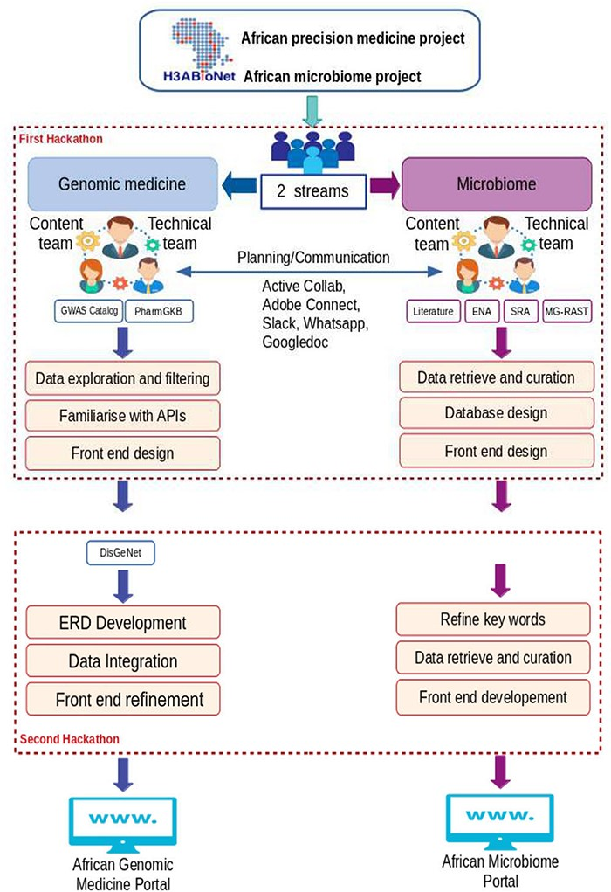
Figure 2. Main hackathons’ goals and components, including communication platforms.
Notes:
Figure 2. Main hackathons’ goals and components, including communication platforms.
Unless provided in the caption above, the following copyright applies to the content of this slide: © The Author(s) 2021. Published by Oxford University Press.This is an Open Access article distributed under the terms of the Creative Commons Attribution License (http://creativecommons.org/licenses/by/4.0/), which permits unrestricted reuse, distribution, and reproduction in any medium, provided the original work is properly cited.

Slide 3
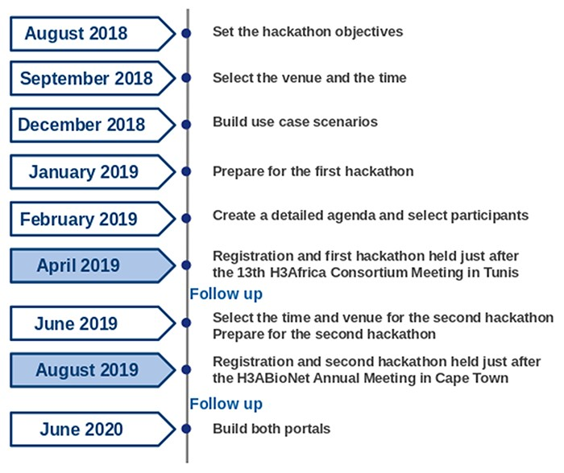
Figure 3. A timeline of the hackathons’ planning activities.
Notes:
Figure 3. A timeline of the hackathons’ planning activities.
Unless provided in the caption above, the following copyright applies to the content of this slide: © The Author(s) 2021. Published by Oxford University Press.This is an Open Access article distributed under the terms of the Creative Commons Attribution License (http://creativecommons.org/licenses/by/4.0/), which permits unrestricted reuse, distribution, and reproduction in any medium, provided the original work is properly cited.

Slide 4
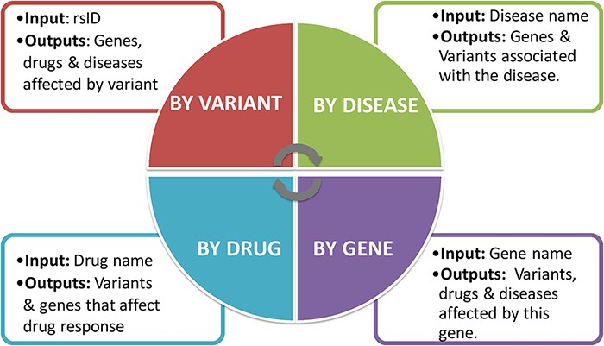
Figure 4. Four different search options have been added to the interface: searching by variant, gene, disease and ...
Notes:
Figure 4. Four different search options have been added to the interface: searching by variant, gene, disease and drug.
Unless provided in the caption above, the following copyright applies to the content of this slide: © The Author(s) 2021. Published by Oxford University Press.This is an Open Access article distributed under the terms of the Creative Commons Attribution License (http://creativecommons.org/licenses/by/4.0/), which permits unrestricted reuse, distribution, and reproduction in any medium, provided the original work is properly cited.

Slide 5
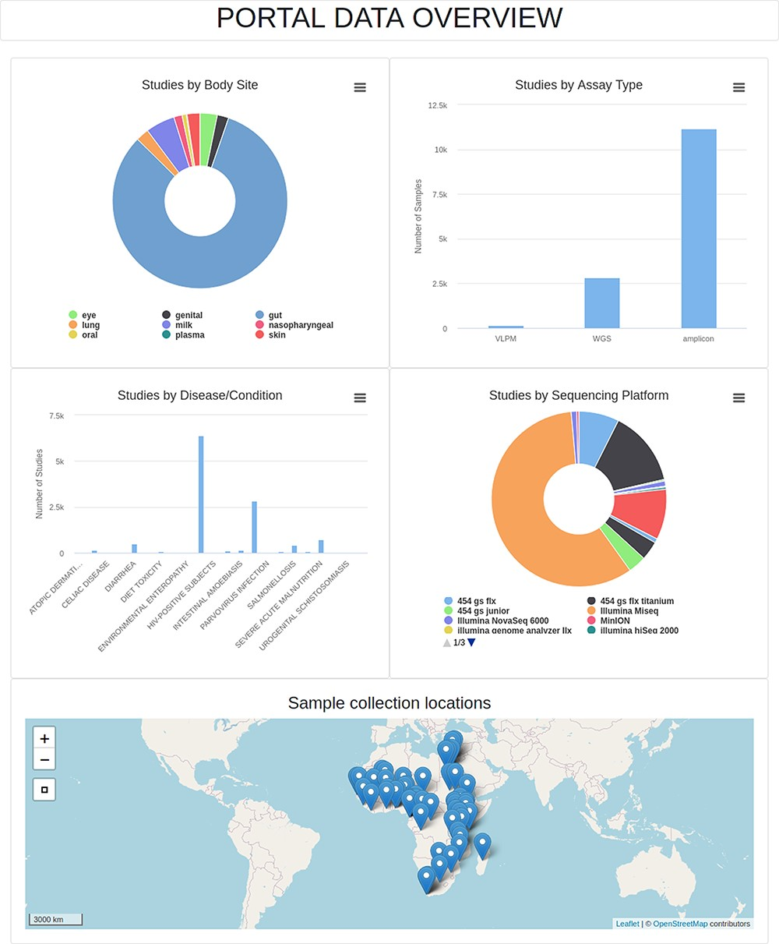
Figure 5. Data overview page of the AMP. VLPM: Virus-like particle metagenomics; WGS: Whole-genome sequencing.
Notes:
Figure 5. Data overview page of the AMP. VLPM: Virus-like particle metagenomics; WGS: Whole-genome sequencing.
Unless provided in the caption above, the following copyright applies to the content of this slide: © The Author(s) 2021. Published by Oxford University Press.This is an Open Access article distributed under the terms of the Creative Commons Attribution License (http://creativecommons.org/licenses/by/4.0/), which permits unrestricted reuse, distribution, and reproduction in any medium, provided the original work is properly cited.

Slide 6
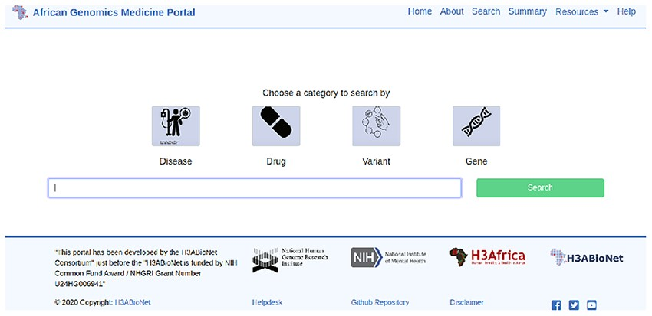
Figure 6. Search page of the AGMP.
Notes:
Figure 6. Search page of the AGMP.
Unless provided in the caption above, the following copyright applies to the content of this slide: © The Author(s) 2021. Published by Oxford University Press.This is an Open Access article distributed under the terms of the Creative Commons Attribution License (http://creativecommons.org/licenses/by/4.0/), which permits unrestricted reuse, distribution, and reproduction in any medium, provided the original work is properly cited.

Slide 7
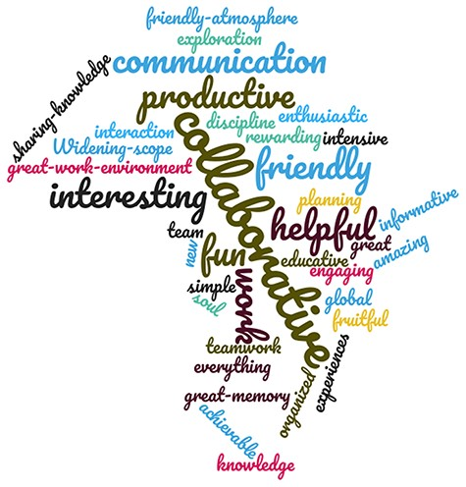
Figure 7. The hackathon as seen by the participants. The figure was generated using https://www.wordclouds.com.
Notes:
Figure 7. The hackathon as seen by the participants. The figure was generated using https://www.wordclouds.com.
Unless provided in the caption above, the following copyright applies to the content of this slide: © The Author(s) 2021. Published by Oxford University Press.This is an Open Access article distributed under the terms of the Creative Commons Attribution License (http://creativecommons.org/licenses/by/4.0/), which permits unrestricted reuse, distribution, and reproduction in any medium, provided the original work is properly cited.

