Slide 1
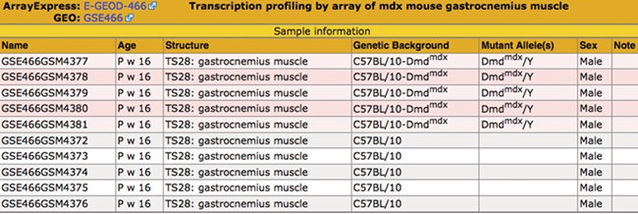
Figure 3 Sample table. The sample information is displayed in a pop-up table that can be accessed by using the View ...
Notes:
Figure 3 Sample table. The sample information is displayed in a pop-up table that can be accessed by using the View button (Figure 2). Samples that match the search criteria (Figure 1) are highlighted in pink. The matching samples are annotated to tissues that are ontological children of the search term skeletal muscle and carry mutations of the dystrophin (Dmd) gene.
Unless provided in the caption above, the following copyright applies to the content of this slide: © The Author(s) 2020. Published by Oxford University Press.This is an Open Access article distributed under the terms of the Creative Commons Attribution License (http://creativecommons.org/licenses/by/4.0/), which permits unrestricted reuse, distribution, and reproduction in any medium, provided the original work is properly cited.

