Slide 1
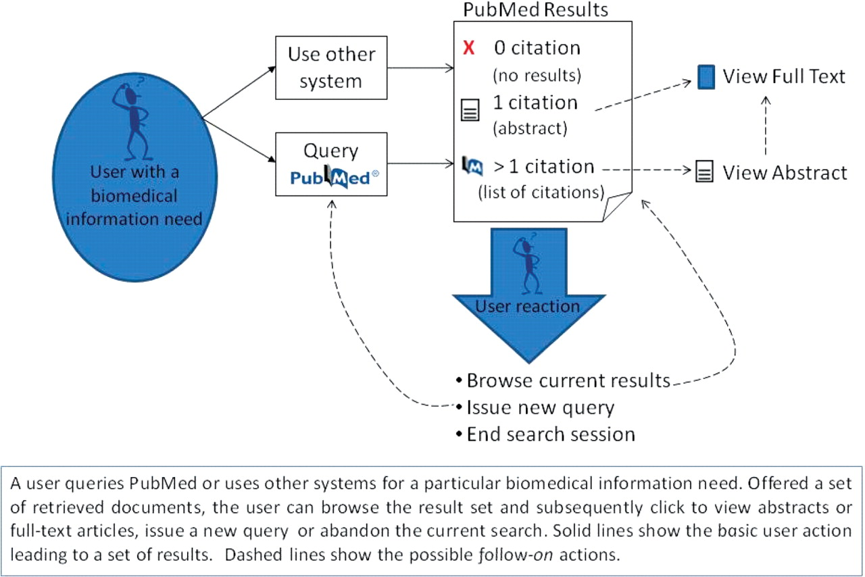
Figure 1. An overview of user interactions with PubMed. A user queries PubMed or uses other systems for a particular ...
Notes:
Figure 1. An overview of user interactions with PubMed. A user queries PubMed or uses other systems for a particular biomedical information need. Offered a set of retrieved documents, the user can browse the result set and subsequently click to view abstracts or full-text articles, issue a new query or abandon the current search. Solid lines show the basic user action leading to a set of results. Dashed lines show the possible follow-on actions.
Unless provided in the caption above, the following copyright applies to the content of this slide: © The Author(s) 2009. Published by Oxford University Press.This is Open Access article distributed under the terms of the Creative Commons Attribution Non-Commercial License (http://creativecommons.org/licenses/by-nc/2.5/uk/) which permits unrestricted non-commercial use, distribution, and reproduction in any medium, provided the original work is properly cited.

Slide 2
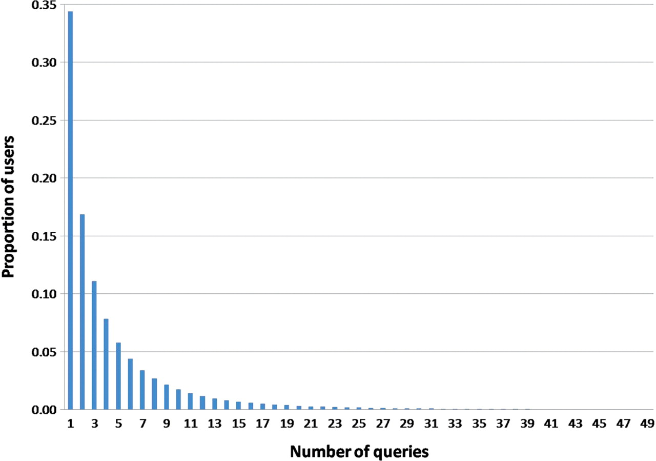
Figure 2. Histogram view of the distribution of users, detailed by number of queries they issue.
Notes:
Figure 2. Histogram view of the distribution of users, detailed by number of queries they issue.
Unless provided in the caption above, the following copyright applies to the content of this slide: © The Author(s) 2009. Published by Oxford University Press.This is Open Access article distributed under the terms of the Creative Commons Attribution Non-Commercial License (http://creativecommons.org/licenses/by-nc/2.5/uk/) which permits unrestricted non-commercial use, distribution, and reproduction in any medium, provided the original work is properly cited.

Slide 3
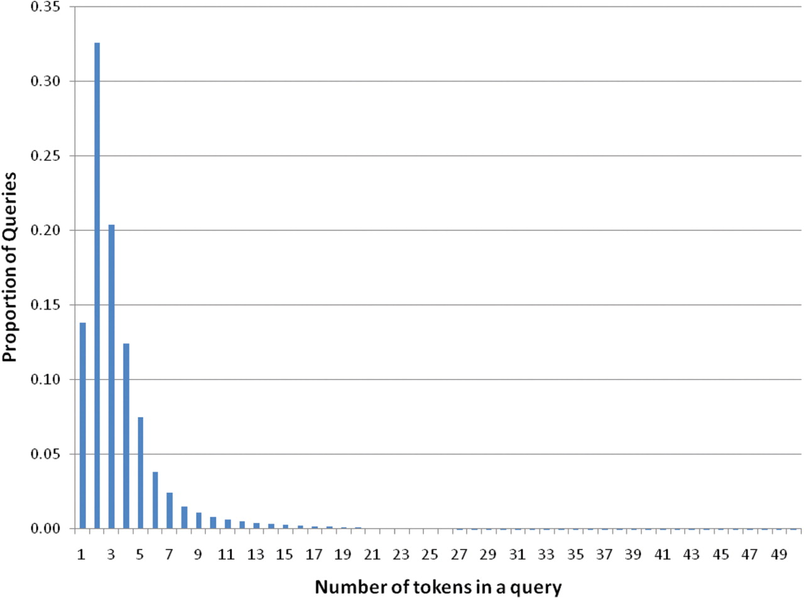
Figure 3. Distribution of number of queries relative to the number of tokens.
Notes:
Figure 3. Distribution of number of queries relative to the number of tokens.
Unless provided in the caption above, the following copyright applies to the content of this slide: © The Author(s) 2009. Published by Oxford University Press.This is Open Access article distributed under the terms of the Creative Commons Attribution Non-Commercial License (http://creativecommons.org/licenses/by-nc/2.5/uk/) which permits unrestricted non-commercial use, distribution, and reproduction in any medium, provided the original work is properly cited.

Slide 4
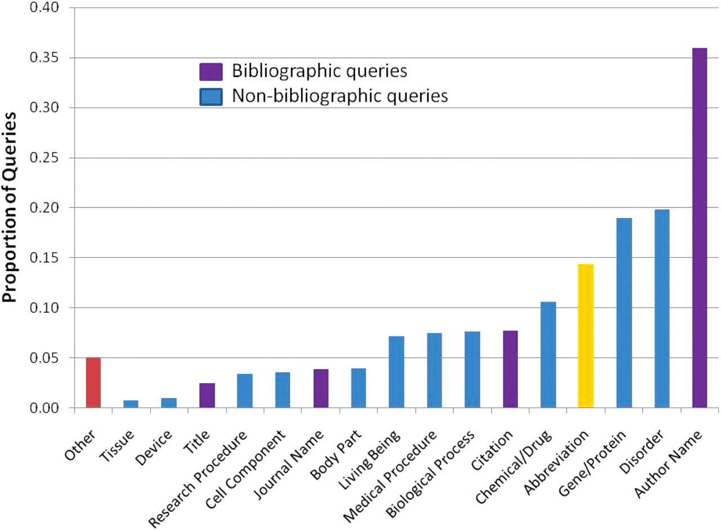
Figure 4. Annotated queries by category. Queries annotated with bibliographic categories (Author Name, Citation, ...
Notes:
Figure 4. Annotated queries by category. Queries annotated with bibliographic categories (Author Name, Citation, Journal Name and MEDLINE Title) are shown in purple, queries annotated with non-bibliographic categories (Gene/Protein, Disorder, Chemical/Drug, Biological Process, Medical Procedure, Living Being, Research Procedure, Cell Component, Body Part, Device or Tissue) are shown in blue, the percentage of queries containing an abbreviation is shown in yellow, and the queries that could not be fitted in the proposed set of categories are shown in red.
Unless provided in the caption above, the following copyright applies to the content of this slide: © The Author(s) 2009. Published by Oxford University Press.This is Open Access article distributed under the terms of the Creative Commons Attribution Non-Commercial License (http://creativecommons.org/licenses/by-nc/2.5/uk/) which permits unrestricted non-commercial use, distribution, and reproduction in any medium, provided the original work is properly cited.

Slide 5
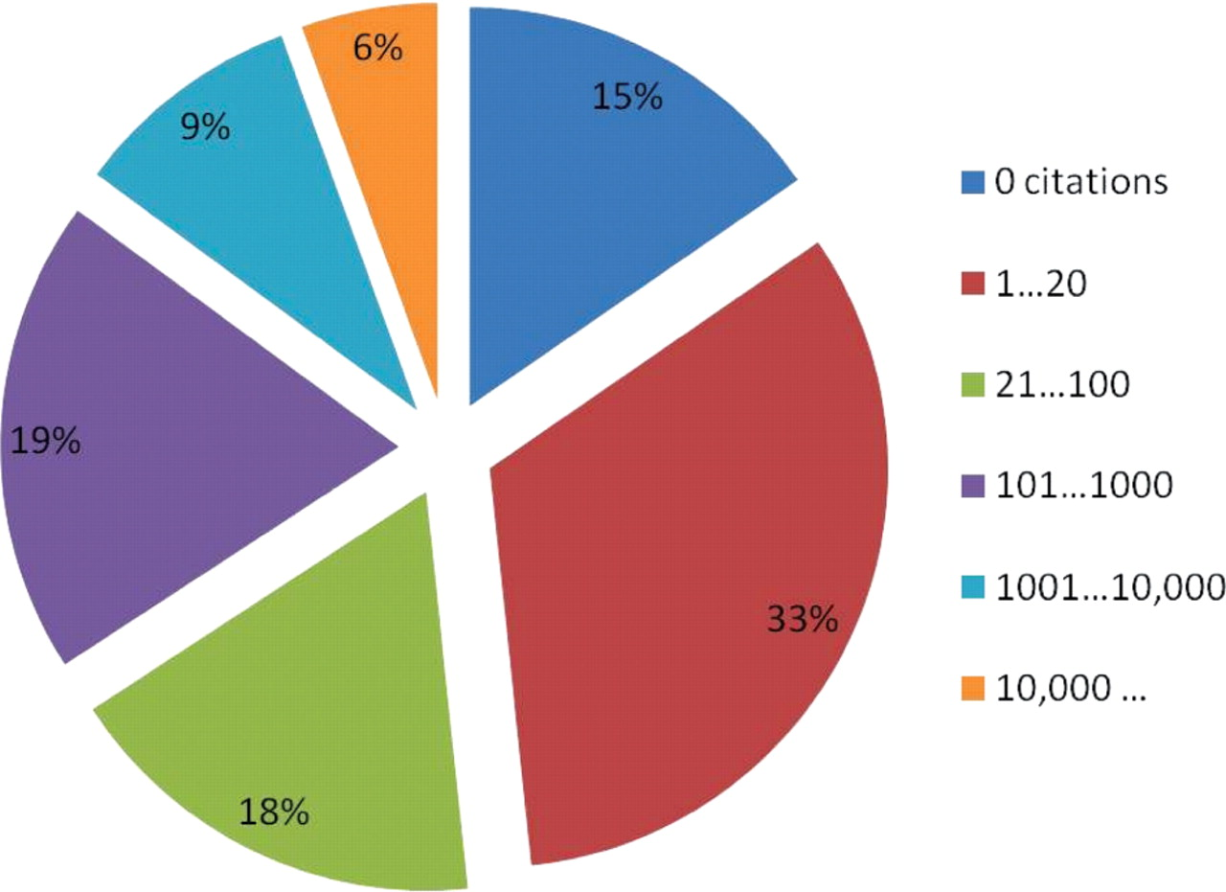
Figure 5. Distribution of queries according to their returned result set size. One third of queries returned from 1 to ...
Notes:
Figure 5. Distribution of queries according to their returned result set size. One third of queries returned from 1 to 20 citations, which are displayed in a single page.
Unless provided in the caption above, the following copyright applies to the content of this slide: © The Author(s) 2009. Published by Oxford University Press.This is Open Access article distributed under the terms of the Creative Commons Attribution Non-Commercial License (http://creativecommons.org/licenses/by-nc/2.5/uk/) which permits unrestricted non-commercial use, distribution, and reproduction in any medium, provided the original work is properly cited.

Slide 6
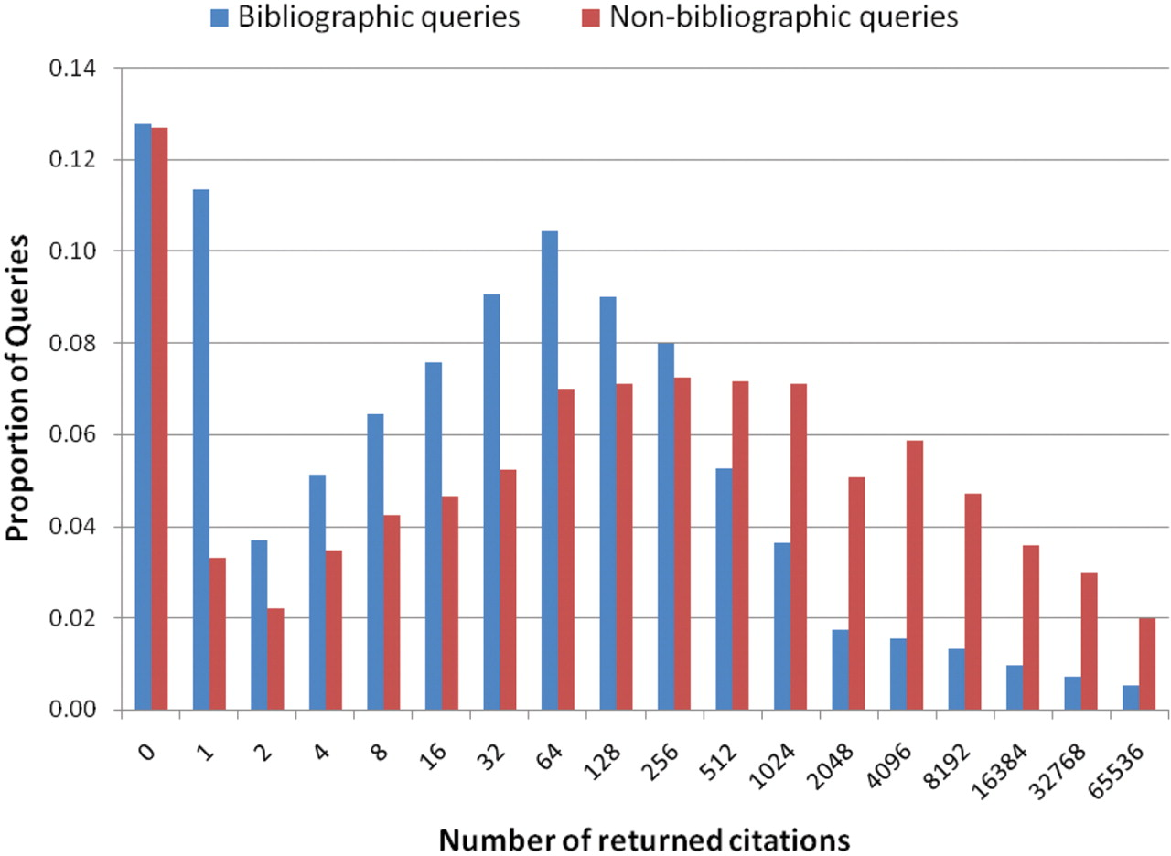
Figure 6. Distribution of bibliographic queries (author name, journal name, title and other citation information) and ...
Notes:
Figure 6. Distribution of bibliographic queries (author name, journal name, title and other citation information) and non-bibliographic queries (disorder, gene/protein, research or medical procedure, device, body part, cell, tissue or living being) according to their result set size.
Unless provided in the caption above, the following copyright applies to the content of this slide: © The Author(s) 2009. Published by Oxford University Press.This is Open Access article distributed under the terms of the Creative Commons Attribution Non-Commercial License (http://creativecommons.org/licenses/by-nc/2.5/uk/) which permits unrestricted non-commercial use, distribution, and reproduction in any medium, provided the original work is properly cited.

Slide 7
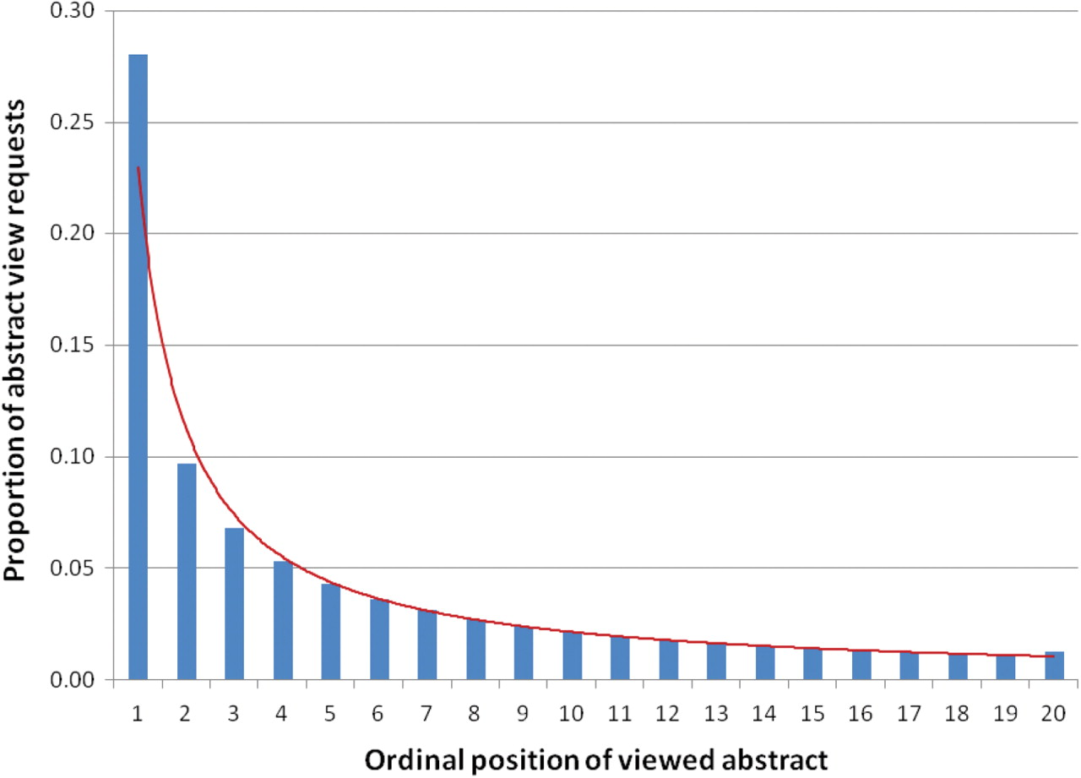
Figure 7. Distribution of abstract view requests for ordinal positions of the first page of results (data follows a ...
Notes:
Figure 7. Distribution of abstract view requests for ordinal positions of the first page of results (data follows a Power law shown with the red line).
Unless provided in the caption above, the following copyright applies to the content of this slide: © The Author(s) 2009. Published by Oxford University Press.This is Open Access article distributed under the terms of the Creative Commons Attribution Non-Commercial License (http://creativecommons.org/licenses/by-nc/2.5/uk/) which permits unrestricted non-commercial use, distribution, and reproduction in any medium, provided the original work is properly cited.

Slide 8
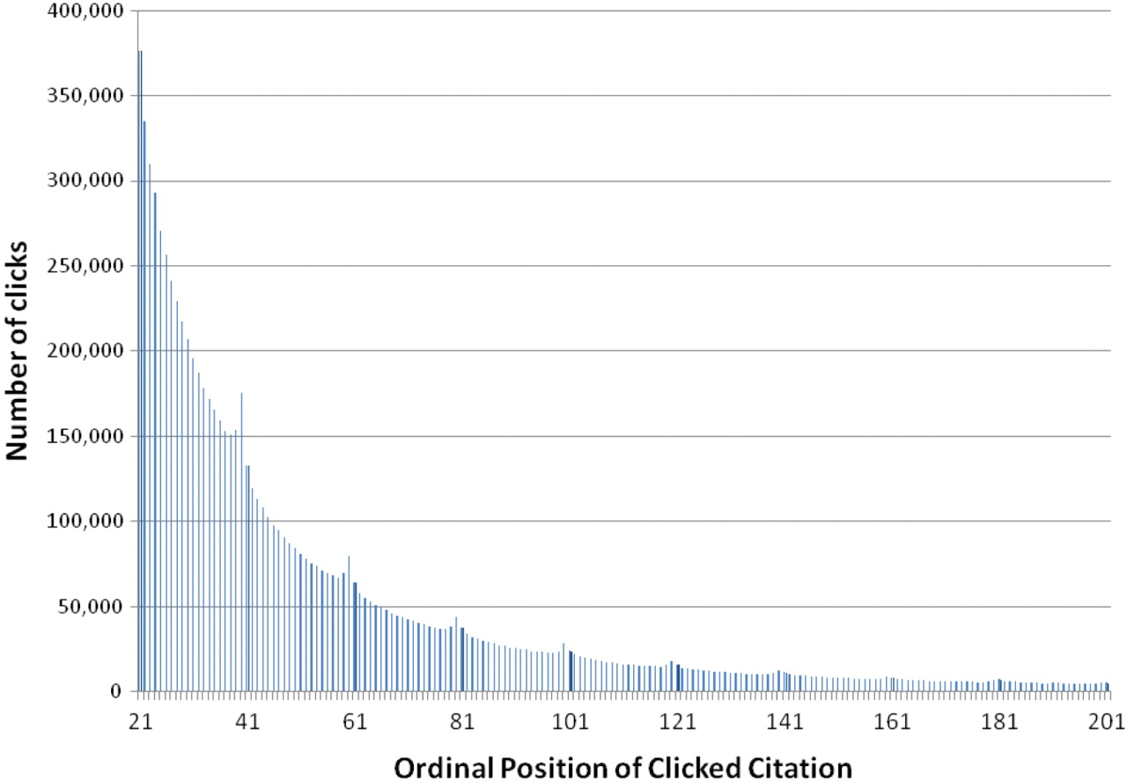
Figure 8. Distribution of abstract retrievals per ordinal position.
Notes:
Figure 8. Distribution of abstract retrievals per ordinal position.
Unless provided in the caption above, the following copyright applies to the content of this slide: © The Author(s) 2009. Published by Oxford University Press.This is Open Access article distributed under the terms of the Creative Commons Attribution Non-Commercial License (http://creativecommons.org/licenses/by-nc/2.5/uk/) which permits unrestricted non-commercial use, distribution, and reproduction in any medium, provided the original work is properly cited.

Slide 9
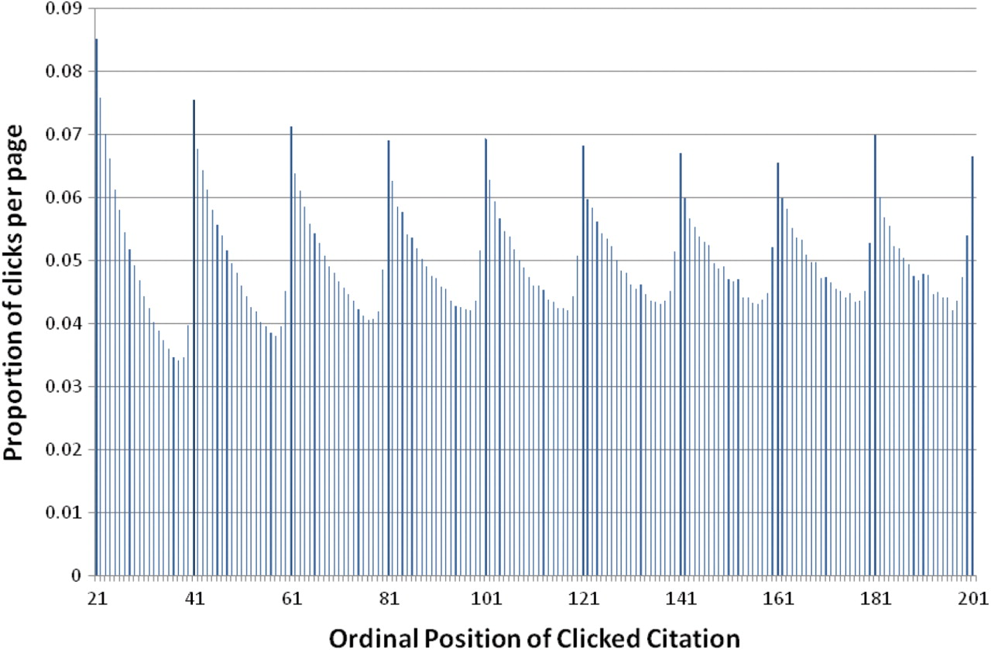
Figure 9. Distribution of abstract retrievals per ordinal position (ratio is computed per page).
Notes:
Figure 9. Distribution of abstract retrievals per ordinal position (ratio is computed per page).
Unless provided in the caption above, the following copyright applies to the content of this slide: © The Author(s) 2009. Published by Oxford University Press.This is Open Access article distributed under the terms of the Creative Commons Attribution Non-Commercial License (http://creativecommons.org/licenses/by-nc/2.5/uk/) which permits unrestricted non-commercial use, distribution, and reproduction in any medium, provided the original work is properly cited.

Slide 10
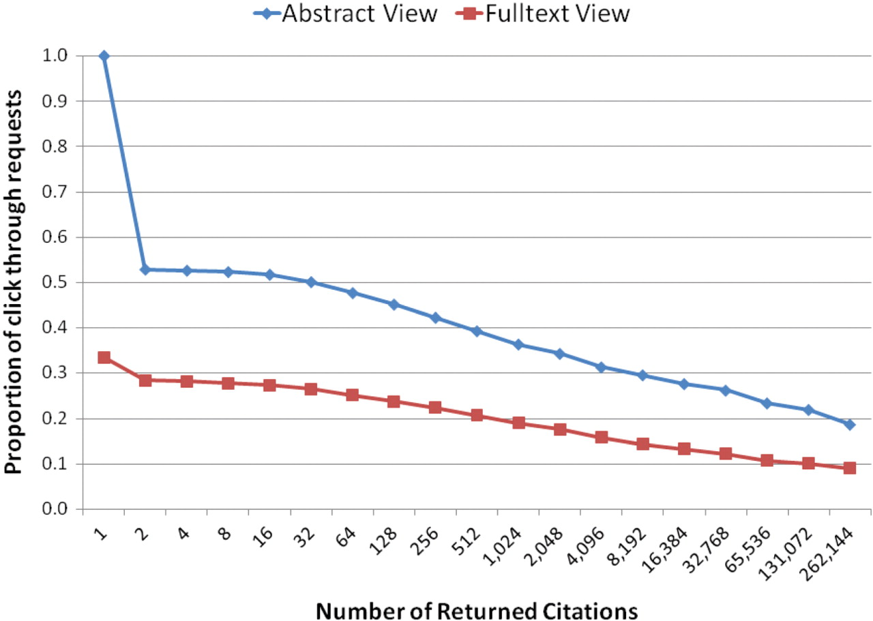
Figure 10. Distribution of abstract and full-text requests given the number of citations returned per query. (Number of ...
Notes:
Figure 10. Distribution of abstract and full-text requests given the number of citations returned per query. (Number of returned citations is shown in log scale).
Unless provided in the caption above, the following copyright applies to the content of this slide: © The Author(s) 2009. Published by Oxford University Press.This is Open Access article distributed under the terms of the Creative Commons Attribution Non-Commercial License (http://creativecommons.org/licenses/by-nc/2.5/uk/) which permits unrestricted non-commercial use, distribution, and reproduction in any medium, provided the original work is properly cited.

Slide 11
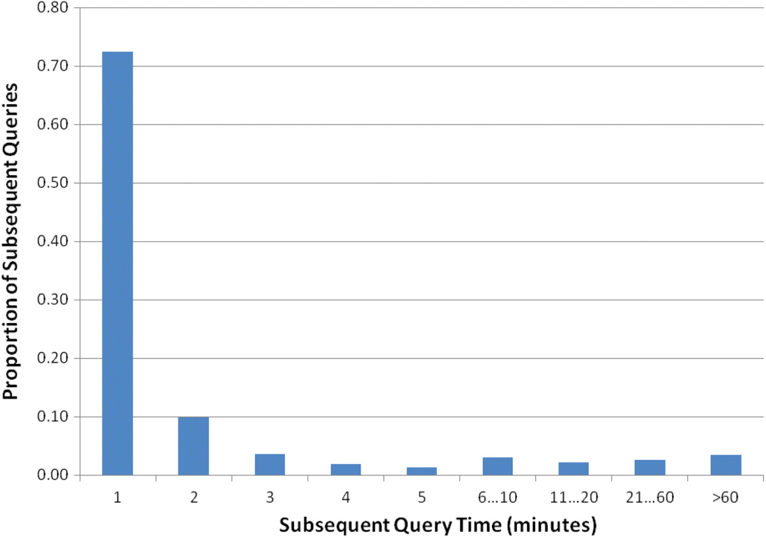
Figure 11. Distribution of subsequent queries according to their time difference.
Notes:
Figure 11. Distribution of subsequent queries according to their time difference.
Unless provided in the caption above, the following copyright applies to the content of this slide: © The Author(s) 2009. Published by Oxford University Press.This is Open Access article distributed under the terms of the Creative Commons Attribution Non-Commercial License (http://creativecommons.org/licenses/by-nc/2.5/uk/) which permits unrestricted non-commercial use, distribution, and reproduction in any medium, provided the original work is properly cited.

Slide 12
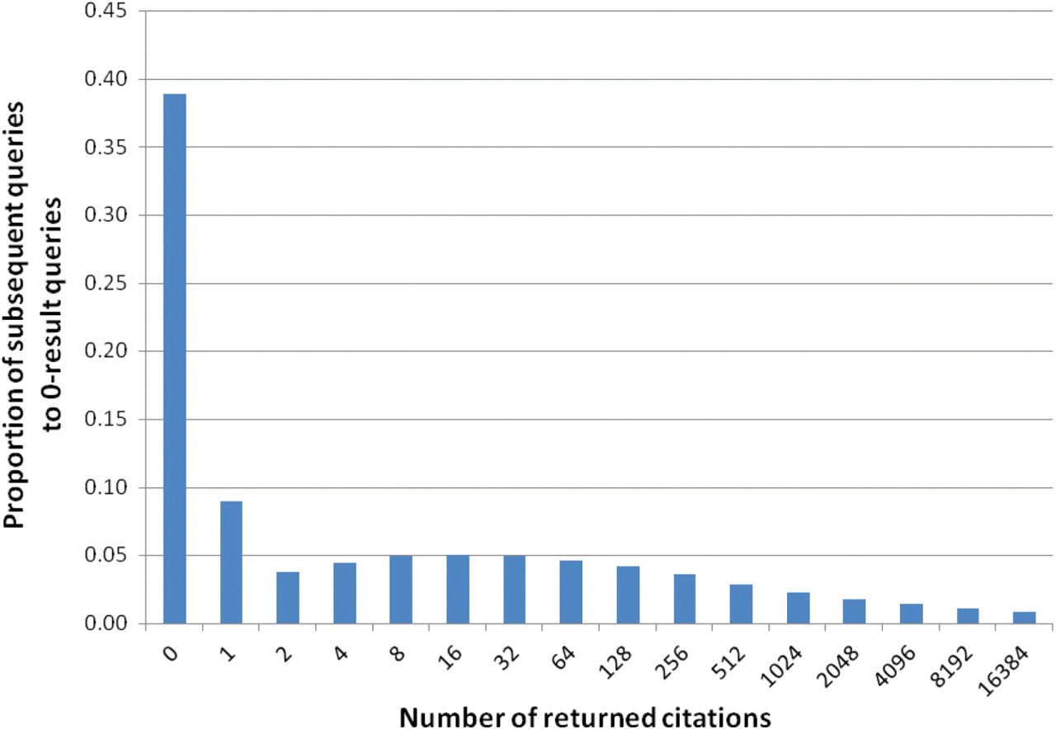
Figure 12. Distribution of queries subsequent to zero-result queries, detailed by the number of returned citations.
Notes:
Figure 12. Distribution of queries subsequent to zero-result queries, detailed by the number of returned citations.
Unless provided in the caption above, the following copyright applies to the content of this slide: © The Author(s) 2009. Published by Oxford University Press.This is Open Access article distributed under the terms of the Creative Commons Attribution Non-Commercial License (http://creativecommons.org/licenses/by-nc/2.5/uk/) which permits unrestricted non-commercial use, distribution, and reproduction in any medium, provided the original work is properly cited.

Slide 13
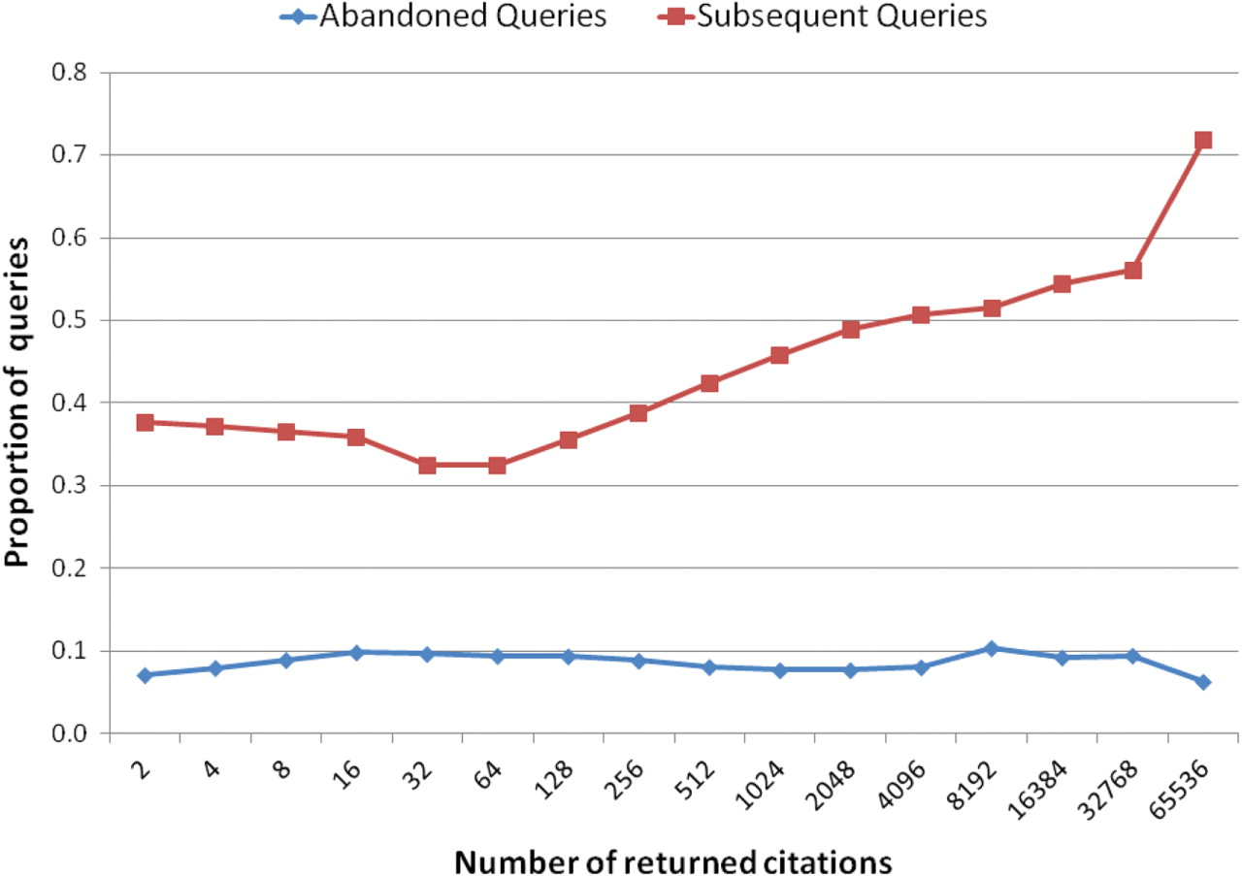
Figure 13. Distribution of the abandoned queries and subsequent queries according to their returned number of ...
Notes:
Figure 13. Distribution of the abandoned queries and subsequent queries according to their returned number of citations.
Unless provided in the caption above, the following copyright applies to the content of this slide: © The Author(s) 2009. Published by Oxford University Press.This is Open Access article distributed under the terms of the Creative Commons Attribution Non-Commercial License (http://creativecommons.org/licenses/by-nc/2.5/uk/) which permits unrestricted non-commercial use, distribution, and reproduction in any medium, provided the original work is properly cited.

Slide 14
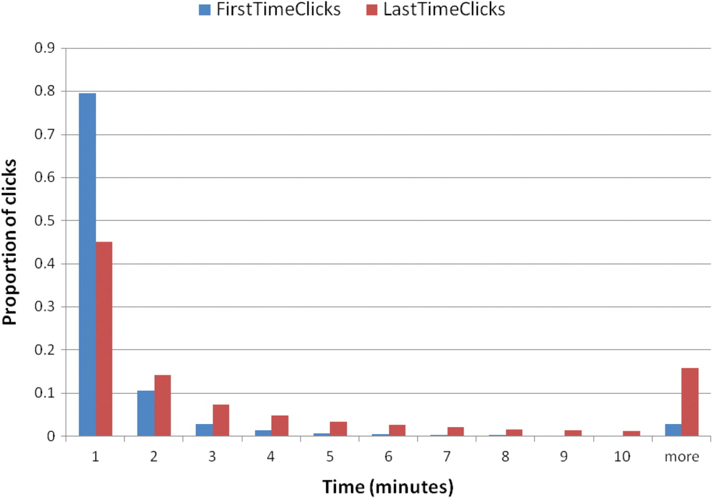
Figure 14. Distribution of time to first and last click in minutes.
Notes:
Figure 14. Distribution of time to first and last click in minutes.
Unless provided in the caption above, the following copyright applies to the content of this slide: © The Author(s) 2009. Published by Oxford University Press.This is Open Access article distributed under the terms of the Creative Commons Attribution Non-Commercial License (http://creativecommons.org/licenses/by-nc/2.5/uk/) which permits unrestricted non-commercial use, distribution, and reproduction in any medium, provided the original work is properly cited.

