Slide 1
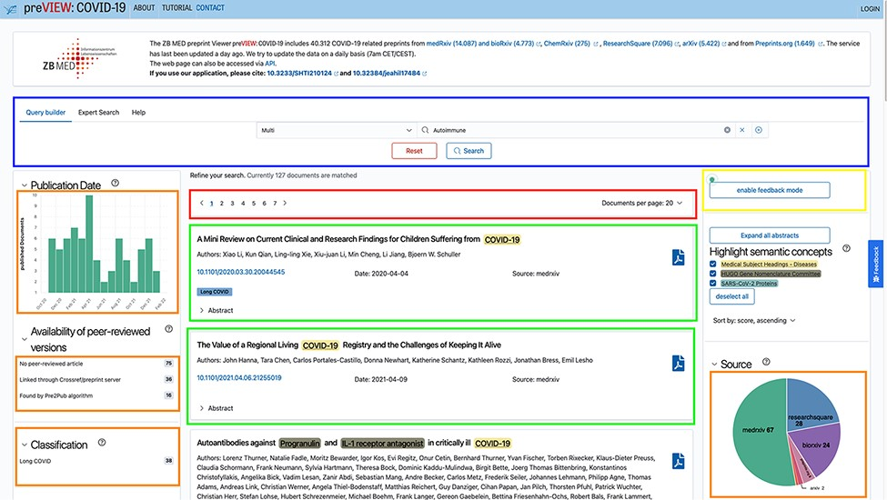
Figure 1. Screenshot of the preVIEW system with sections highlighted.
Notes:
Figure 1. Screenshot of the preVIEW system with sections highlighted.
Unless provided in the caption above, the following copyright applies to the content of this slide: © The Author(s) 2022. Published by Oxford University Press.This is an Open Access article distributed under the terms of the Creative Commons Attribution-NonCommercial License (https://creativecommons.org/licenses/by-nc/4.0/), which permits non-commercial re-use, distribution, and reproduction in any medium, provided the original work is properly cited. For commercial re-use, please contact journals.permissions@oup.com

Slide 2
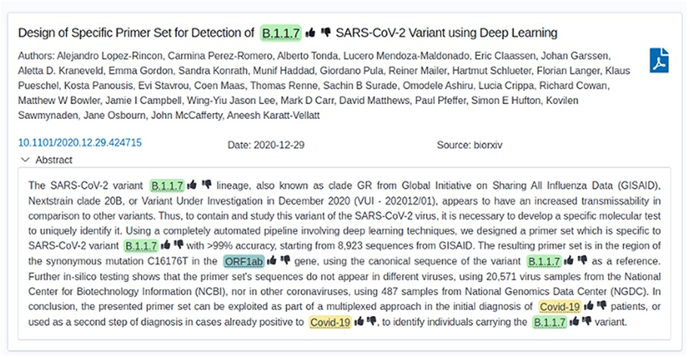
Figure 2. Screenshot of a single document with the feedback mode enabled (thumbs up/down).
Notes:
Figure 2. Screenshot of a single document with the feedback mode enabled (thumbs up/down).
Unless provided in the caption above, the following copyright applies to the content of this slide: © The Author(s) 2022. Published by Oxford University Press.This is an Open Access article distributed under the terms of the Creative Commons Attribution-NonCommercial License (https://creativecommons.org/licenses/by-nc/4.0/), which permits non-commercial re-use, distribution, and reproduction in any medium, provided the original work is properly cited. For commercial re-use, please contact journals.permissions@oup.com

Slide 3
Figure 3. Screenshot of the Query Builder. Search terms can be added via drop-down lists.
Notes:
Figure 3. Screenshot of the Query Builder. Search terms can be added via drop-down lists.
Unless provided in the caption above, the following copyright applies to the content of this slide: © The Author(s) 2022. Published by Oxford University Press.This is an Open Access article distributed under the terms of the Creative Commons Attribution-NonCommercial License (https://creativecommons.org/licenses/by-nc/4.0/), which permits non-commercial re-use, distribution, and reproduction in any medium, provided the original work is properly cited. For commercial re-use, please contact journals.permissions@oup.com

Slide 4
Figure 4. Screenshot of the Expert Search. The raw query string can be seen here and can be manually edited.
Notes:
Figure 4. Screenshot of the Expert Search. The raw query string can be seen here and can be manually edited.
Unless provided in the caption above, the following copyright applies to the content of this slide: © The Author(s) 2022. Published by Oxford University Press.This is an Open Access article distributed under the terms of the Creative Commons Attribution-NonCommercial License (https://creativecommons.org/licenses/by-nc/4.0/), which permits non-commercial re-use, distribution, and reproduction in any medium, provided the original work is properly cited. For commercial re-use, please contact journals.permissions@oup.com

Slide 5
Figure 5. Questions about background and experiences as answered by the participants. The absolute number of persons is ...
Notes:
Figure 5. Questions about background and experiences as answered by the participants. The absolute number of persons is shown in brackets.
Unless provided in the caption above, the following copyright applies to the content of this slide: © The Author(s) 2022. Published by Oxford University Press.This is an Open Access article distributed under the terms of the Creative Commons Attribution-NonCommercial License (https://creativecommons.org/licenses/by-nc/4.0/), which permits non-commercial re-use, distribution, and reproduction in any medium, provided the original work is properly cited. For commercial re-use, please contact journals.permissions@oup.com

Slide 6
Figure 6. Implementation of Long COVID Classification in preVIEW.
Notes:
Figure 6. Implementation of Long COVID Classification in preVIEW.
Unless provided in the caption above, the following copyright applies to the content of this slide: © The Author(s) 2022. Published by Oxford University Press.This is an Open Access article distributed under the terms of the Creative Commons Attribution-NonCommercial License (https://creativecommons.org/licenses/by-nc/4.0/), which permits non-commercial re-use, distribution, and reproduction in any medium, provided the original work is properly cited. For commercial re-use, please contact journals.permissions@oup.com

