Slide 1
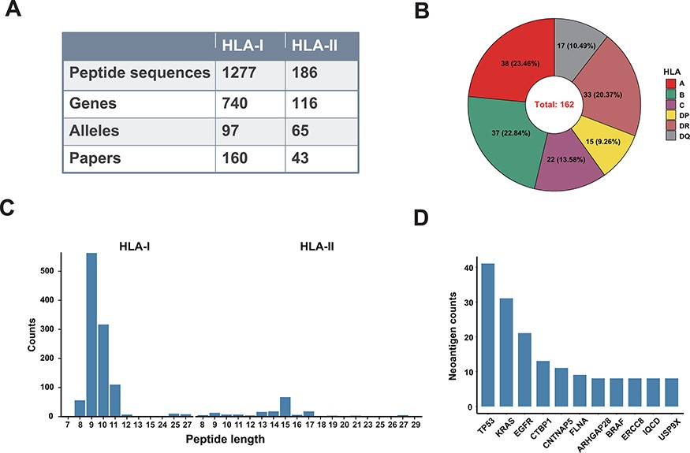
Figure 2. A data summary for Val-Neo. (A) A comparison of counts of neoantigens, genes, alleles and research papers ...
Notes:
Figure 2. A data summary for Val-Neo. (A) A comparison of counts of neoantigens, genes, alleles and research papers between HLA-I and HLA-II. (B) Distribution of different HLA alleles. (C) Distribution of peptide lengths of different HLA types. (D) Top 10 genes with the most number of validated neoantigens.
Unless provided in the caption above, the following copyright applies to the content of this slide: © The Author(s) 2023. Published by Oxford University Press.This is an Open Access article distributed under the terms of the Creative Commons Attribution License (https://creativecommons.org/licenses/by/4.0/), which permits unrestricted reuse, distribution, and reproduction in any medium, provided the original work is properly cited.

