Slide 1
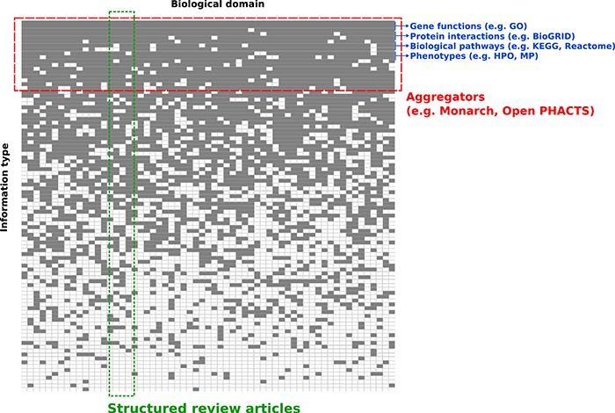
Figure 1 Conceptual overview of structured review articles. This figure represents the distribution of knowledge in ...
Notes:
Figure 1 Conceptual overview of structured review articles. This figure represents the distribution of knowledge in databases accessible to the community in terms of domains compiled (X axis) and information structured (Y axis). Gray squares indicate knowledge focus of a database with regards to the domain(s) and information structured.
Unless provided in the caption above, the following copyright applies to the content of this slide: © The Author(s) 2020. Published by Oxford University Press.This is an Open Access article distributed under the terms of the Creative Commons Attribution License (http://creativecommons.org/licenses/by/4.0/), which permits unrestricted reuse, distribution, and reproduction in any medium, provided the original work is properly cited.

