Slide 1
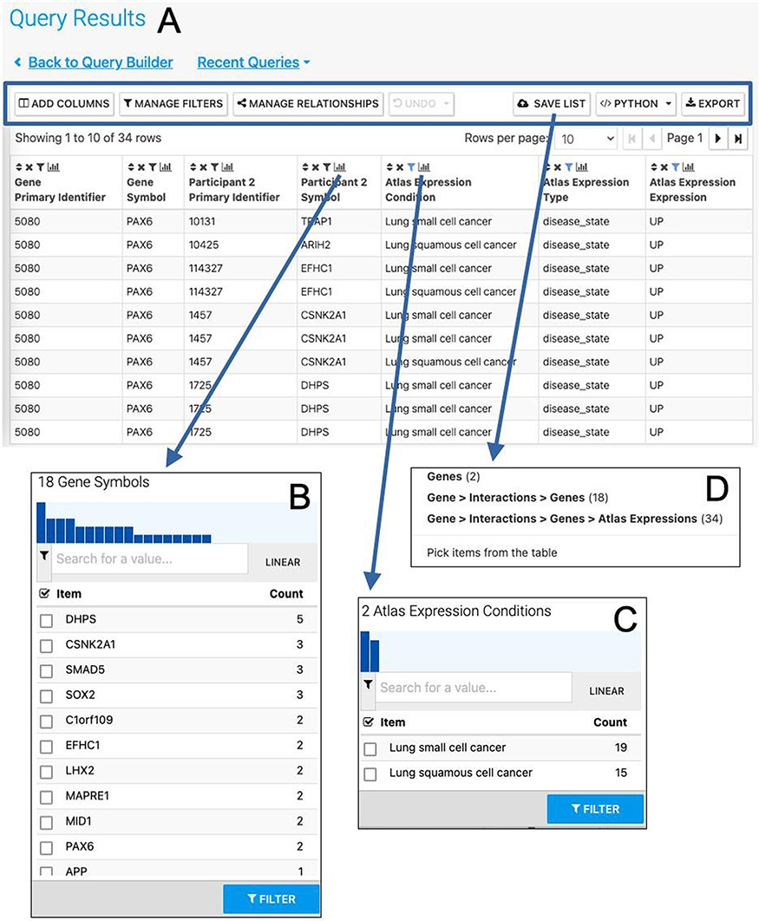
Figure 7. The Results Table showing results from the query ‘Gene(s) + Disease Interactors + Disease Expression’ for the ...
Notes:
Figure 7. The Results Table showing results from the query ‘Gene(s) + Disease Interactors + Disease Expression’ for the PAX6 gene with constraints on the disease name for small cell lung cancer or lung squamous cell cancer. The results tables provide many additional functions including ‘Add columns’ allowing additional data to be added, ‘Manage filters’ allowing filters on any column to be defined, ‘Manage relationships’ enabling either the union or intersect of classes of related data in the table to be defined, ‘Save list’ enabling subsets of items in the table to be saved as lists, ‘Python’, automatic code generation, available as a drop-down list of available languages and ‘Export’ (A). The column summary on the Participant 2 > Symbol column (the genes with which PAX6 interacts) allows the number of unique interacting genes (18) to be found (B). Using the column summary on the Atlas Expression > Condition column it is possible to see the number of rows for each disease condition. This could be used to filter the table to show just one of the disease conditions (C). The ‘Save as list’ function can be used to save any set of items from the table. Here it may be useful to save the set of interacting genes (Gene > Interactions > Genes (18)) (D). To save the set of interacting genes specific to one of the cancers, the table could be filtered first using the column summary function as described above.
Unless provided in the caption above, the following copyright applies to the content of this slide: © The Author(s) 2022. Published by Oxford University Press.This is an Open Access article distributed under the terms of the Creative Commons Attribution-NonCommercial License (https://creativecommons.org/licenses/by-nc/4.0/), which permits non-commercial re-use, distribution, and reproduction in any medium, provided the original work is properly cited. For commercial re-use, please contact journals.permissions@oup.com

