Slide 1
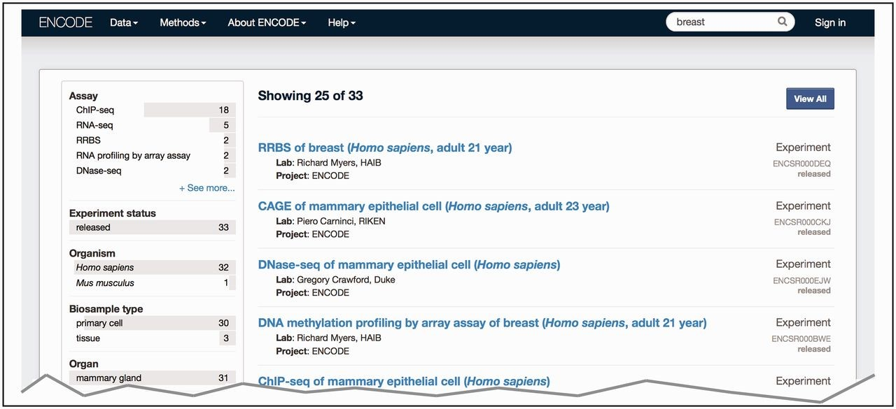
Figure 3. Search at the ENCODE portal ( https://www.encodeproject.org/ ). In this example, a free text search is done ...
Notes:
Figure 3. Search at the ENCODE portal ( https://www.encodeproject.org/ ). In this example, a free text search is done for ‘breast’. The user selects ‘Experiment’ for the ‘Data Type’ facet. The interface returns a list of various experiments (right column) that have been conducted on biosamples that match the search term. The search uses the annotated ontological term for the biosample, synonyms found in the ontology or inferred relationships to the ontological term breast—UBERON:0000310.
Unless provided in the caption above, the following copyright applies to the content of this slide: © The Author(s) 2015. Published by Oxford University Press.This is an Open Access article distributed under the terms of the Creative Commons Attribution License (http://creativecommons.org/licenses/by/4.0/), which permits unrestricted reuse, distribution, and reproduction in any medium, provided the original work is properly cited.

