Slide 1
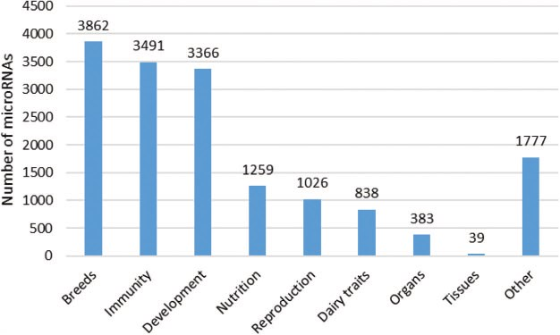
Figure 5 Number of microRNAs according to the conditions studied. The different topics presented here are in line with ...
Notes:
Figure 5 Number of microRNAs according to the conditions studied. The different topics presented here are in line with the issues addressed in the publications. A total of 78 publications were considered, and each article is mentioned only once. Each microRNA was counted several times, if they were described in several publications corresponding to different topics.
Unless provided in the caption above, the following copyright applies to the content of this slide: © The Author(s) 2019. Published by Oxford University Press.This is an Open Access article distributed under the terms of the Creative Commons Attribution License (http://creativecommons.org/licenses/by/4.0/), which permits unrestricted reuse, distribution, and reproduction in any medium, provided the original work is properly cited.

